Slide 1
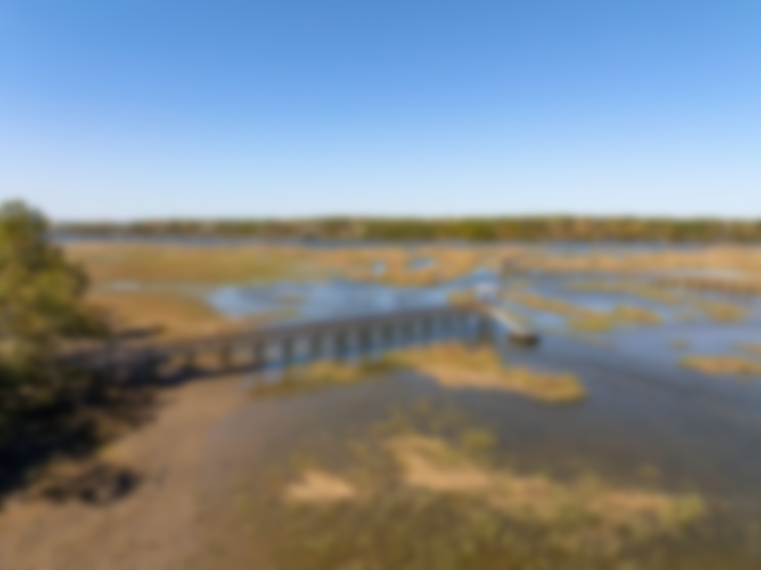
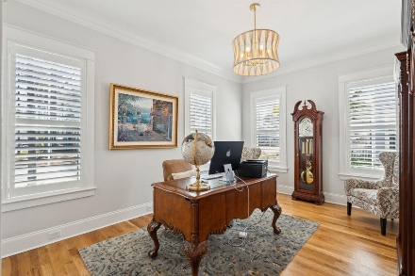
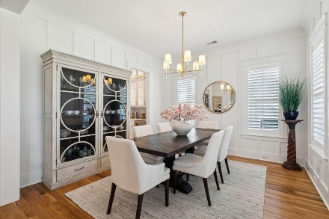
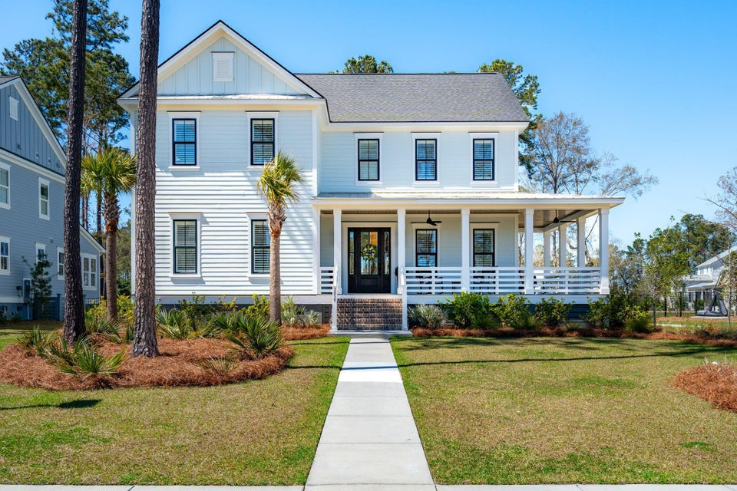
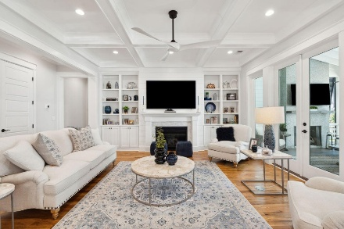
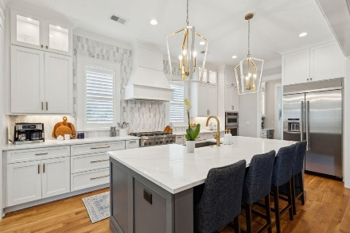
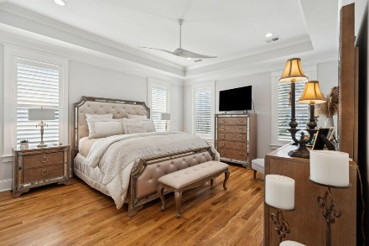
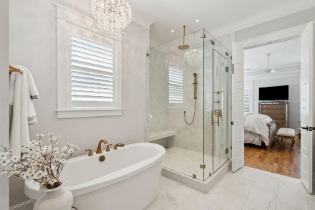
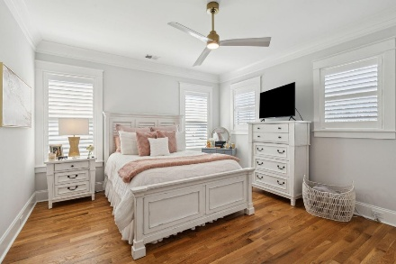
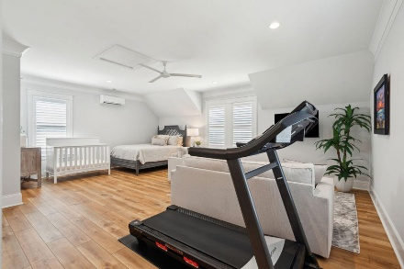
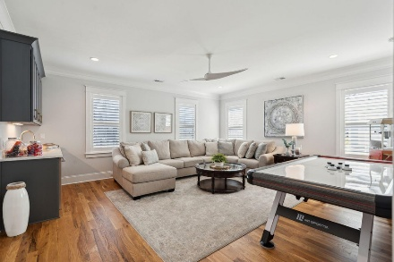
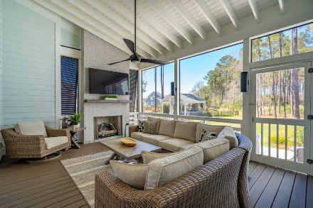
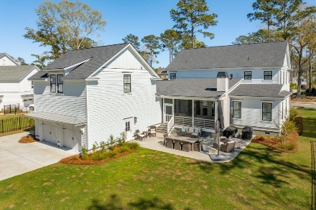
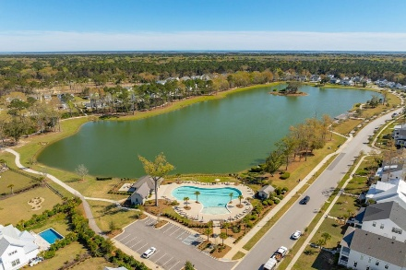


3858 Sawyers Island Drive
Carolina Park | Mount Pleasant, SC 29466
MLS# 25008425 | $2,595,000
Shows Like A Model Motivated Seller
Past the sparkling waters of Bolden Lake, nestled into a beautiful landscape in highly desired Riverside at Carolina Park, this custom designed residence, built by award winning Cline Homes, showcases the ultimate blend of Lowcountry charm and modern elegance. Custom finishes abound, and no detail was left unattended in this stunning masterpiece. The entry flows into the rear of the home and the floor plan opens to reveal an enlarged living area (the home was bumped out an additional two feet to enlarge the living space as well as the Owner's Suite) This room is spacious but manages to feel both cozy and inviting. The coffered ceiling caps off a gorgeous focal point fireplace with marble surround, shiplap wall, and flanked on either side by custom built-ins, providing extra storage as well as a place to display photos and keepsakes. Perfect for entertaining, this room is open to the true gourmet kitchen. A large island offers additional seating for grabbing a quick bite or a place to sit and chat while gathered in everyone's favorite room in the house! A much desired main floor Owners' Suite is a true oasis of calm in this home. The enlarged retreat offers plenty of privacy with space to relax and features a luxury en-suite bathroom that evokes the feel of an upscale hotel. The spa-like bath boasts dual vanities, an oversized frameless shower with rainhead and handheld sprayer, freestanding soaker tub, private water closet, and two walk-ins with custom closet systems.
In addition to the wrap-around southern style front porch, a rear screened-in porch provides a private place to enjoy morning coffee or grab a blanket and a glass of wine to sip in front of the beautiful fireplace on Lowcountry Spring evenings. The spacious yard offers plenty of room for children and pets to play while backing to a privacy buffer of trees. Riverside at Carolina Park offers an endless array of amenities, including the Lake Club featuring a resort-style pool, picnic pavilion, and fire pit overlooking scenic Bolden Lake. Residents have access to a playground, tennis and pickleball courts, an open-air pavilion, dog park, the Great Lawn, miles of walking trails, as well as access to a private Sawyers Island community dock for kayaking, fishing, and paddle boarding. The Bend shopping development, easily accessed by a quick golf cart or bike ride, includes restaurants, coffee shops, boutiques, a wine bar, hair and nail salons, yoga and dance studios, and other local businesses. Top rated Mount Pleasant schools, including Carolina Park Elementary within biking distance, Roper hospital, pharmacies and grocery stores are also in the immediate vicinity. All of this and just minutes to the area beaches and the world class shopping and dining of historic downtown Charleston.
VIDEO TOUR | MATTERPORT TOUR
Don Dawson
843-514-0452
ddawson@carolinaone.com
Carolina One Real Estate • 2713 Highway 17 North • Mount Pleasant, SC 29466
www.TeamDawsonSC.com

