Slide 1
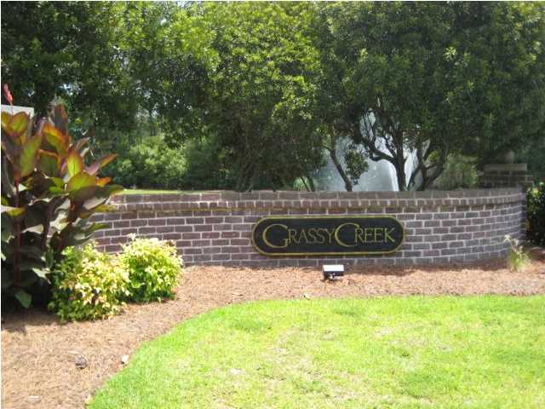
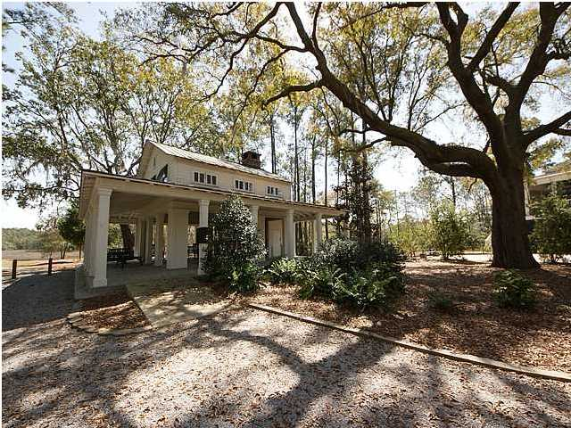
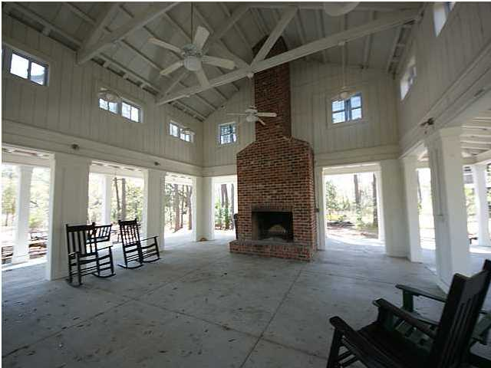
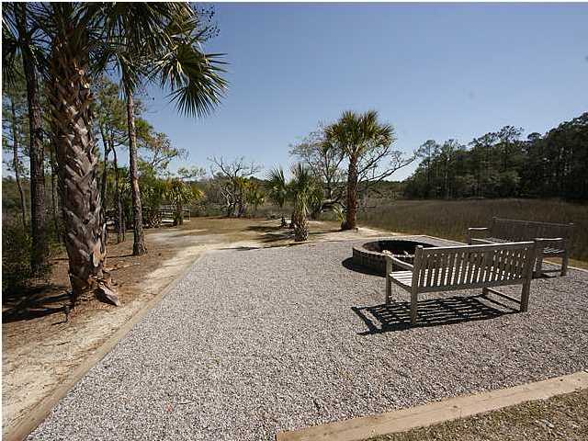
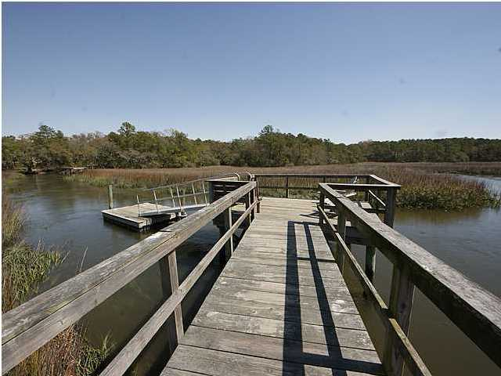
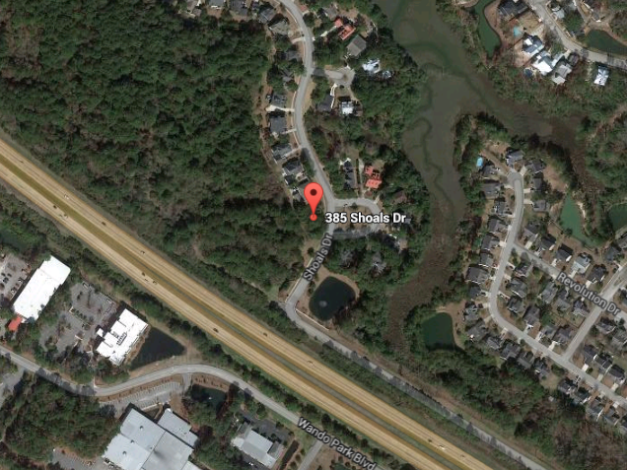

385 Shoals Dr Grassy Pointe Mt Pleasant MLS# 1415143 $135,000 .29 Acres
Only lot currently available in Grassy Creek.
Building plans by Dobson Homes have been approved by the ARB and can accompany sale.
Great opportunity to own in Grassy Creek with many amenities including a crabbing dock, pavilion with a fireplace and a play park.
Lot in Grassy Creek for $135k!
Kendra Boozer
843.834.5089
kendrafboozer@gmail.com

