Slide 1
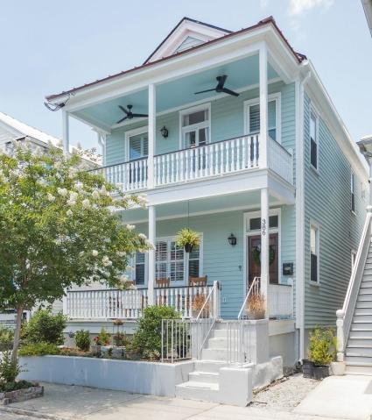
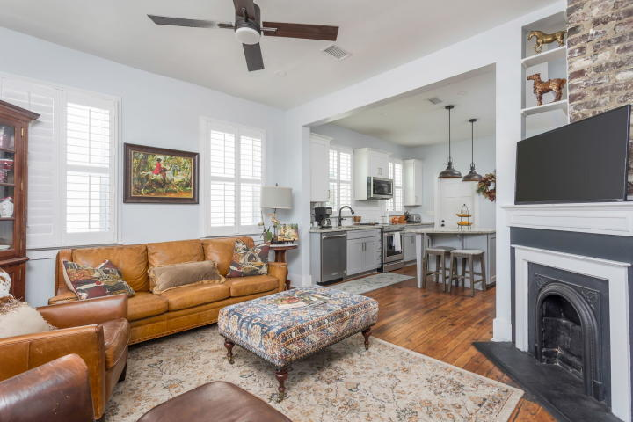
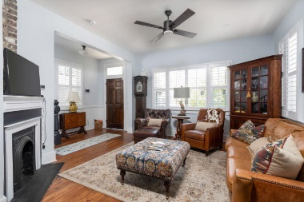
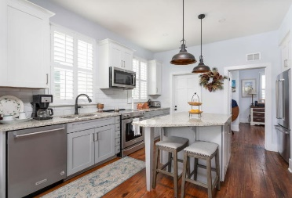
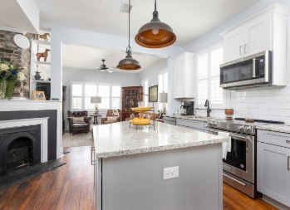
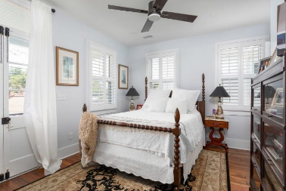
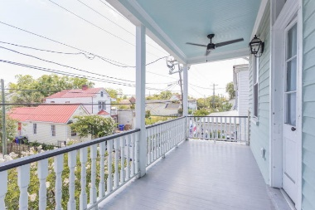
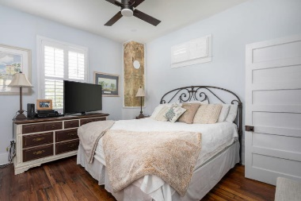
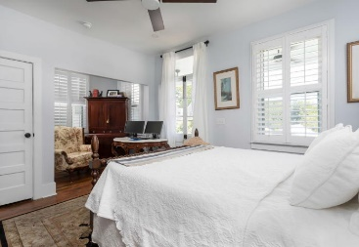
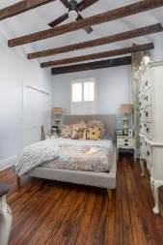
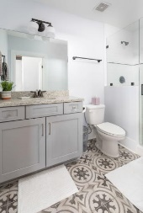
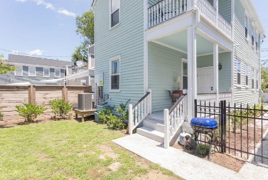
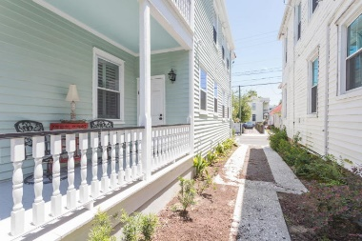
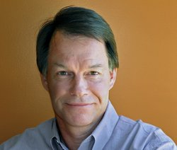

OPEN HOUSE
Saturday June 27, 2020
11:00AM to 2:00PM.
386 Huger Street
North Central | Charleston, SC 29403
MLS# 20002784 | $669,500
Historic Charleston charm with all the new features. Off street parking, two comfortable piazzas on two levels, gorgeous original heart pine floors, original staircase and brick fireplaces. Custom Plantation shutters on windows, Kitchen Aid stainless steel appliances, granite counter tops. Walk to Hampton Park and The Citadel events. Close to great restaurants and entertainment. Open floor plan with master suite on the first level. All three bedrooms has a private full bathroom! Plus a half bath off the living room. Recently renovated inside and out with new electrical, plumbing, HVAC, stainless steel front appliances baths and more. An enclosed back yard for privacy. Super location in friendly neighborhood. Much of the furniture may be purchased under separate agreement. New ADT security system for peace of mind and Honeywell thermostat for maximum comfort.
Duncan Townsend
843-324-1954
dtown88@gmail.com
www.dana-properties.com
Dana Properties, LLC
6650 Rivers Ave, Charleston, SC 29406

