Slide 1
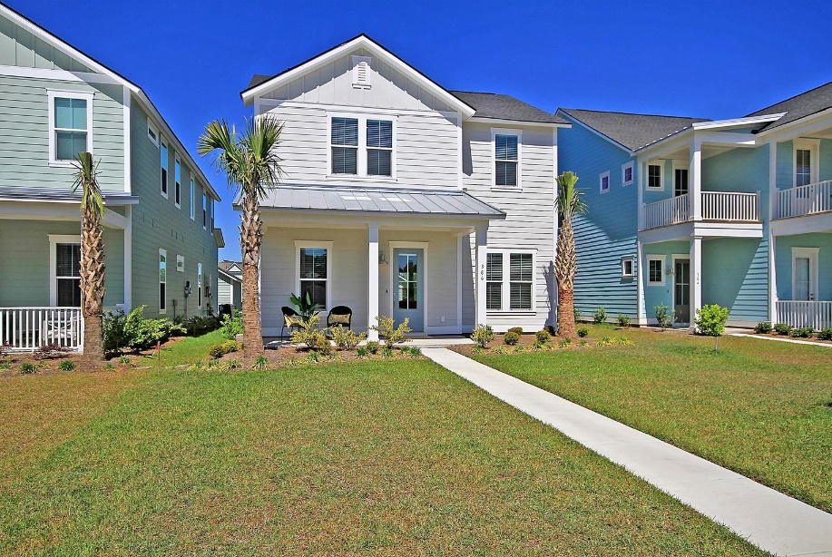
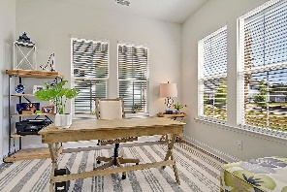
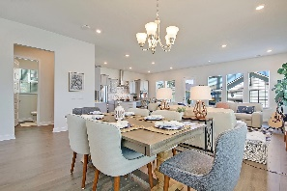
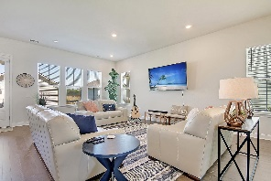
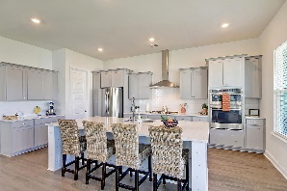
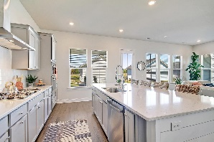
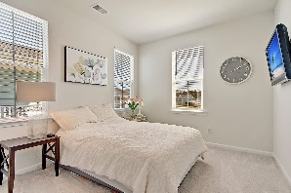
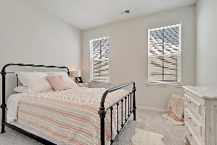
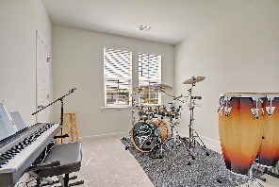
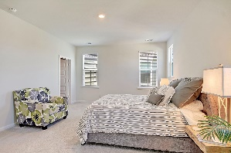
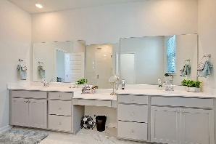
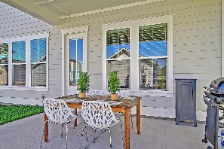
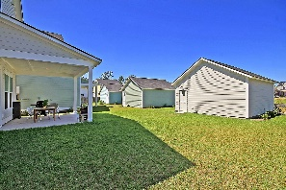


Why Wait For New Construction?
386 Watergrass Way
Summers Corner
Summerville, SC 29485
MLS# 21009950
$399,900
4 Bedrooms | 2½ Baths | 2,525 sf
No need to wait for new construction! This home is less than a year old and ready for you to move in! Upon arriving at this home, you'll notice the large front yard. This area is maintained by the HOA! You're only responsible for the area up to the end of the flower bed. Upon entering, you'll immediately notice the tons of natural light, gorgeous flooring and open floor plan. To your right will be the home office with French doors. Straight ahead is the living room, dining room and stunning kitchen! Large island, gas cooktop, walk in pantry, tons of cabinetry, all open to the living room. Off the hall is a large storage closet, some flex space that could be turned in to a drop zone as well as a half bath. Head upstairs and you'll find three good sized bedrooms with large closets, a full bath in the hall with a large vanity and a door to close off the shower and toilet area. The laundry room is a great size and has plenty of room for added storage if needed. Down the hall is the master suite which has a huge walk in closet. The master bath is lovely with dual vanities, oversized shower stall with raindrop shower head. Back downstairs, head outside to the covered back patio and two car detached garage with alley way access. Summers Corner is a great way to get away from it all! Homeowners have access to the community pool and Buffalo Lake for kayaking and canoeing. Dorchester District Two schools service this community with Sand Hill Elementary and Rollins School of the Arts both located within the community. This home won't last long, come see it today!
Larry & Kathy Mazalatis
Larry Cell 843-693-0529
Kathy Cell 843-693-0159
Office 843-871-9133
AGENTOWNED PREMIERE GROUP | 1800 TROLLEY RD | SUMMERVILLE, SC 29485

