Slide 1
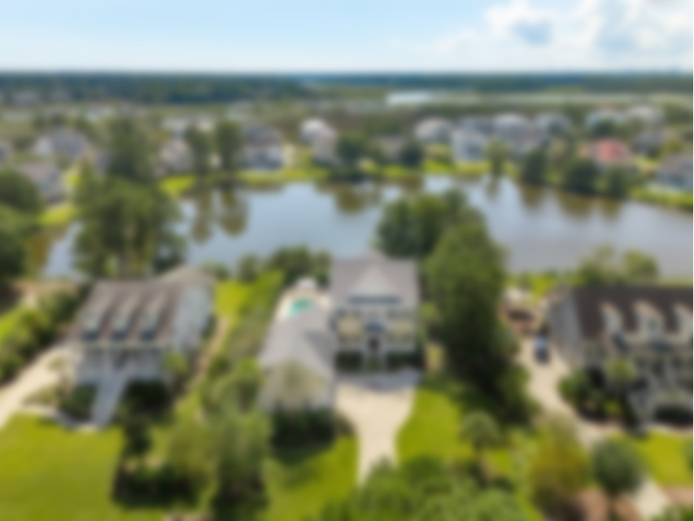
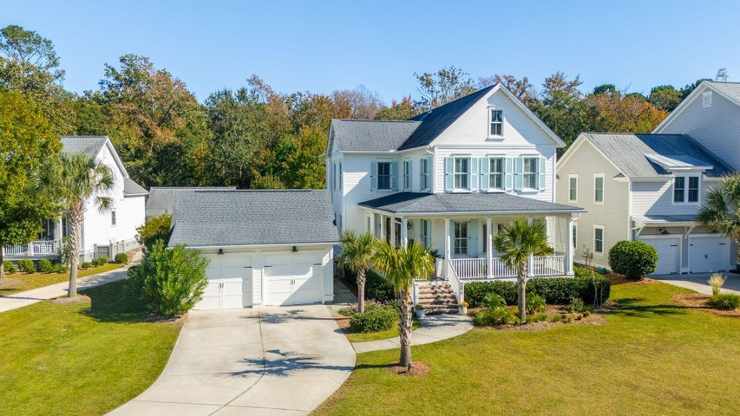
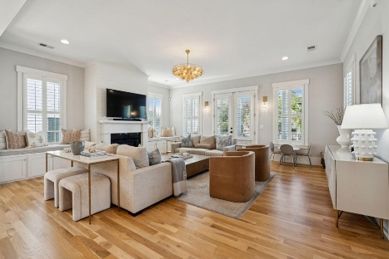
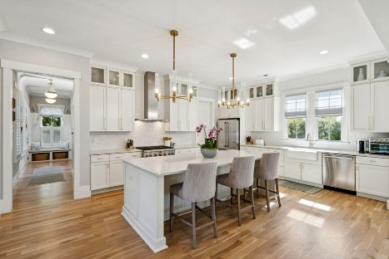
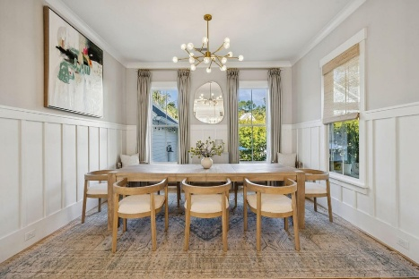
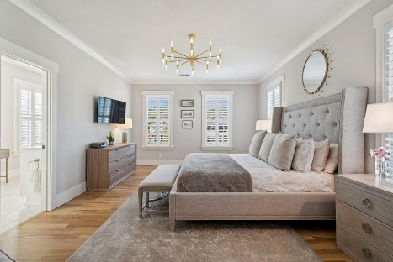
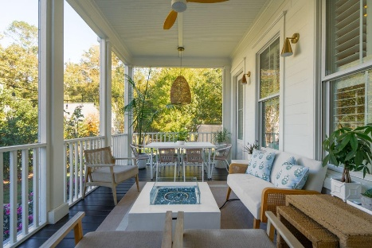
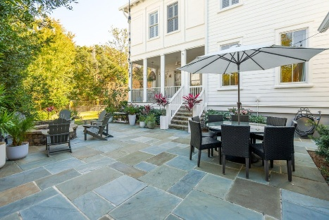
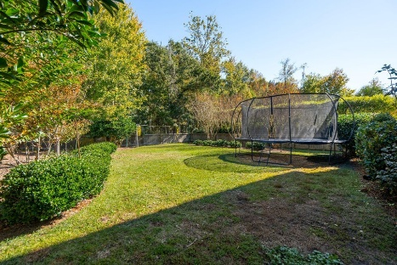
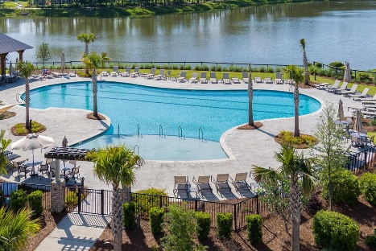

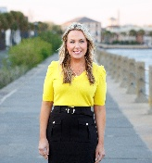
Just Listed in
Riverside Carolina Park
3870 Fifle Street
Mount Pleasant, SC 29466
MLS# 25029954 | $1,495,000
Nestled in the prestigious Riverside section of Carolina Park, this custom-built Saussy Burbank residence showcases timeless sophistication and modern Charleston style. Privately situated on a wooded lot in a peaceful cul-de-sac, this home showcases refined design and exceptional livability. Experience the essence of Lowcountry living with inviting outdoor spaces, including a charming front porch perfect for unwinding on the swing, a tranquil screened porch, and a private backyard featuring a patio, firepit, and built-in grill. The spacious yard provides ample room to add a pool if desired, completing this home's rare combination of elegance, comfort, and luxury. *Pool plans to convey*
Ideally situated within walking or biking distance to local amenities and top-rated schools, this home offers a genuine sense of community living.
As you enter, you're greeted by an open, sunlit layout that feels instantly comfortable and inviting. Beautifully refinished white oak hardwood floors flow throughout and designer touches make every space feel special. Thoughtful custom upgrades include high-end lighting and kitchen hardware, plantation shutters and shades, detailed wall trim and tiling, and wallpaper accents that add charm and personality.
Enjoy your own secluded outdoor oasis, with a generous yard that opens to peaceful conservation land. Ideal for family fun, hosting gatherings, or adding a pool, this backyard combines space, privacy, and endless possibilities for outdoor living.
This property offers not only a luxurious lifestyle, but also the convenience of modern living. Riverside at Carolina Park offers an endless array of amenities, including the Lake Club, featuring a resort-style pool, picnic pavilion, and fire pit overlooking scenic Bolden Lake. Residents also have access to a playground, tennis and pickleball courts, an open-air pavilion, dog park, the Great Lawn, miles of walking trails, as well as the crabbing dock. The nearby Bend shopping development, easily accessed by a quick golf cart or bike ride, includes restaurants, coffee shops, boutiques, a wine bar, hair and nail salons, and yoga and dance studios, among other local businesses. A fantastic regional library, top rated Mount Pleasant schools, hospital, fire station, pharmacies and grocery stores are also in the immediate area. This home is also only 20 minutes to the beaches of Isle of Palms and Sullivans Island and 25 minutes to Downtown Charleston and the Charleston International Airport.
VIDEO TOUR
Virginia Landon
803-493-9202
vlandon.realestate@gmail.com
The Boulevard Company | 806 Johnnie Dodds Blvd Ste 100 | Mount Pleasant, SC 29464

