Slide 1

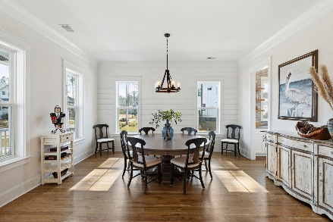
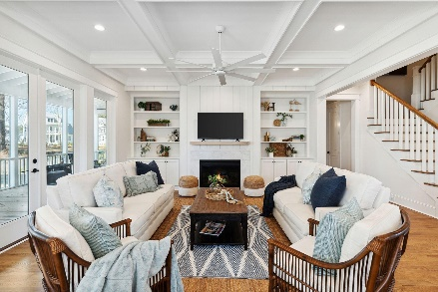
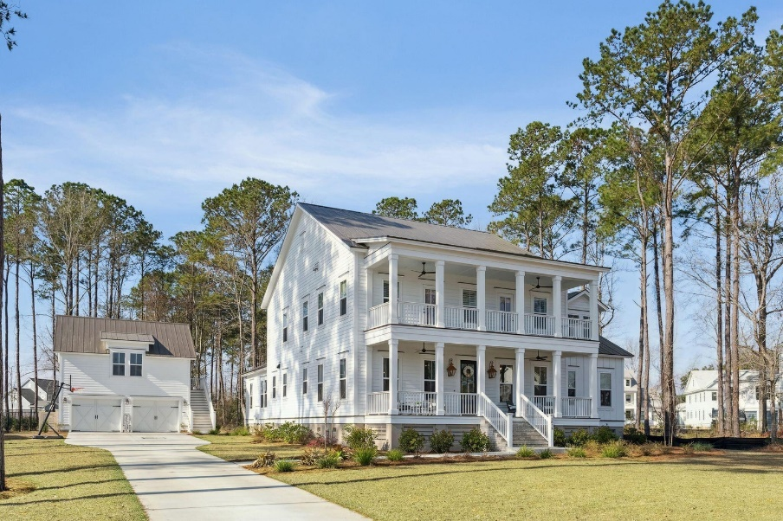
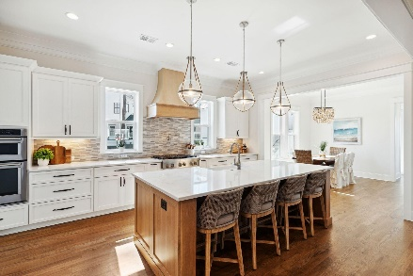
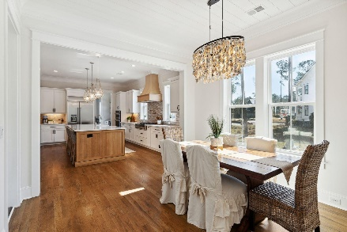
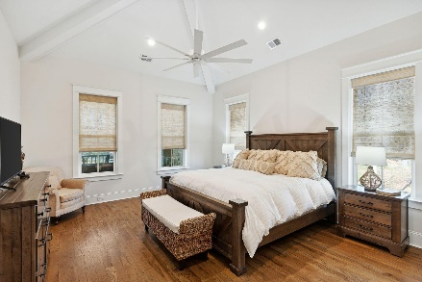
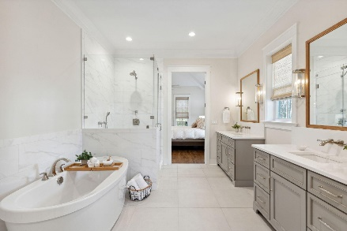
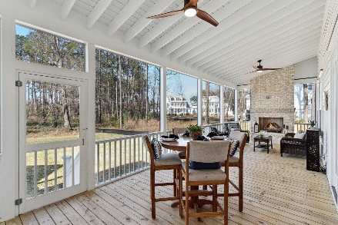
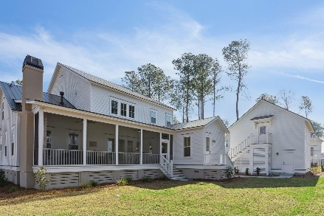
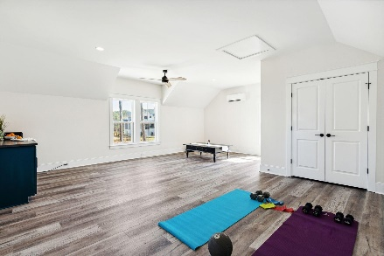
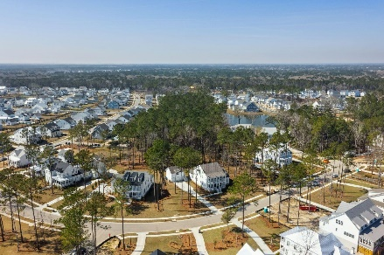
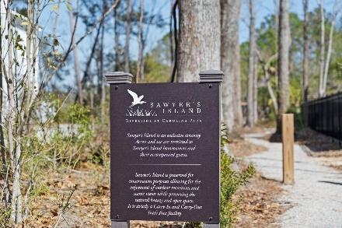
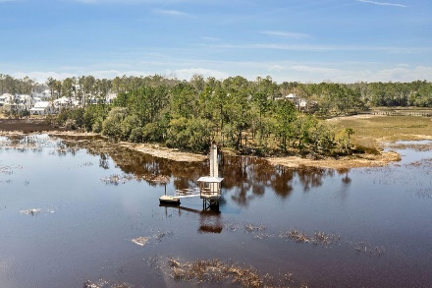
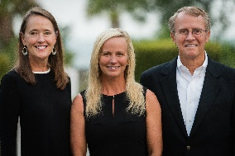

3874 Sawyers Island Drive
Carolina Park
Mount Pleasant, SC 29466
MLS# 23004177 | $1,990,000
Better than New
Launch a Kayak, Paddleboard, or do some sunset fishing! Sawyer's Island is the most exclusive section in all of Riverside built to date offering exclusive access to a private amenity, The Sawyer's Island Dock. This beautiful custom home is a rare opportunity to be part of this exclusive Riverside Section. Did you know? Riverside at Carolina Park is now a ten-year-old beautifully mature Mt. Pleasant SC community. Some (not all) of the homes in Riverside are CUSTOM built - and this is one! It's smart to know the difference in a custom-build. The home was completed in 2021 by Award Winning Cline Homes and has been barely lived in - it's like buying new.
This unique offering provides a rare chance to enjoy a CUSTOM home next to one of Riverside's most significant amenities Bolden Park featuring Bolden Lake AND offers access to the exclusive Sawyer's Island Dock. With its convenient Mt. Pleasant address, abundant natural beauty, friendly neighbors and endless array of amenities and conveniences, Riverside provides residents with a true sense of community. Schools are within walking or bike riding distance, neighbors share conversations on wide front porches, and opportunities for relaxation and recreation are around every corner. Drive your golf cart to the exclusive Riverside-only Lake Club Pool, great lawn, dog park, or Costco, or The Bend featuring local eateries and more commercial conveniences with many more to come!
Don Dawson
843-514-0452
ddawson@carolinaone.com
Carolina One Real Estate • 2713 Highway 17 North • Mount Pleasant, SC 29466
www.TeamDawsonSC.com

