Slide 1
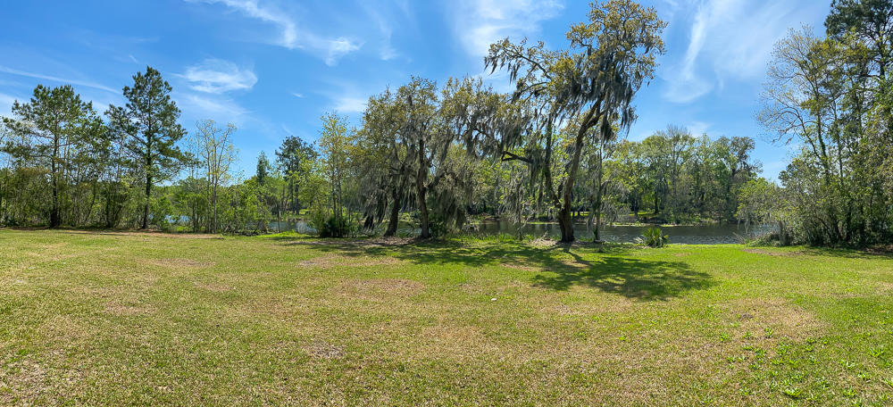
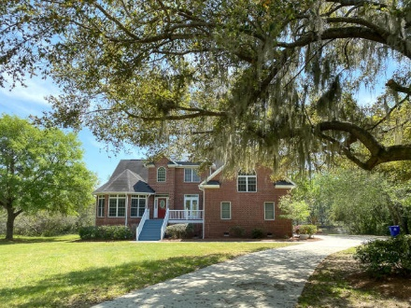
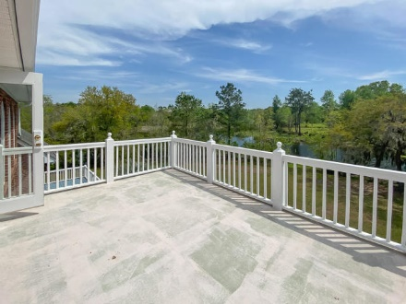
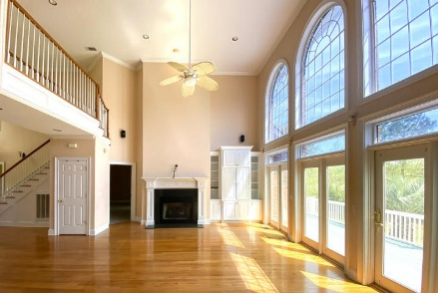
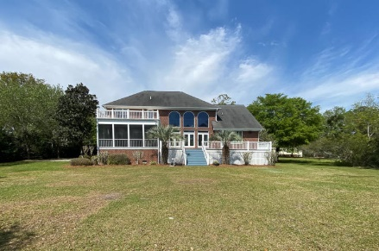
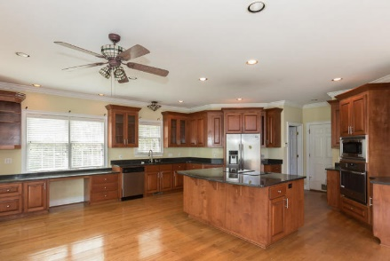
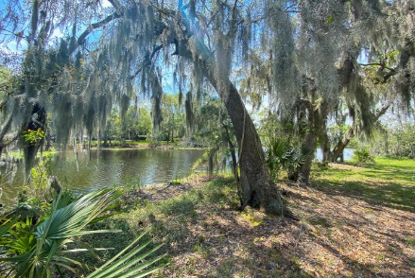


Must See!!
3891 Moss Pointe Court
Gift Plantation · Johns Island, SC 29455 · MLS# 20008872 · $569,000
Beautiful 3 Bed 3.5 bath with huge game room/4th bedroom with water views in Gift Plantation. Hardwood floors throughout main living areas. Upon entering the home you will see the grand staircase and formal dining room with 10ft ceilings. The 2 story great room is open to the dining room and kitchen with huge windows and glass doors looking onto the private back yard. Kitchen has a large center island with cook top, stainless steel built in wall oven and microwave, stainless steel refrigerator and dishwasher and room for a large table. Glass doors leading onto the screened in porch off kitchen. Downstairs large master bedroom with 2 walk in closets and en suite with walk in shower and jacuzzi tub with outside access to deck. Upstairs are 2 spacious bedrooms, each with a bathroom and a huge game room. Gift Plantation has a deep water dock on the Stono River, a community pool and tennis courts.
Michael Dew
O 843-769-5100
M 843-870-7000
michaeledew@gmail.com
www.michaeldewrealestate.com
AgentOwned Charleston Group
902 Savannah Hwy
Charleston, SC 29407
Real Estate ● Mortgage Insurance ● Business Brokerage

