Slide 1
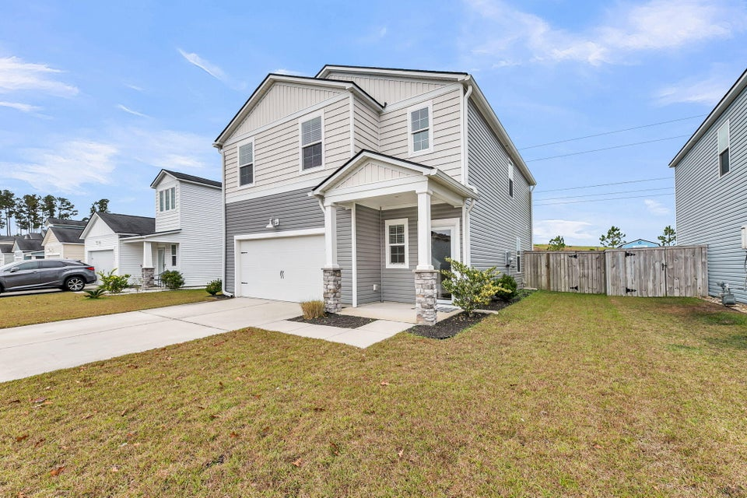
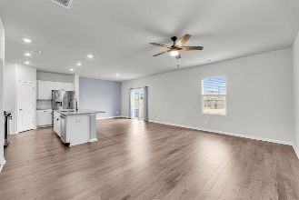
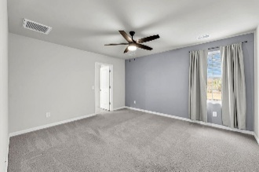
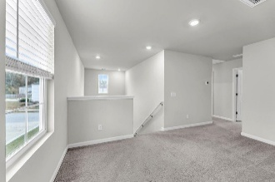
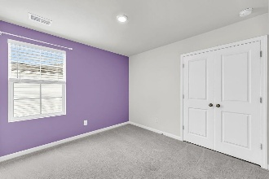
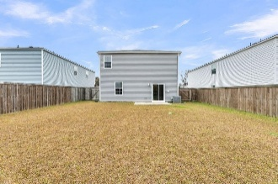


NEW PRICE IN GRAND BEES
$15,000 Agent Bonus
with ratified contract by 4/15/18
389 Matuskovic Drive
Grand Bees
Charleston, SC 29414
MLS# 25030302
$479,990
$12,100 Under
Recent Appraised Value
PRICE ADJUSTMENT! 4-bedroom home offers one of the largest fenced yards in Grand Bees! This exceptionally well maintained home includes an open concept layout and spacious kitchen with granite and stainless appliances that make everyday living and entertaining effortless. Out back it is perfect for grilling out, hosting friends, or relaxing. Upstairs, a versatile loft, generous owner's suite that offers great space with a walk-in closet and dual vanities. Additional bedrooms provide flexibility for guests, work-from- home needs, or a growing household.
Residents enjoy community amenities (pool, tennis and pickle ball courts, recreation center), walking trails, and quick access to Bees Ferry Road, shopping, dining, hospitals, and schools. You're also just a short drive to Charleston's beaches, historic downtown, and everything West Ashley has to offer.
At this new price, this home delivers one of the strongest lifestyle opportunities in the area. This is the perfect place for first time, investment, and second home buyers to say, ahhhhhhhhh, I'm home!
Paige Markland
843-518-0067
paigegmarkland@gmail.com
www.prattandco.com
RE/MAX Southern Shores
9209 University Blvd, Charleston, SC 29406

