Slide 1
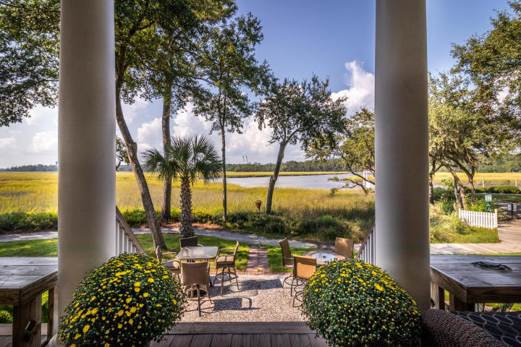
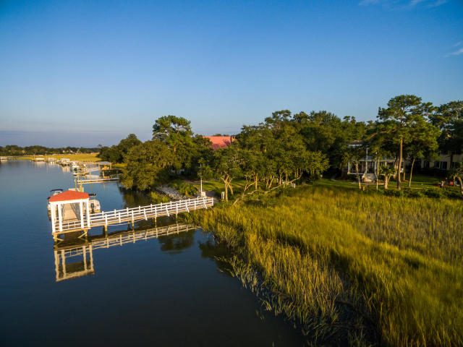
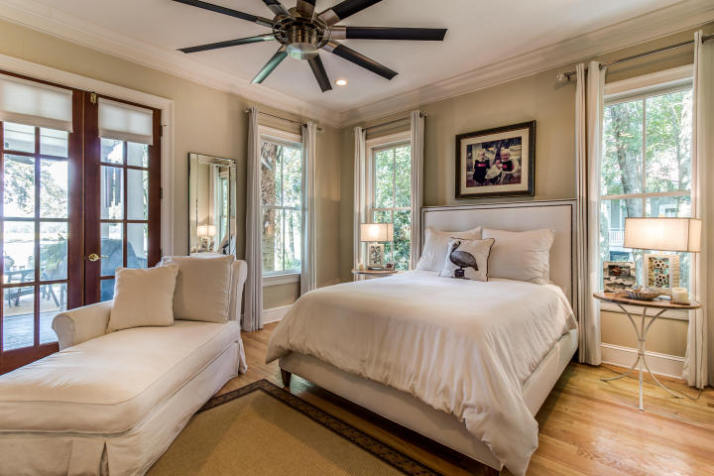
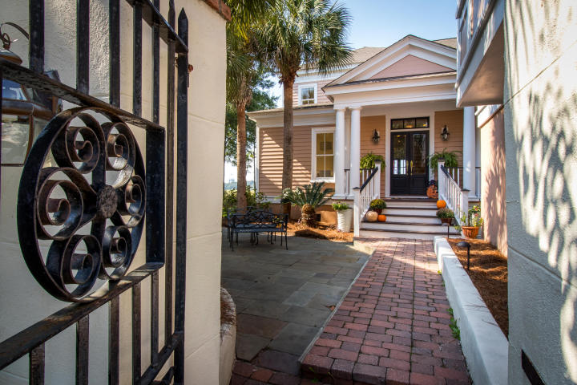
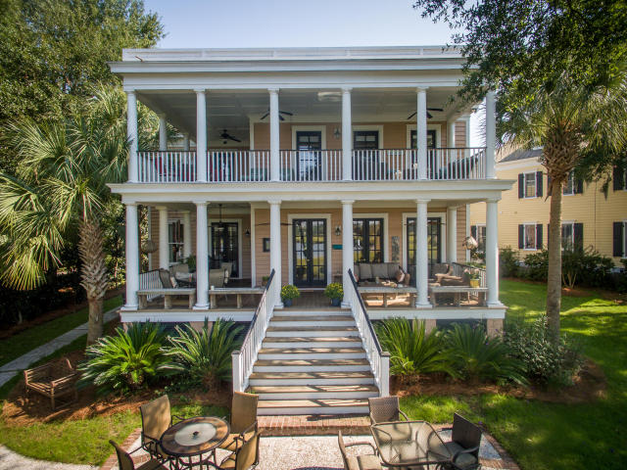
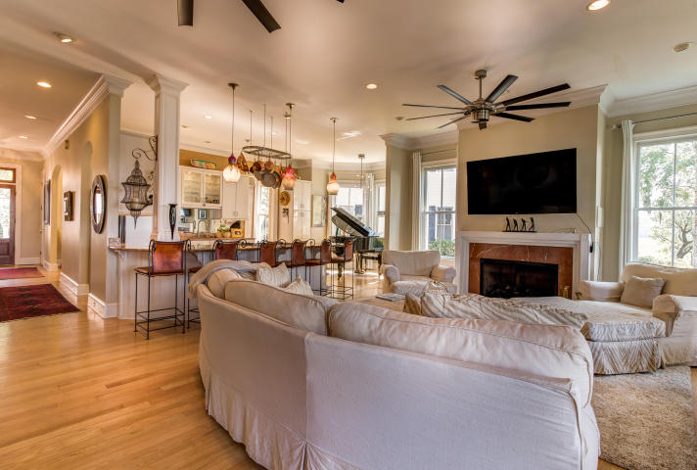
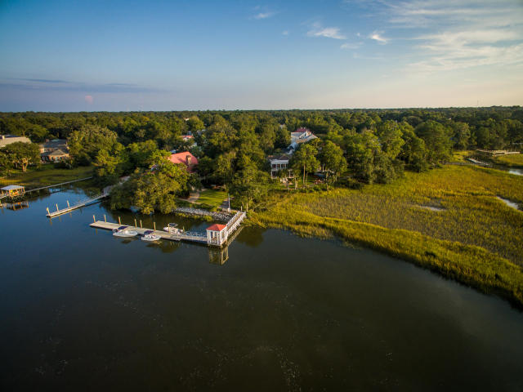


Deep Water Views in I'On
38 Saturday Road ~ MLS# 16026193 ~ $1,835,000
Enjoy breathtaking Water views, Boating and Sunsets from this home in I'ON, located on the Hobcaw Creek that feeds into the Wando River! Extra seating areas for guest surround the back yard just steps away from the boat dock. The double back porches overlooking the deep water and marsh are perfect for entertaining, relaxing and watching the abundant wildlife.
The first floor master suite overlooks the views of the water and marsh, with French doors leading out to the columned porch.
Upstairs the large covered porch is accessible from 3 of the bedrooms for privacy and enjoyment!
The beautiful, one bedroom carriage house, has a vaulted ceiling in the living room, with a full kitchen and granite countertops.
Marilyn Stewart, Realtor
Realtor of Distinction
843-297-4098 M
843-416-2200 F
marilyn@charlestonsells.com
Keller Williams Realty
496 Bramson Ct Ste 200
Mt. Pleasant, SC 29464

