Slide 1
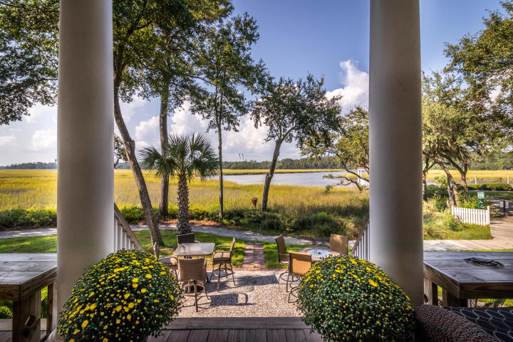
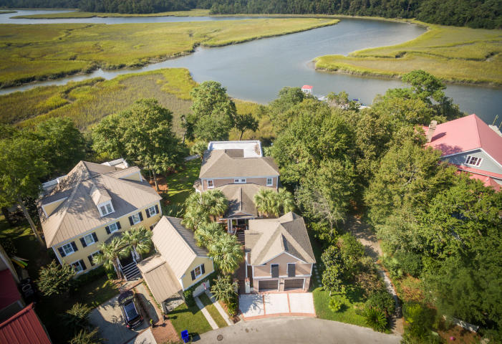
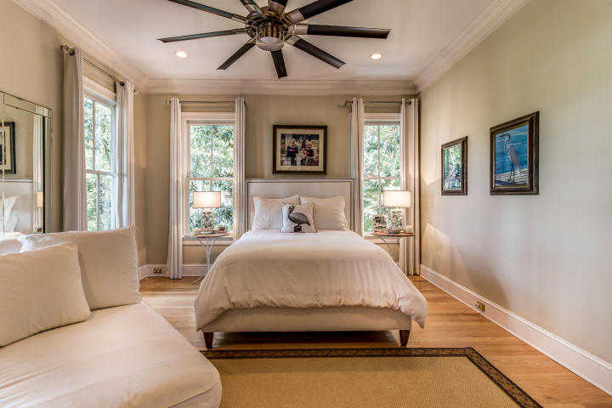
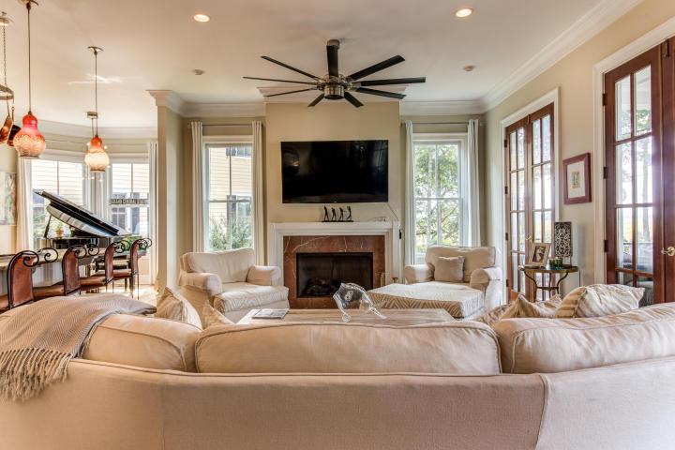
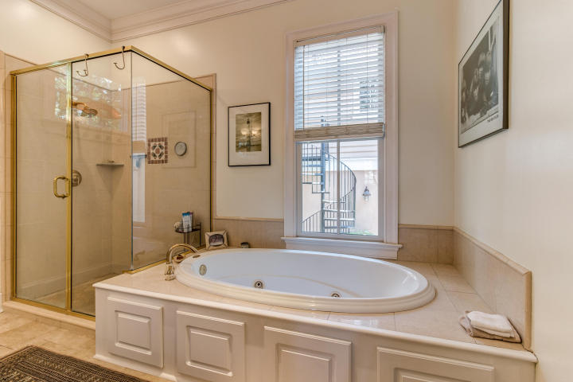
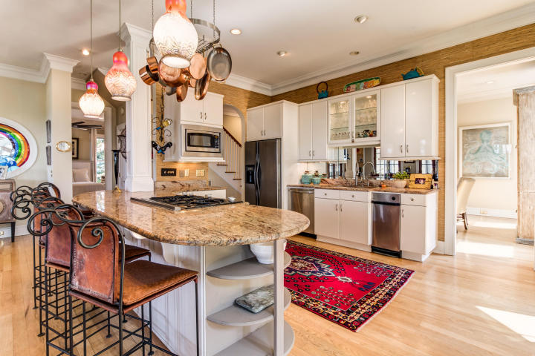
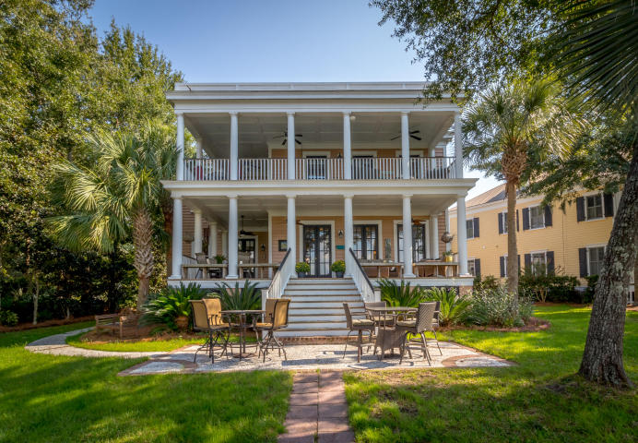
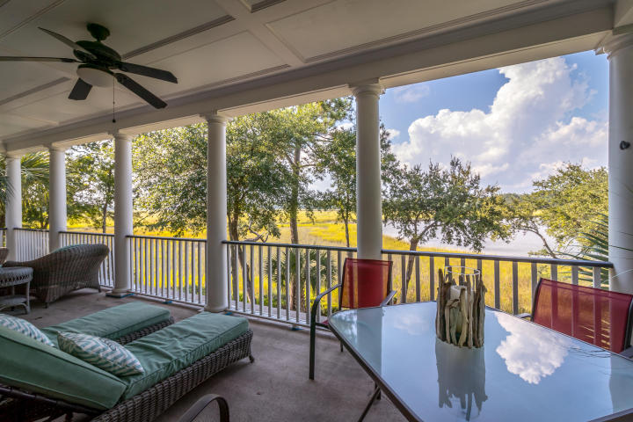
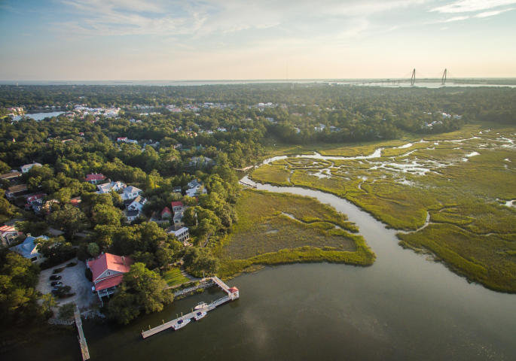


Water Views & Income Producing Property In I'on
38 Saturday Road ~ MLS# 16026193 ~ $1,835,000
Enjoy breathtaking Water views, Boating and Sunsets from this home in I'ON, located on the Hobcaw Creek that feeds into the Wando River! Extra seating areas for guest surround the back yard just steps away from the boat dock. The double back porches overlooking the deep water and marsh are perfect for entertaining, relaxing and watching the abundant wildlife. Entering through the private gate is a charming courtyard and fountain that welcomes you at the front of the home. The open kitchen features a large breakfast bar, with gas cook top and beveled mirror back splash. The family room with a gas fireplace and display of french doors across the back lead to the expansive main porch. The first floor master suite overlooks the views of the water and marsh, with french doors leading out to the columned porch. Wood floors are through out the entire home and Windsor windows. Downstairs are 3 new Fanimation Studio collection ceiling fans ! Upstairs the large covered porch is accessible from 3 of the bedrooms for privacy and enjoyment , all bedrooms feature Harbor Breeze fans!
Crawl space underneath the house is encapsulated for moisture control as well as a termite bond on the home.
The beautiful one bedroom carriage house, has a vaulted ceiling in the living room with a full kitchen and granite counter tops. The income producing carriage/apartment at $2800 monthly, is booked through the end of April
Marilyn Stewart, Realtor
Realtor of Distinction
843-297-4098 M
843-416-2200 F
marilyn@charlestonsells.com
Keller Williams Realty
496 Bramson Ct Ste 200
Mt. Pleasant, SC 29464

