Slide 1
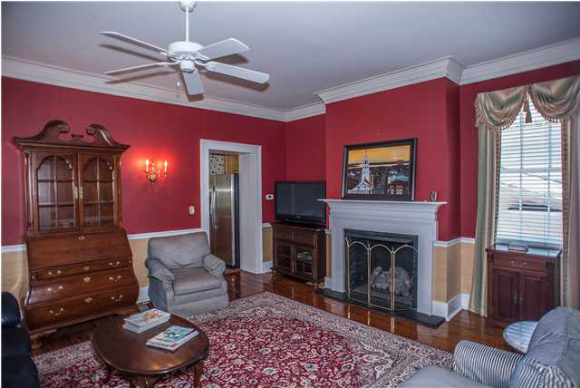
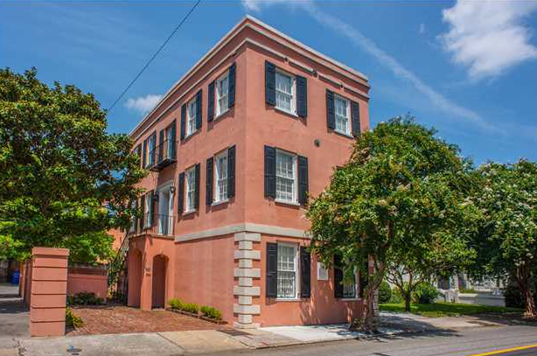
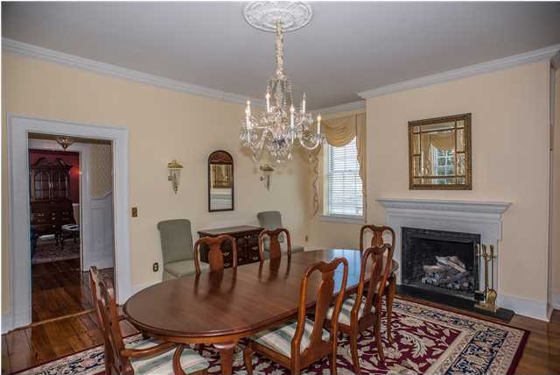
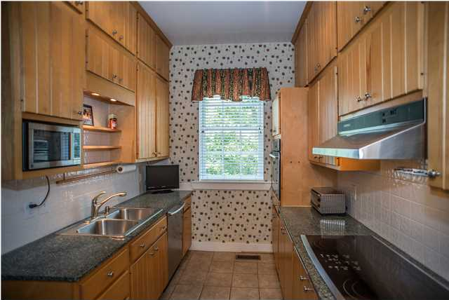
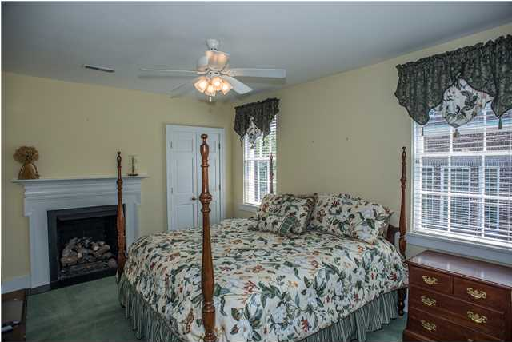
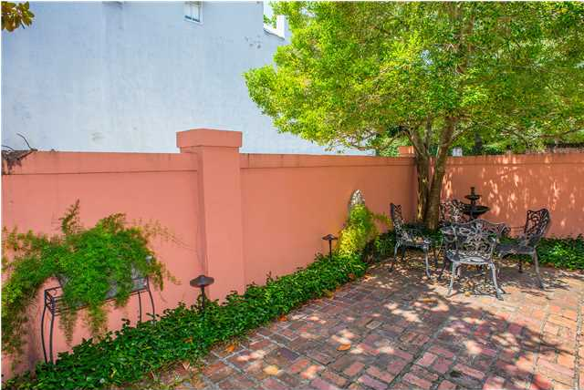
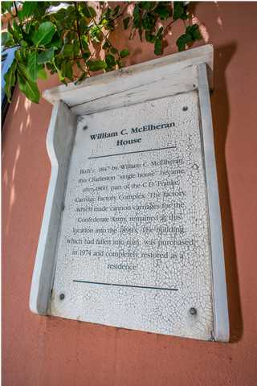
Downtown Charleston - Walk to Everything!
$1,150,000
3 Bedroom
3½ Bath
2,979 Sq Ft
38 Wentworth St
Ansonborough
Charleston, SC
MLS# 1422928
The William C. McElheran was built circa 1847 and was purchased in 1860 and used for construction of gun carriages for the confederacy. This house features and interesting history including a massive renovation featured in a 1977 Post and Courier article about historic renovations. Of course the home has been updated and renovated since then. The main floor features a foyer with a formal living room with fireplace to the right and a Living room/den with fireplace to the left. The updated kitchen is beyond the den and features custom cabinets, stainless appliances, and granite tops. A powder room is also located off of the kitchen. Downstairs is currently configured as two bedrooms and a bath (giving a total of 4 bedrooms), but features it's own entrance and could easily be used as a Mother-in-Law Suite with a separate small kitchen. Upstairs features two bedrooms each with it's own updated bathroom and fireplace. The walled outside courtyard provides the perfect place to relax in the afternoon. The location allows for easy walking to shopping, restaurants, and art galleries. The location also makes it the perfect lock and leave second home. Please take a look at this wonderful home in a great location.
Frank Thornhill, Realtor®
(843) 224-7997
frank@scplaces.com
www.scplaces.com
Places Real Estate LLC
400 Hibben Street, Suite 200
Mount Pleasant, SC 29464

