Slide 1
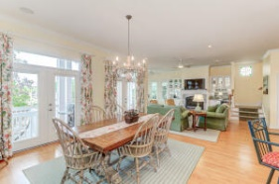
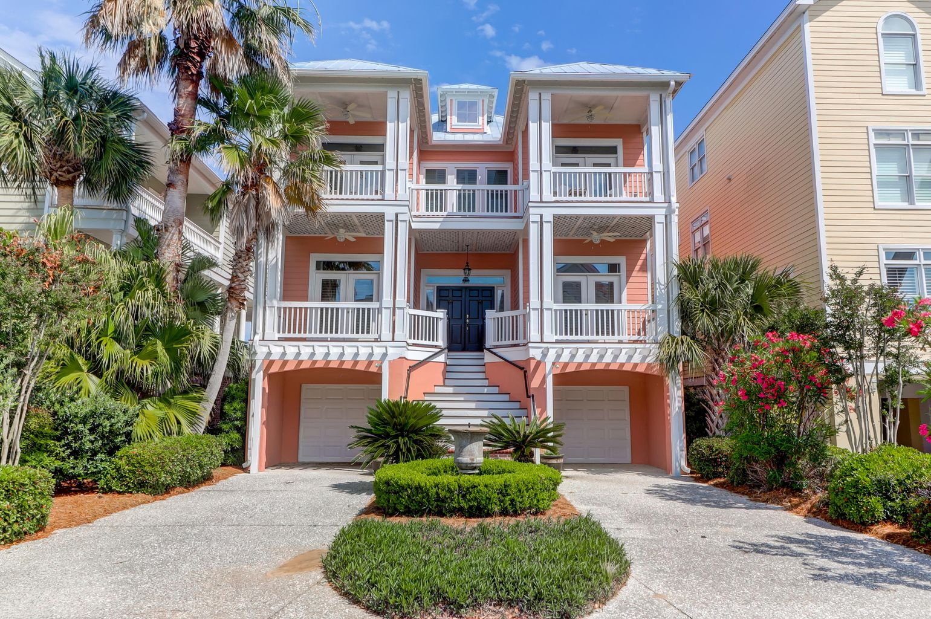
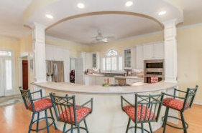
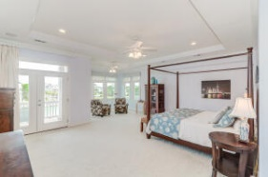
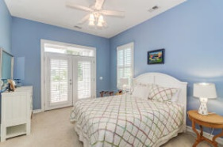
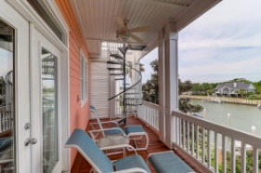
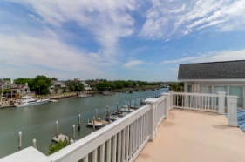
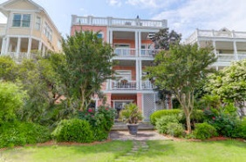
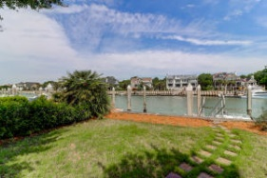
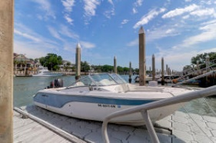
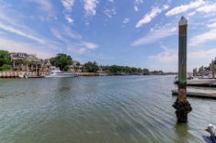


38 Morgan Drive
Wild Dunes | Isle of Palms, SC 29451
MLS# 21012524 | $2,200,000
Wild Dunes Home with 2, 40' Boat Slips
Welcome to 38 Morgan Place in beautiful Wild Dunes on the Isle of Palms. This home features 2, 40 foot boat slips directly in front of property. This fabulous 2 story home is situated on beautiful Morgan Creek and from the 3rd story deck views of the IOP Marina. This home offers a bright, open plan great for entertaining large or small groups. A fireplace in the Great Room, multiple decks, an elevator, 2 car garage and is close to the beach. Enjoy the spacious kitchen with Stainless Steel appliances, gas range and lots of counter space and storage. Home comes with 2 - 40 foot slips. See list of furniture to convey under documents.
Darlene Smith
Office - (843) 886-8110
Mobile - (843) 696-7824
darlenesmith@carolinaone.com
DarleneSmithTeam.com
Carolina One Real Estate
1503 Palm Blvd Ste
Isle of Palms, SC 29451

