Slide 1
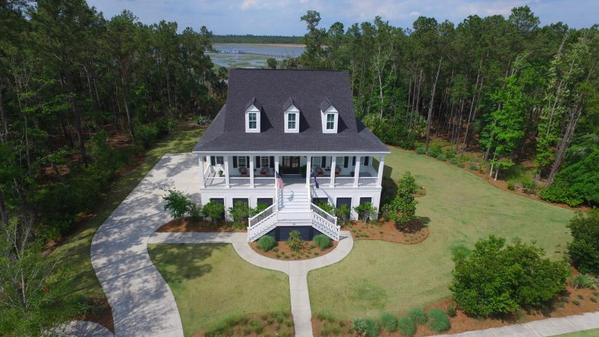
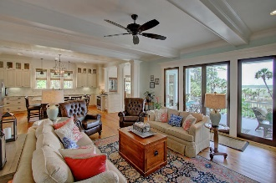
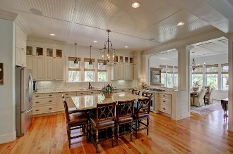
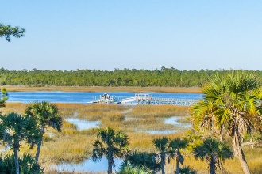
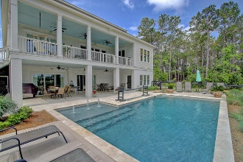
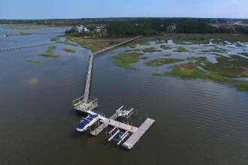


3901 Ashton Shore Lane
Mount Pleasant :: MLS# 16011803 :: $1,579,000
Private Park Island Waterfront
If you are looking for an amazing home, look no further…
This custom home is located on private/gated Park Island with expansive Wando River views and a deep water (8 feet at low tide) boat slip with boat lift
When you enter the home, you will be greeted by a wide-center hallway with views to water.
To the left of the center hall is a study with built-ins and an elevator to the right
Open concept great room/kitchen.
Gourmet kitchen with large center island and separate dining area which opens to additional outdoor living space.
Main floor master with captivating water views and stunning bath including a large walk-in closet.
Laundry on the main floor.
Upstairs you will find three additional bedrooms each with en suite baths, loft area, and extra storage space
Lower level contains a current fitness room and full bath, recreational space, and a home office with separate entrance, three bay garage and more storage.
If that isn't enough, there is a landscaped yard, inviting saltwater pool, and porches to enjoy it all!
Clay Cunningham
O (843) 886-8110
M (843) 345-4647
clay@carolinaone.com
www.claysre.com
Carolina One Real Estate
1503 Palm Blvd Ste
Isle of Palms, SC 29451

