Slide 1
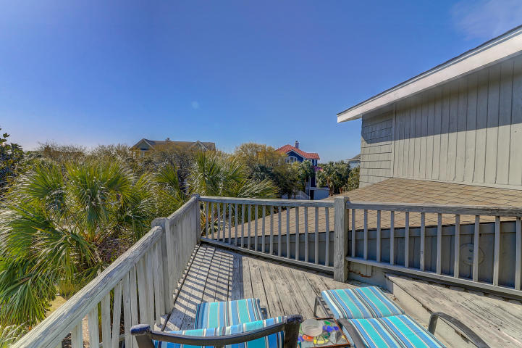
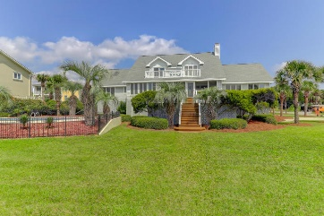
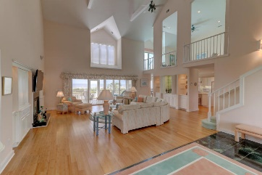
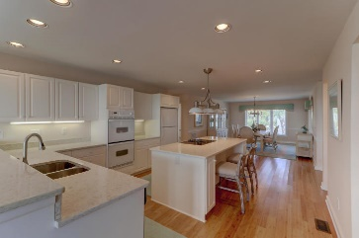
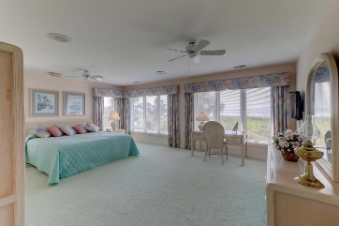
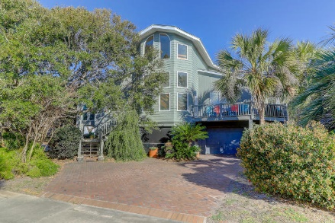
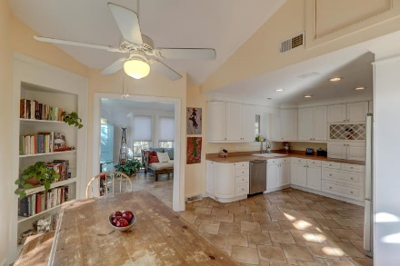
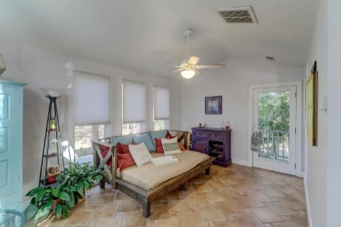
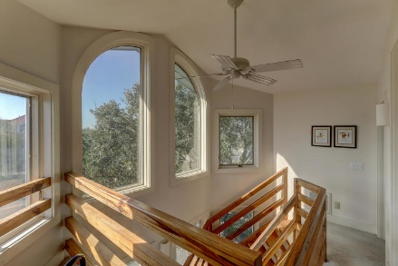
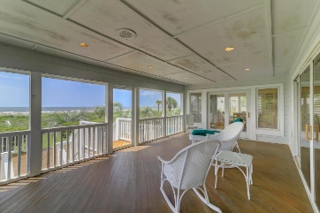


3901 Palm Boulevard Isle of Palms, SC 29451 | MLS# 19009778 NEW PRICE!! $1,499,000
New Price
Beach Access, Ocean Views & Great Rental Potential
Exceptional location, corner lot across from the beach w/beach access on the Isle of Palms. This 6 bd/4ba home has great rental potential. Easy to Show. The spacious kitchen offers stainless steel appliances. The lower level features a full kitchen, living room and bedroom suite with a screen porch for private access to the lower level.
Darlene Smith Office - (843) 886-8110
Mobile - (843) 696-7824
darlenesmith@carolinaone.com
DarleneSmithTeam.com
Carolina One Real Estate
1503 Palm Blvd Ste
Isle of Palms, SC 29451

