Slide 1
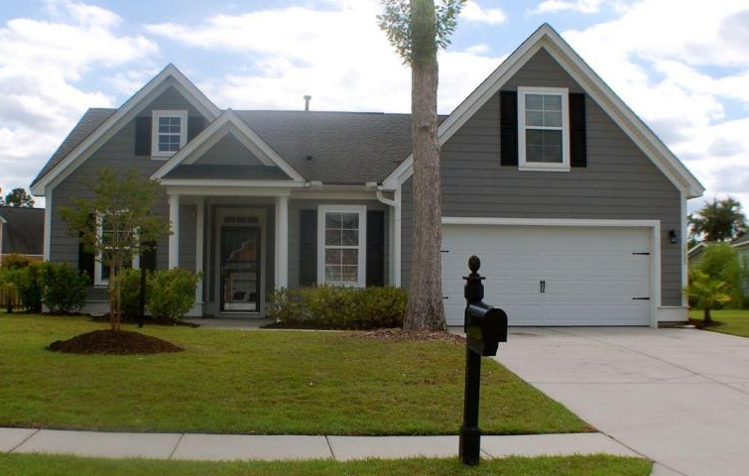
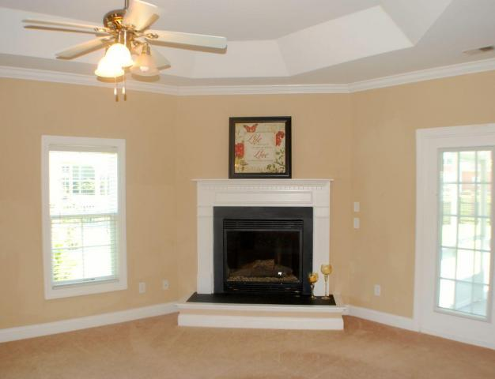
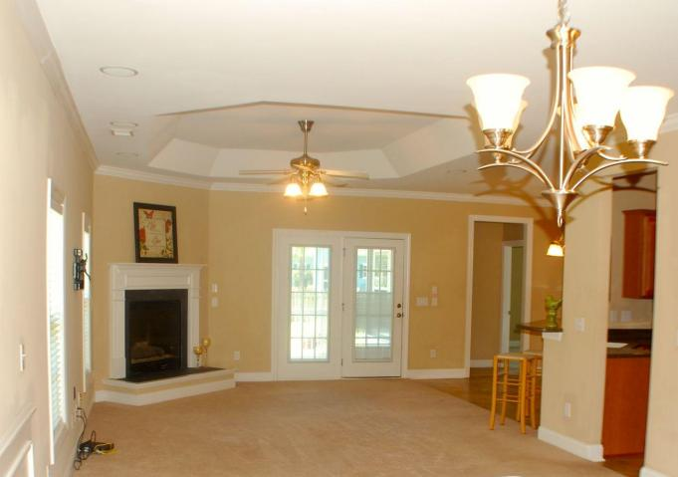
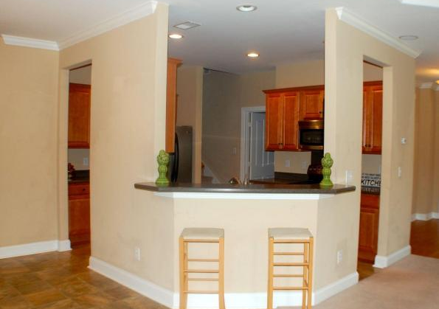
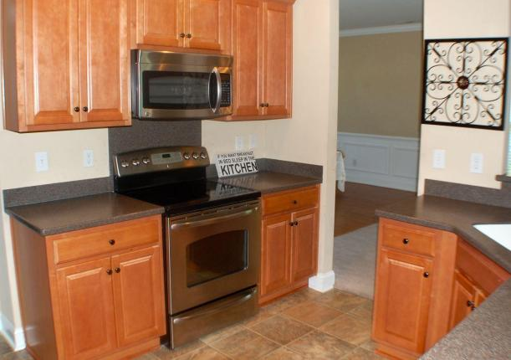
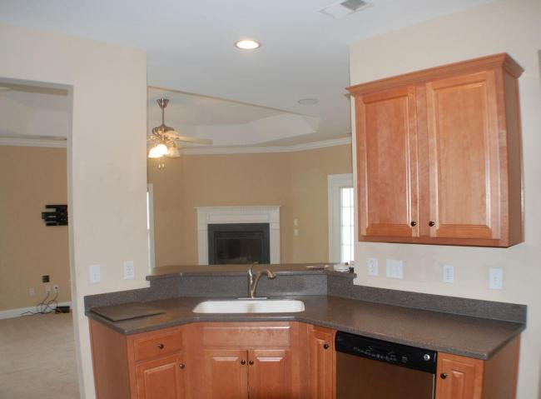
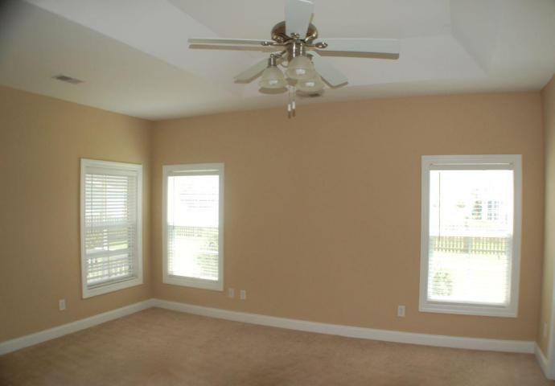
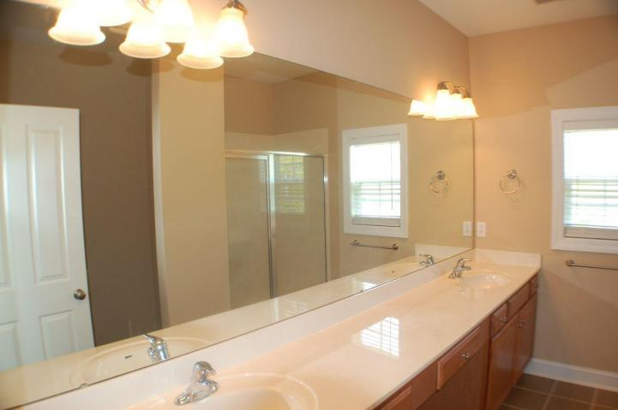
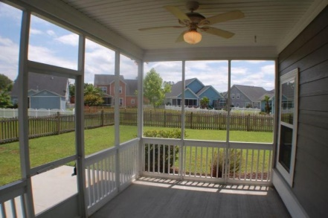
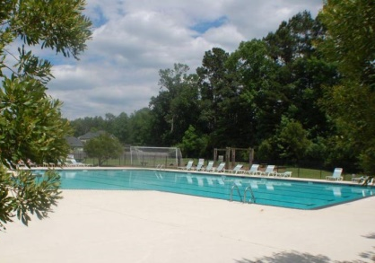


3905 Bismarck Ct
Indigo Palms
North Charleston
MLS# 15013646
$250,000
4 Beds | 2 Baths
2,420 Square Feet
Dorchester II school district. Energy efficient Earthcraft home. One story home w FROG on cul-de-sac. Spacious Master Down! Fireplace in the Large family room. Stainless Steel EAT in Kitchen. Frog has a large closet. Many upgrades, Cement siding and trey ceilings, ceiling fans, 9x14 SCREENED PORCH, Tiled bathrooms. Entertainment package -upgraded wiring, -5.1 in-ceiling surround sound in living room - Back porch has speakers wired to sound system - Flat screen TV mount with hidden cable access. The convenience of IRRIGATION. Walk to the Jr olympic POOL! 15 minutes to Boeing and AFB. 10 mins to Boeing Ladson. Interior of House being painted this week.
Di Johnson
843-270-6448
dijohnsonsc@gmail.com
www.agentownedrealty.com
AgentOwned Premiere Group
100 Crowfield Blvd
Goose Creek, SC 29445

