Slide 1
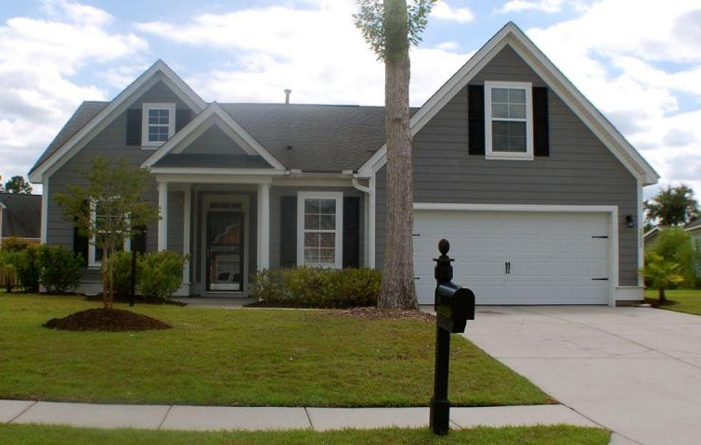
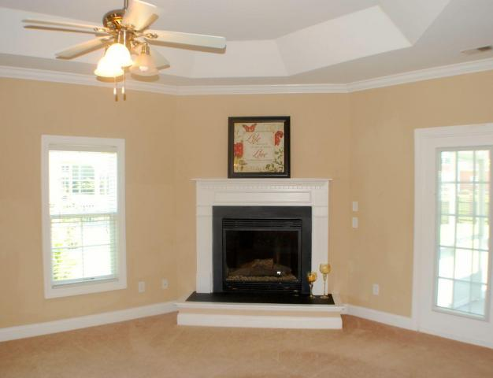
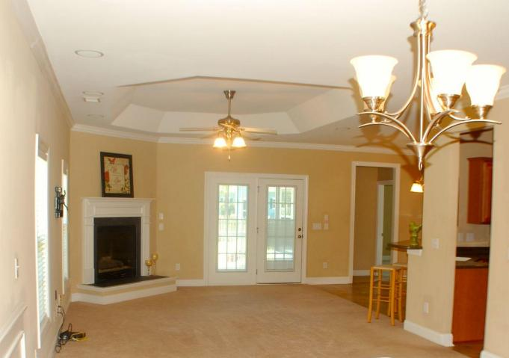
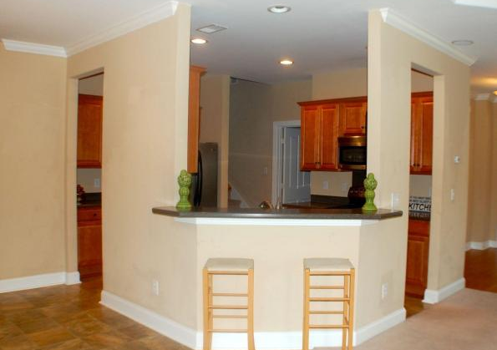
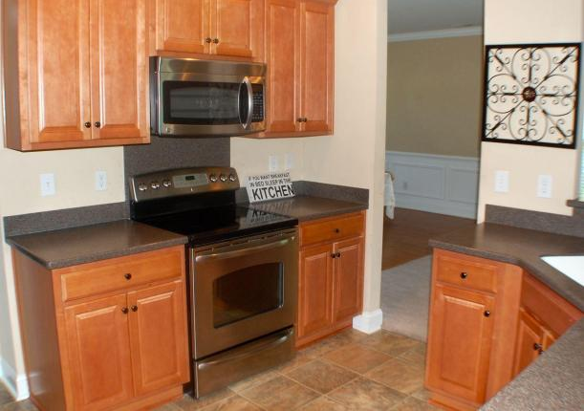
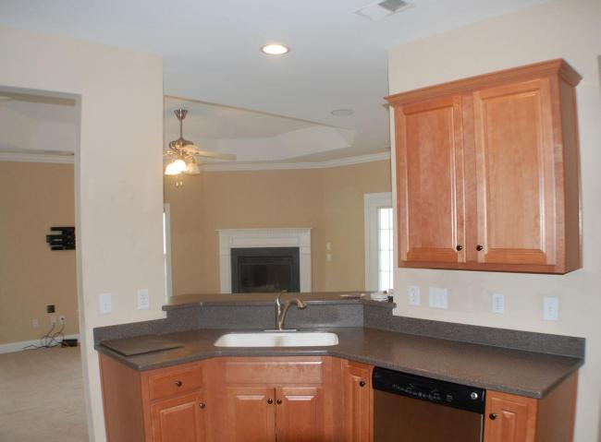
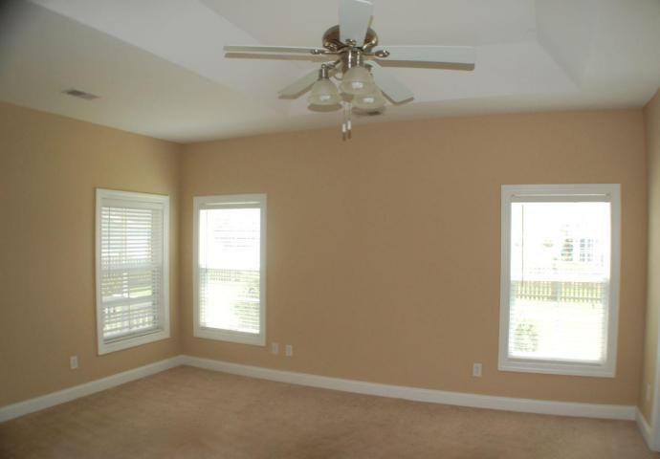
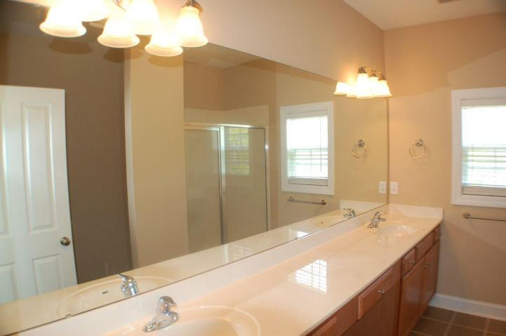
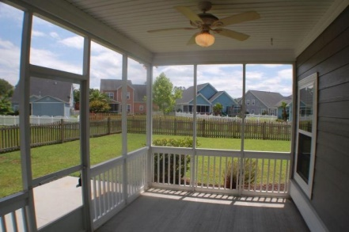
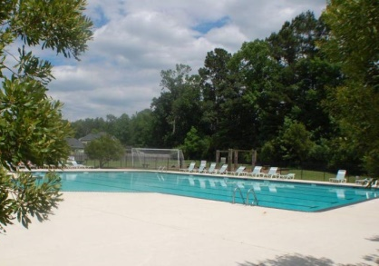


3905 Bismarck Ct
Indigo Palms
North Charleston
MLS# 15013646
$230,000
4 Beds | 2 Baths
2,420 Square Feet
Dorchester II school district. FRESHLY PAINTED Energy efficient, Earthcraft home. Master Down home w FROG on cul-de-sac. Fireplace in the Expansive family room. BEAUTIFUL UPGRADED Stainless Steel EAT IN Kitchen. Frog can be used as a man cave, guest room or office. HUGE GARAGE w WORK SPACE. Over sized Pantry/Laundry. Many upgrades, FENCED YARD!! Cement siding, trey ceilings, ceiling fans, 9x14 SCREENED PORCH, Tiled bathrooms. The convenience of IRRIGATION. Entertainment package -SURROUND SOUND upgraded wiring, 5.1 in-ceiling surround sound in living room. Back porch has speakers wired to sound system. Flat screen TV mount with hidden cable access. Walk to the NEIGHBORHOOD Jr Olympic POOL! 15 minutes to Boeing and AFB. 10 mins to Boeing Ladson. Check out the schools!!
Di Johnson
843-270-6448
dijohnsonsc@gmail.com
www.agentownedrealty.com
AgentOwned Premiere Group
100 Crowfield Blvd
Goose Creek, SC 29445

