Slide 1
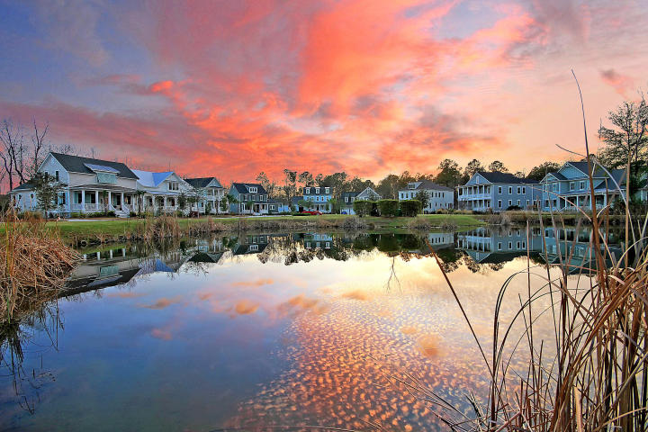

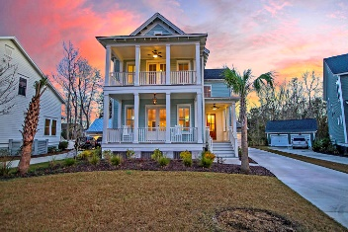
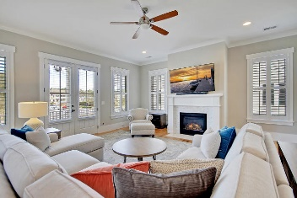
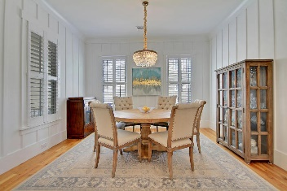
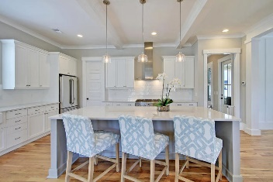
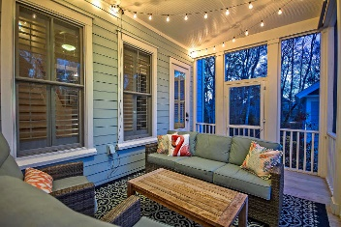
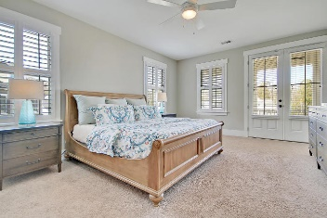
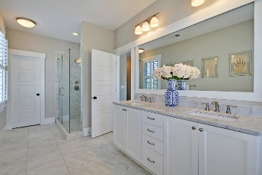
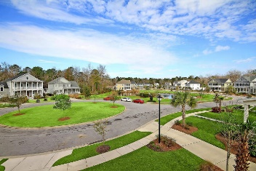
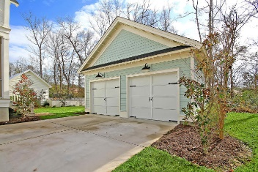
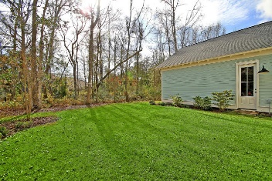
Price Reduced in Dunes West!
New A/C Units With Nest Controllers PLUS a 10 Year Warranty
$2,500 Agent Bonus
Open House Friday 3-6:30
3910 Fifle Street
Carolina Park ~ Mount Pleasant, SC 29466 ~ MLS# 20004107 ~ $745,000
Carolina Park is a beautiful, 1,700 acre master-planned community, and has so much to offer! As a homeowner in Riverside at Carolina Park, you can enjoy large lots, gorgeous live oak trees, lots of common green space, and lovely architecture. Amenities include a zero-entry pool, clubhouse, pavilion, fenced-in park, playpark, 20 acre Bolden Lake, dog park, and walking trails. The Riverside Community has future plans for a pool, Wando River access, a kayak launch, and a crabbing dock. With a well thought out blend of shopping, dining, and close-by retail locations, Carolina Park offers an exclusive Park-like setting that is also close to schools, Isle of Palms, Sullivan's Island, and historic downtown Charleston. Come discover why Carolina Park is among the fastest-growing most dynamic neighborhoods in the Low Country. Schedule your private tour of 3910 Fifle Street and come see the exceptional value of this incredible home and community.
Nate Gainey nate@mattoneillteam.com 843-513-2038

