Slide 1
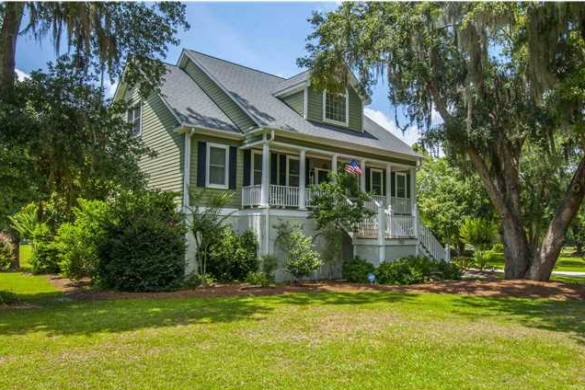
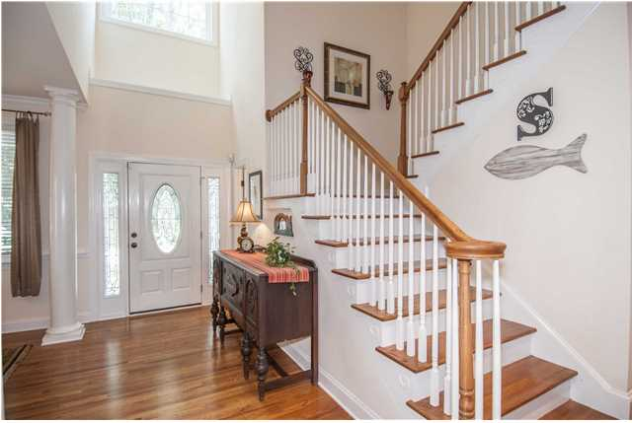
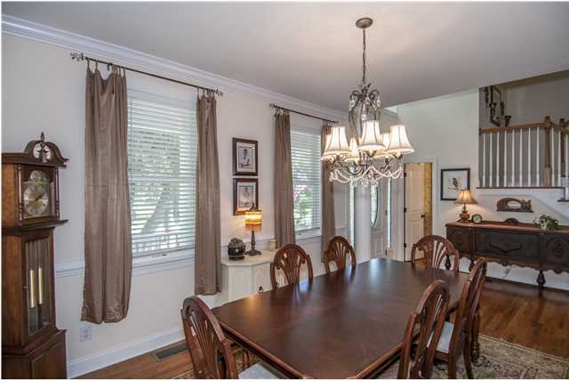
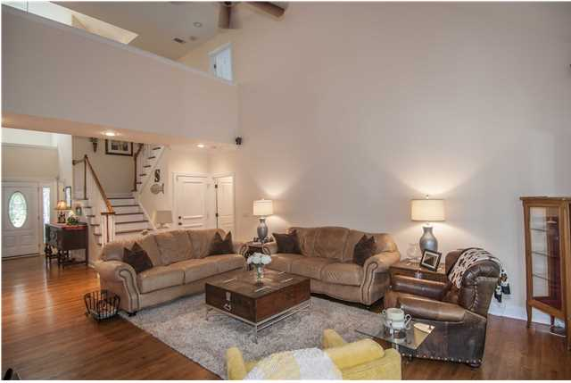
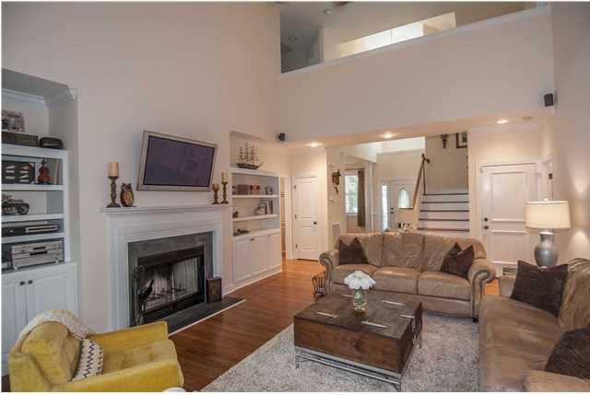
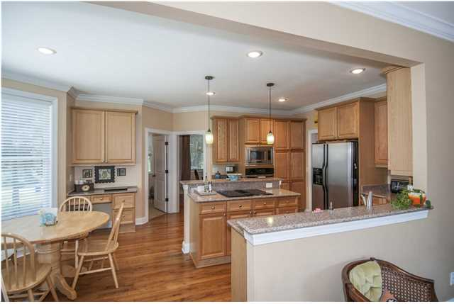
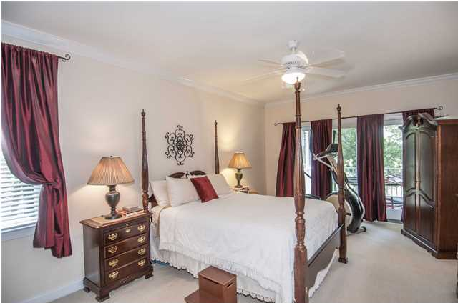
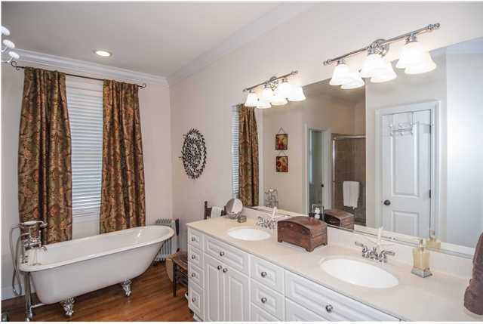
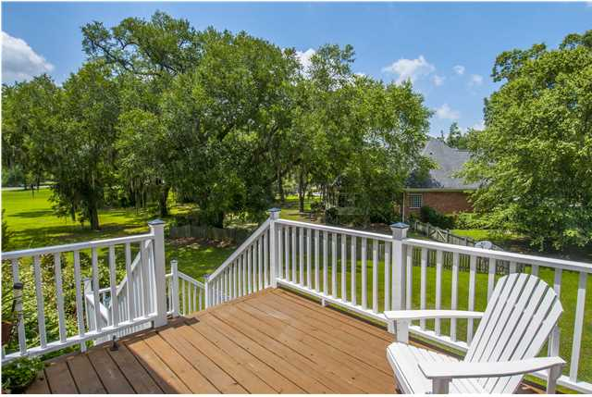
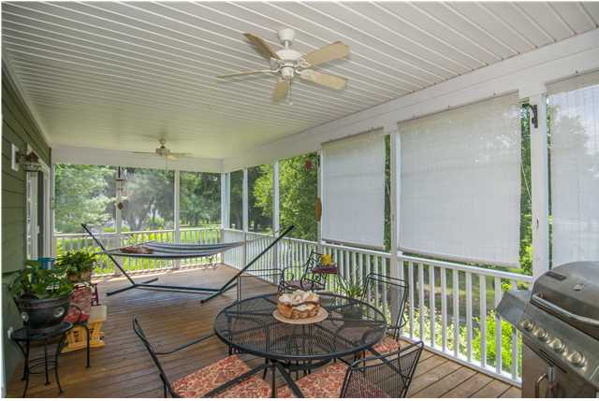
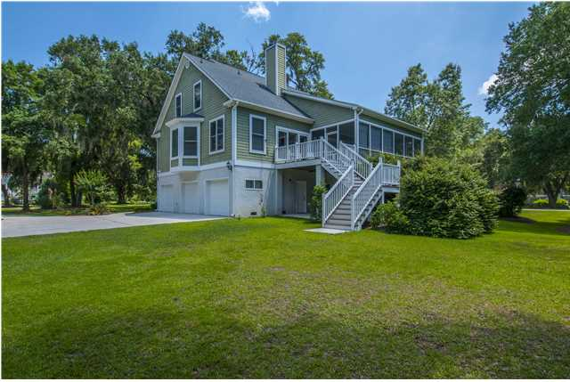


3912 Regal Oak Ln Gift Plantation Johns Island, SC MLS# 1416337 $460,000 4 Bedrooms | 2½ Baths | 2,600 Sq Ft
Agent Luncheon Open House ~ Tuesday, July 1st ~ 12-2p
House is a must see, Charming Low Country Home with 3+ car garage built-in. Large covered front porch and screen porch with open deck and full 33x11 covered rear patio, great for boats and other storage or entertaining. This home is priced right, "you can't build this home and lot at this price". Master on main floor with claw foot tub, with separate shower, his and her closets, Living room has valued 20 foot ceilings, open floor plan with all 9 foot ceilings. Large corner lot beautiful landscaping, live oaks in front and back yard with natural shade. Enjoy Gift Plantation community dock, tennis courts, clubhouse and pool. Covenant location to Lead Limehouse boat landing.
Justin Albright
O (843) 556-5800
C (803) 466.5787
justinalbright1@yahoo.com
Carolina One Real Estate
873 Orleans Road, Ste 102
Charleston, SC 29407

