Slide 1
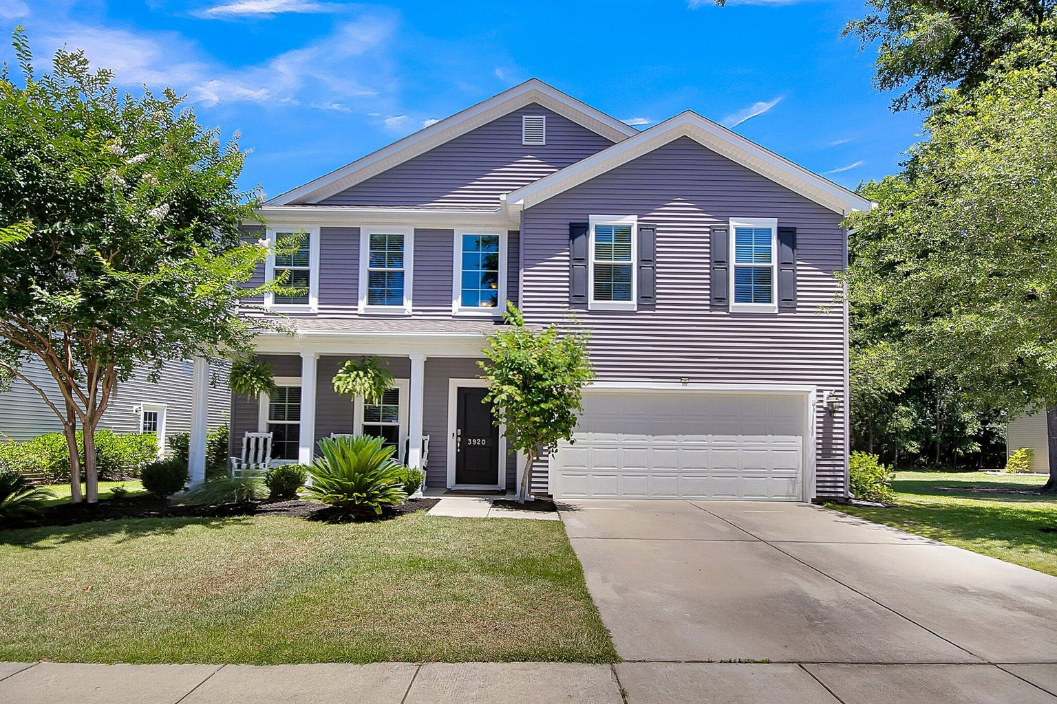
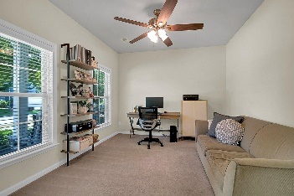
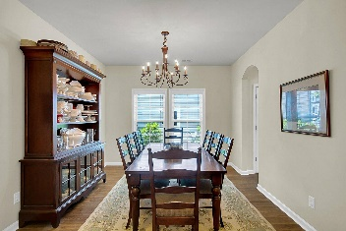
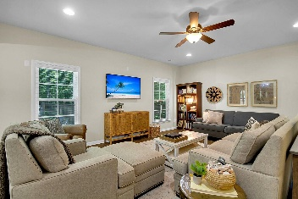
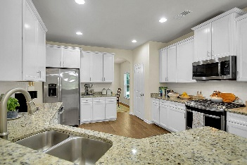
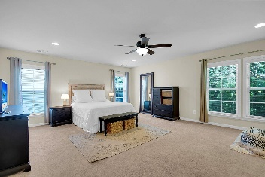
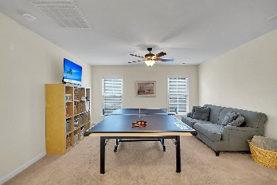
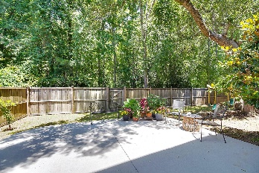
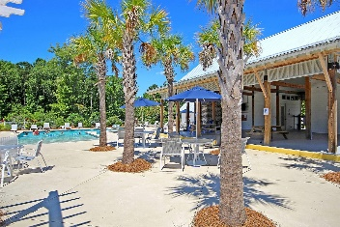

3920 Percheron Drive Tupelo · Mount Pleasant, SC 29429 MLS# 24014562 · $890,000
NEW Listing 5 Bedrooms 4 baths
Beautiful 5 bedroom, 4 bath home with gorgeous curb appeal is one of the largest floorplans in the desired Tupelo neighborhood. Upon entering the home, you are greeted with stunning hardwood floors, and an abundance of natural light. To the left is a flex/office/sitting room with French doors. Continuing in is the dining room, which is large enough for a table, buffet, and additional furniture. The dining room opens to the chef-inspired gourmet kitchen and living room with an open-concept feel. The kitchen is stunning with all GE stainless steel appliances, granite countertops, custom white 42'' cabinets, breakfast bar, pantry, and eat-in area. A guest bedroom and full bath are also located on the first floor. Upstairs boasts the oversized primary bedroom suite with two walk-in closets and a relaxing beautiful ensuite bathroom featuring a tiled shower, water closet, and double sink vanity. There is a mother-in-law/teen suite bedroom with it's own private ensuite full bath. The are two additional nicely sized bedrooms that share a full bath making for 4 bedrooms, 3 full bathrooms upstairs and one bedroom and 1 full bath downstairs. Finally, there is a HUGE bonus room on the second level that presently holds a ping-pong table-it is large enough to be a media room or play area. The backyard patio overlooks a fenced backyard and has mature trees providing shade for afternoon BBQ's or entertaining. Tupelo is a wonderfully landscaped neighborhood that offers an amazing pool, gazebos, grills, playground and walking trails. Located a short drive to the schools, beaches, restaurants, shopping and downtown Charleston.
Stan Huff
843-670-2835 stan.huff@agentowned.com
Jill Marcacci
843-297-5590 jill@agentowned.com
www.agentownedrealty.com
AgentOwned Realty Co. Preferred Group, Inc. | 824 Johnnie Dodds Blvd | Mt Pleasant, SC 29464

