Slide 1
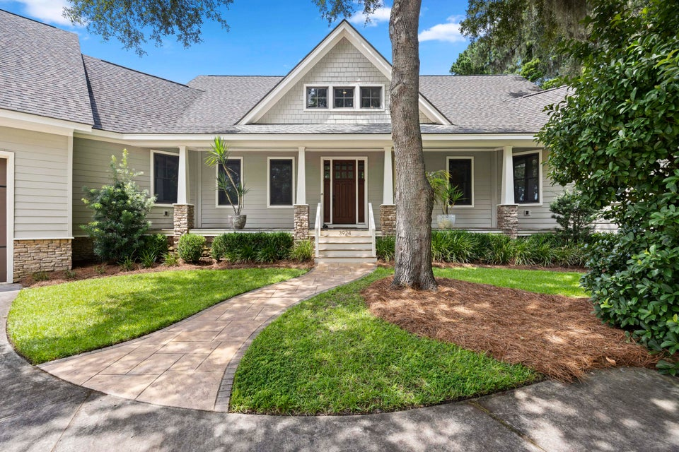
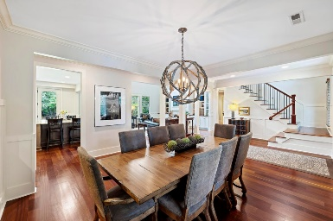
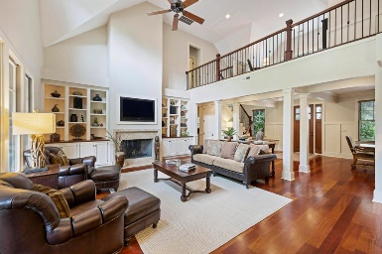
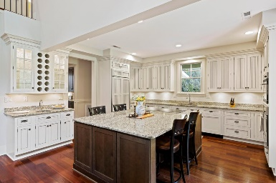
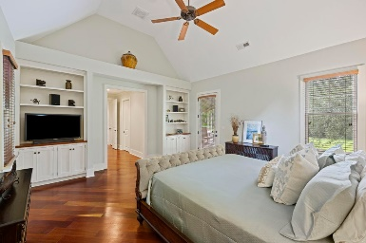
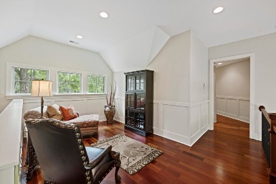
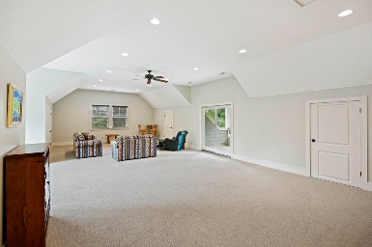
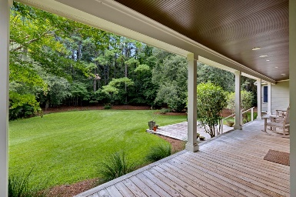
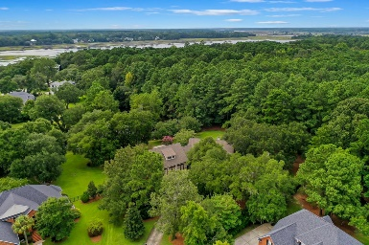


3924 REGAL OAK LANE
Gift Plantation | Johns Island, SC 29455
MLS# 24020419 | $1,495,000
Stunning Custom Home
The House of Seven Gables, 3924 Regal Oak Lane, a stunning custom-built home in the sought-after Gift Plantation on Johns Island. This exceptional 5-bedroom, 4-bathroom residence, set on a sprawling 1.12-acre lot at the end of a peaceful cul-de-sac, offers picturesque views of a serene pond surrounded by grand live oaks. The primary bedroom is conveniently located on the main level, while two additional bedrooms and bathrooms are upstairs, providing privacy for family and guests. The gourmet kitchen features a large island, GE Monogram appliances, and a stylish wet bar, perfect for entertaining. Enjoy the expansive FROG with its own wet bar and covered porch. This home also boasts a three-door, six-car garage with endless storage options. Residents enjoy access to a deep-water dock on the Intracoastal Waterway, a community pool, clubhouse, and tennis / pickleball courts. Don't miss this incredible opportunity...schedule your private showing today!
Take a 3D Virtual Tour!
Ryan Wilks
843-442-4020
ryan.wilks@carolinaone.com
www.ryanwilks.com
Carolina One Real Estate
873 Orleans Road, Ste 102
Charleston, SC 29407-5753

