Slide 1
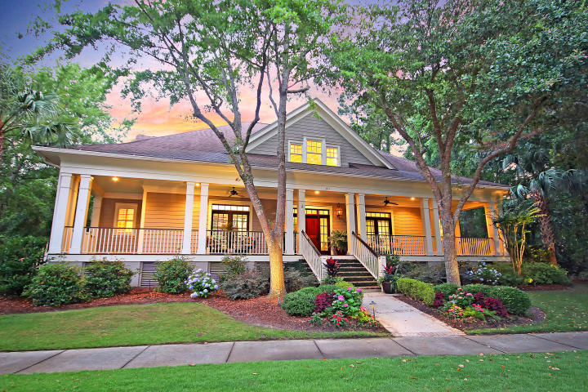

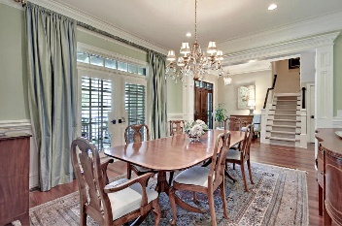
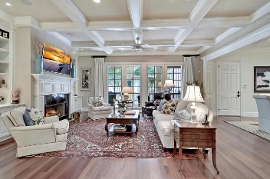
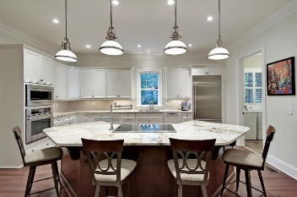
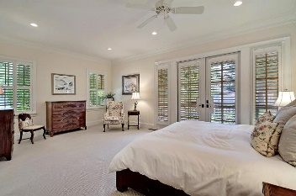
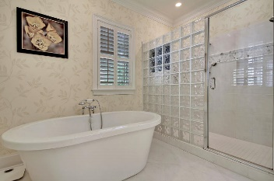
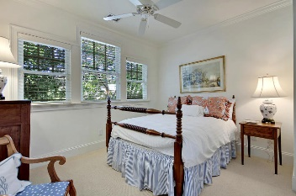
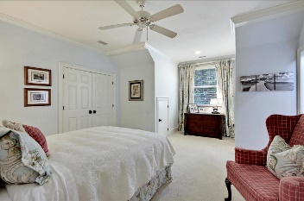
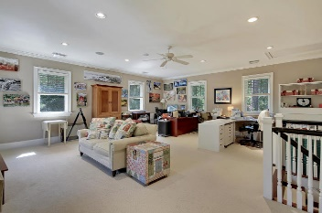
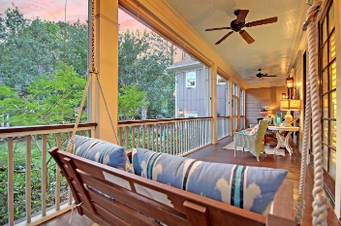
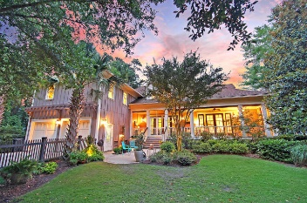
Price Reduced in Dunes West!
New A/C Units With Nest Controllers PLUS a 10 Year Warranty
$2,500 Agent Bonus
Open House Saturday & Sunday 1-3
393 Ralston Creek Street
Daniel Island, SC 29492 ~ MLS# 19016627 ~ $1,259,000
LUXURIOUS LIVING WITH LOWCOUNTRY CHARM ON DANIEL ISLAND!
Elegant living with high-end finishes awaits you with this stunning custom home built by Max Crosby on Daniel Island. Situated on a parklike, corner lot with mature trees that offer peaceful shade, this home welcomes you with a massive, wrap-around front porch where you can spend hours relaxing in a rocking chair enjoying the outdoors. The gorgeous, fenced-in, manicured yard is the perfect place to entertain, relax with a glass of iced tea or wine, enjoy the sway of the trees, and soak in the Lowcounty climate.
Joe Kavanagh joe@mattoneillteam.com 843-345-8506

