Slide 1
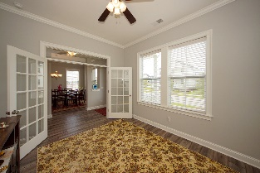
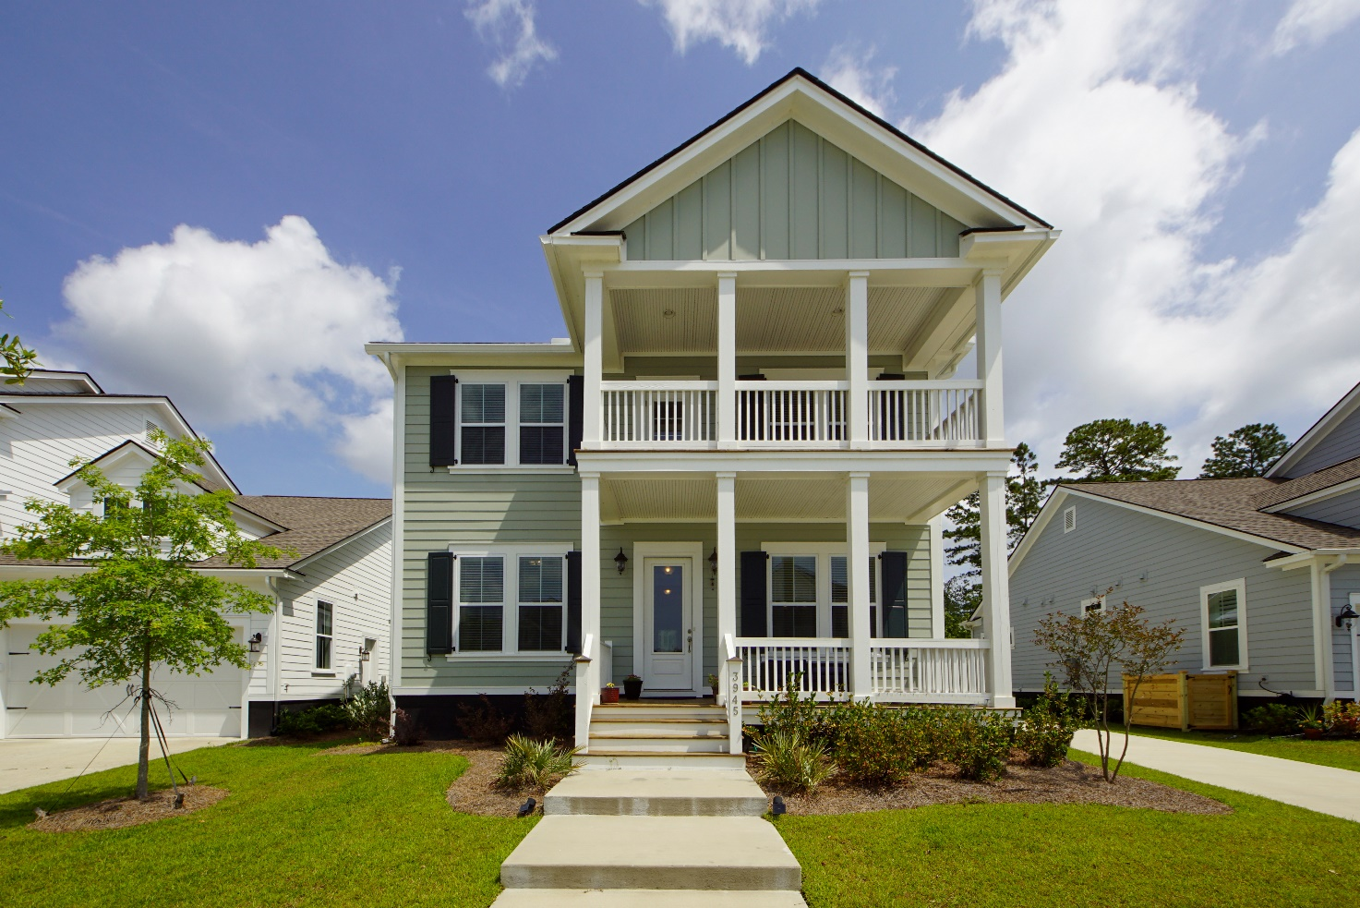
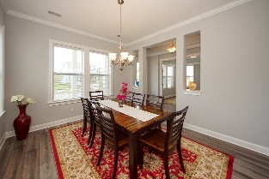
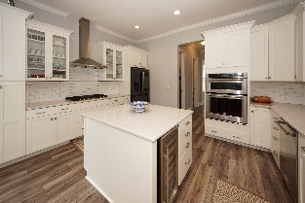
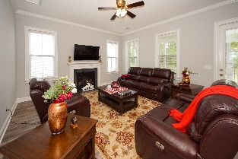
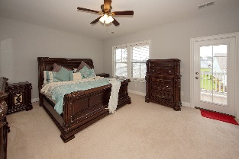
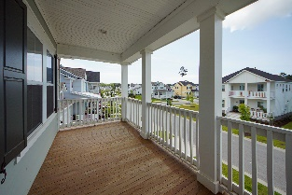
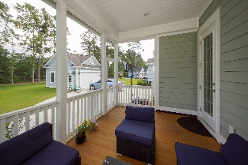
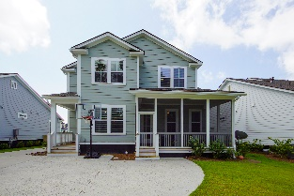
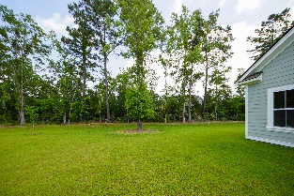


3945 Maidstone Drive
Carolina Park ~ Mount Pleasant, SC 29466
MLS# 20014717 ~ $595,000
Larger, Wooded Lot in Carolina Park Shows like a Model!
Beautiful Carolina Park four bedroom home with double front porches set on a private wooded quarter acre lot. Featuring the very desirable Wando Floor Plan, this home has a large modern gourmet kitchen with center island, 36-inch gas cooktop with hood and double oven, and opens to a family room with custom crown moulding and gas fireplace. A formal dining room and executive-style office are also on the first floor, as well as a guest suite with a full bathroom. Upstairs, the master bedroom features a beautiful ensuite bath, as well as three spacious bedrooms, full bath, and large loft space. A screened-in porch leads to an extra patio space outside.
A $2500 lender credit is available and will be applied towards the buyer's closing costs if the buyer chooses the seller's preferred lender. This credit is in addition to any other negotiated seller concessions.
Kristin Schatmeyer
Cell - (843) 697-7370
kristin.schatmeyer@carolinaone.com
www.KristinSchatmeyer.com
Carolina One Real Estate
2713 Highway 17 North
Mt. Pleasant, SC 29466

