Slide 1
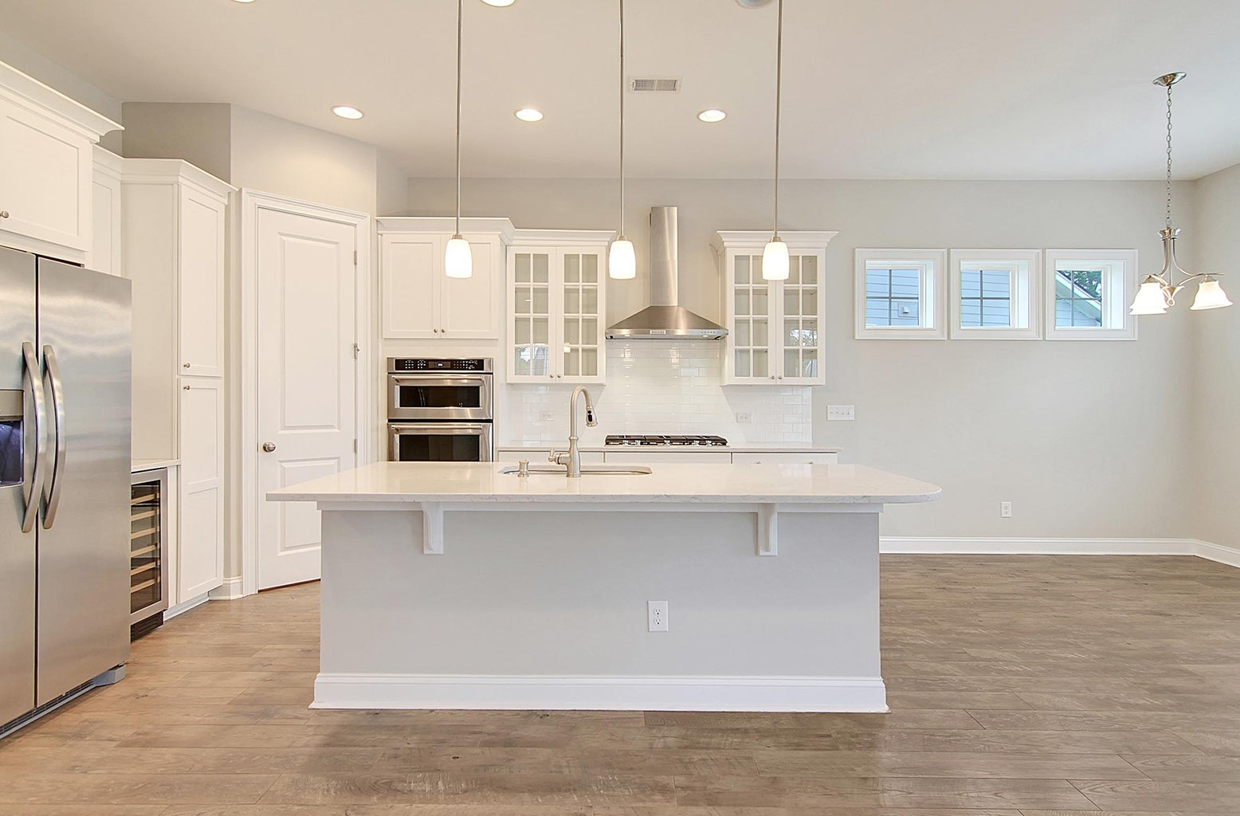
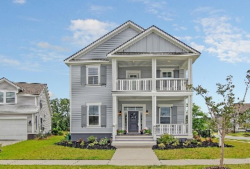
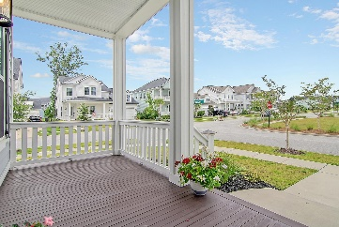
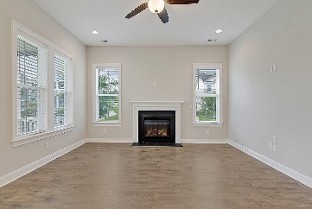
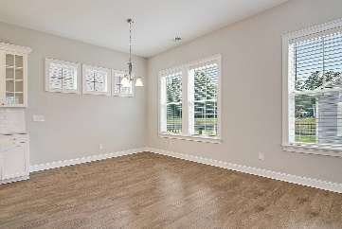
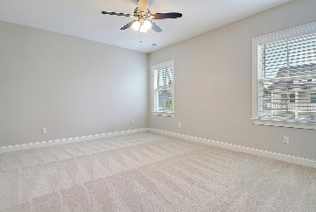
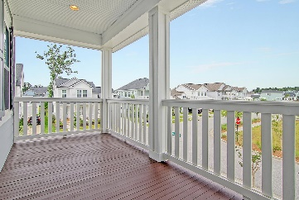
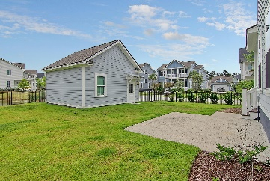
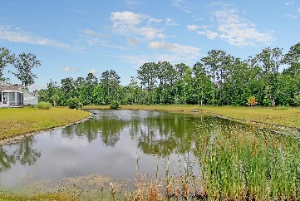

3953 Bryson Lane Carolina Park · Mount Pleasant, SC 29466 MLS# 23013528 · $825,000
Just Listed in Carolina Park
Stunning 4 bedroom 3 bath home with inviting double front porches, awesome curb appeal, in a cul-de-sac overlooking green space, on a corner lot, backing up to a pond in desirable Carolina Park-shows beautifully! Upon entering the house you are greeted with handsome floors, soaring ceilings, open floor-plan, and an abundance of natural light. To the left is a guest bedroom that could also be an office or flex room. Continuing in is a gorgeous chef-inspired kitchen that features 42-inch white cabinets, white quartz countertops, tile backsplash, stainless steel KitchenAid appliances with a 36-inch gas cooktop and hood vent, built-in oven and microwave, dishwasher, wine cooler, and French door fridge, under cabinet lighting, and a counter height island with pendant lights that looks into the dining area and family room complete with fireplace.Upstairs you will find the luxurious owner's suite with a walk-in closet. The spa-like ensuite bath offers: tile floors, dual vanities, a separate relaxing soaking tub, and separate shower with tile surround. Two additional nicely sized bedrooms share a full bath upstairs. Finally, the second level has an oversized walk-in laundry room. This home features eight foot solid doors downstairs, premium laminate wood floors throughout the common areas downstairs and hall upstairs, hardwood stairs with storage underneath, and a covered lanai with a patio overlooking the pond. Move-in ready!
Take a video tour: https://vimeo.com/837768283
Stan Huff
843-670-2835 stan.huff@agentowned.com
Jill Marcacci
843-297-5590 jill@agentowned.com
www.agentownedrealty.com
AgentOwned Realty Co. Preferred Group, Inc. | 824 Johnnie Dodds Blvd | Mt Pleasant, SC 29464

