Slide 1
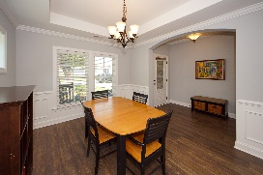
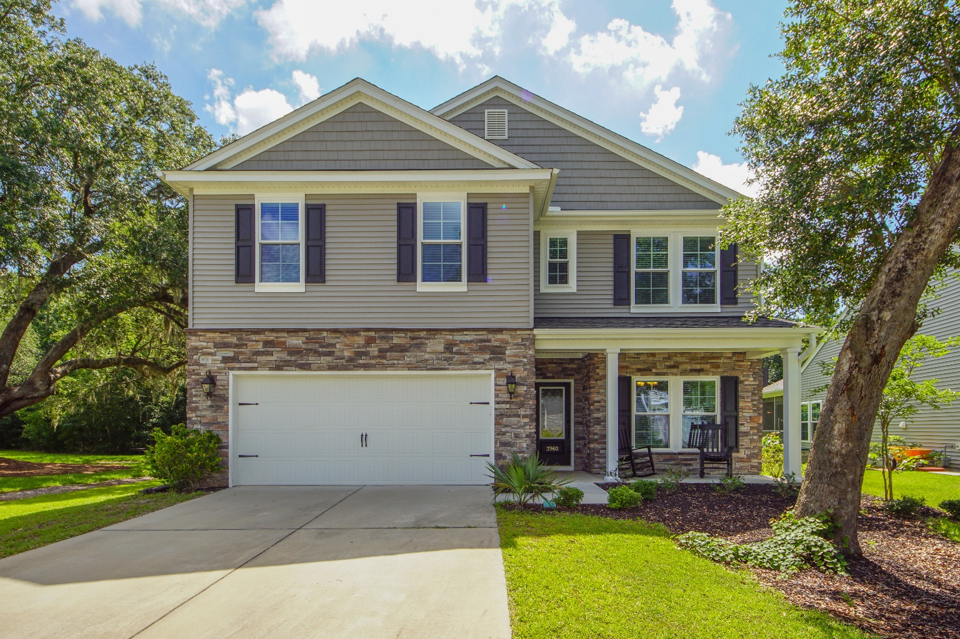
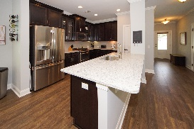
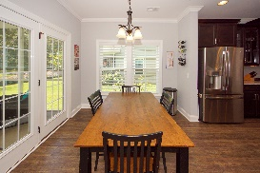
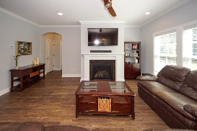
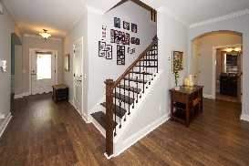
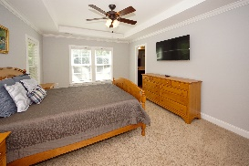

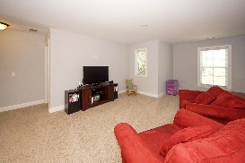
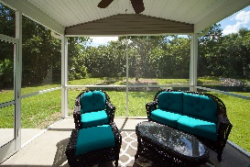
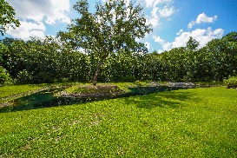
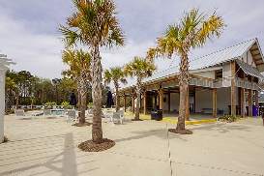


3960 Hanoverian Drive
Tupelo ~ Mount Pleasant, SC 29429 ~ MLS# 19019227 ~ $479,000
New 5 Bed/3 Bath With Private Wooded Pond Lot
$70,000+
Price Reduction
Nestled among large oaks and your own private pond and wooded buffer sits this like new 5 bedroom/3 bath home. Take advantage of this rare chance to have both the house and lot you've been waiting for! Besides the mature tress adding to the curb appeal, the front of the home has been beautifully upgraded with stone veneer. Inside you have all the spaces you need with an open concept family room and kitchen, dining room, bedroom/office and full bath all on the main floor. Upstairs you will find a spacious loft area, master bed and bath plus 3 additional bedrooms, another full bath and laundry room. The kitchen comes complete with a large island, granite countertops, and all stainless appliances. The kitchen leads right onto the back screened porch and outside patio making entertaining a breeze. A trail right outside your back door makes for easy hiking/walking through the woods.
Updates to this unit include:
Tankless water heater
Wiring for surround sound
Crown molding
Extra storage space in the attic
Garage sink
Security system
Tupelo is conveniently located right off Hwy 17 close to schools, recreation areas, a hospital, shopping, dining and a boat/kayak/paddleboard launch. Neighborhood amenities include a community pool and pavilion and play park. Downtown Charleston and the beaches are only 20 min away! Come see this beautiful home for yourself!
Melodie Smith
(843) 408-5067 M
melodie.smith@exprealty.com
www.melodiesmith.exprealty.com

