Slide 1
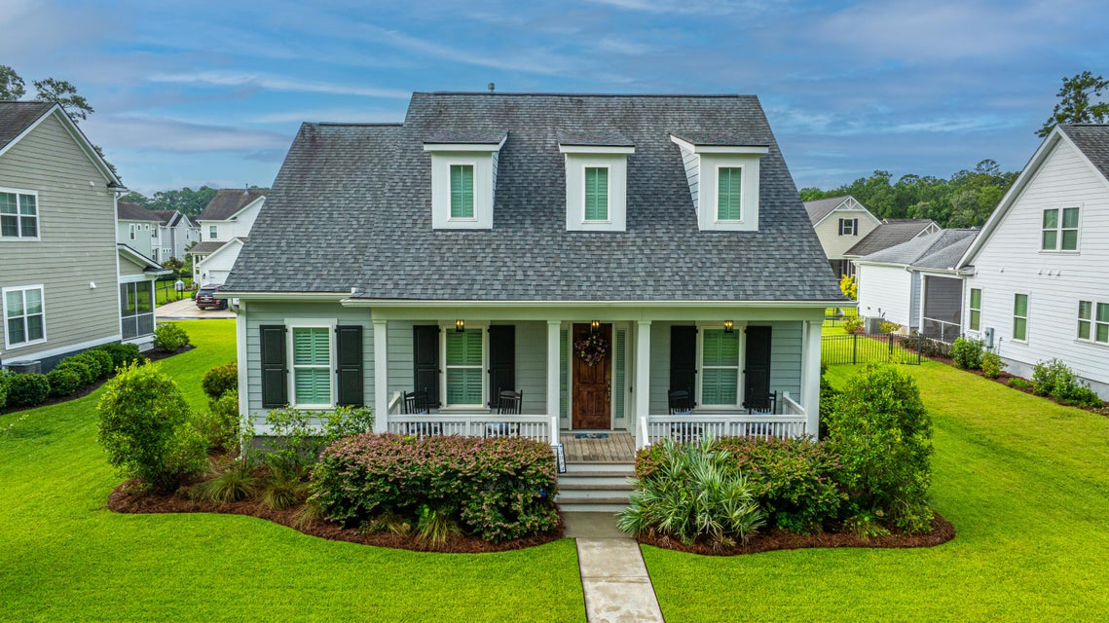
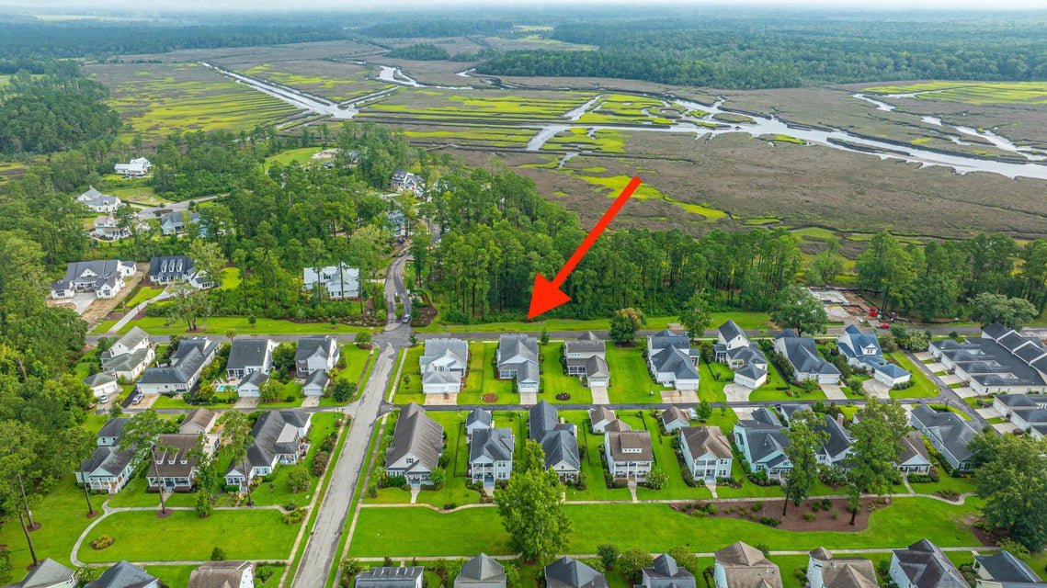
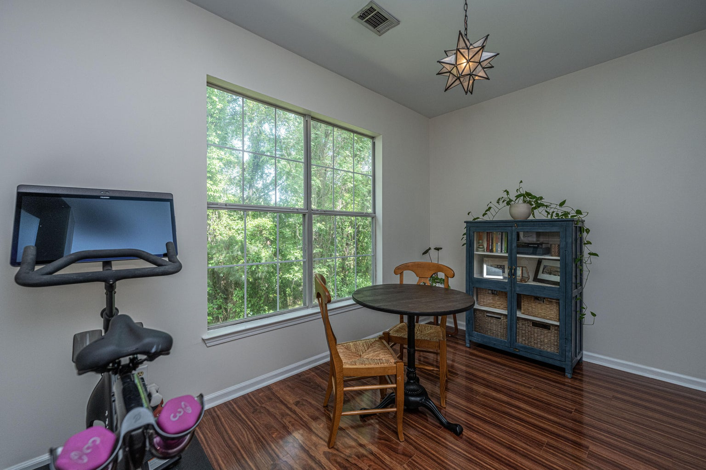
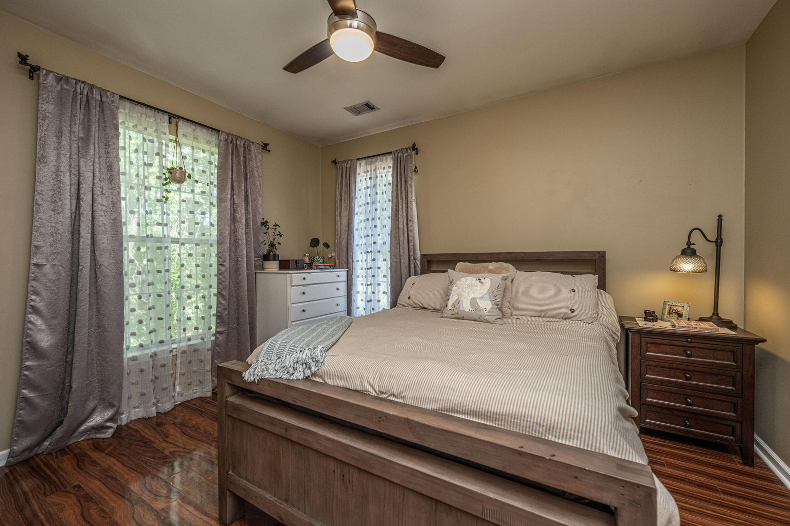



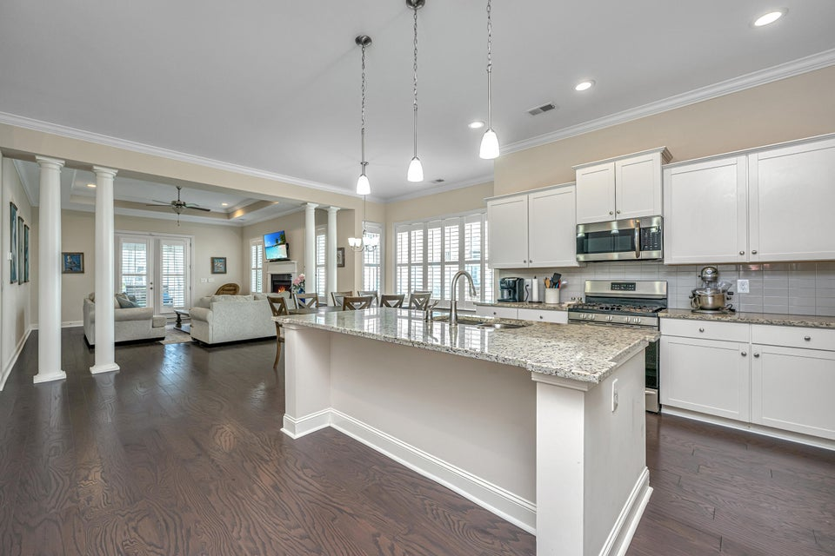
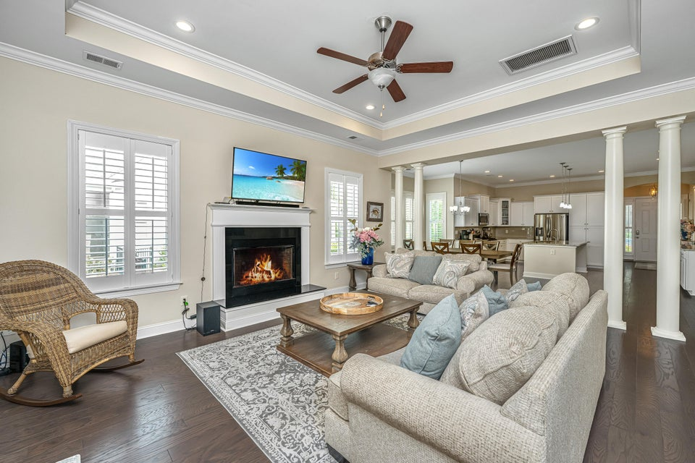
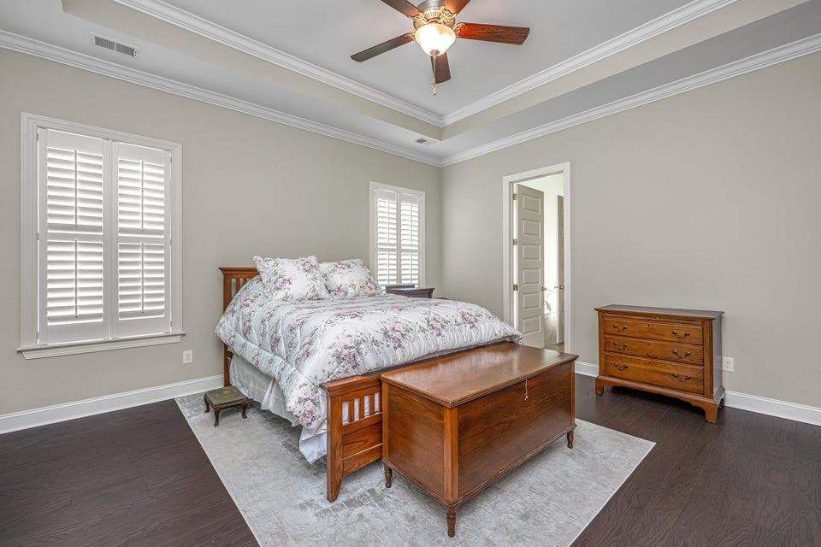
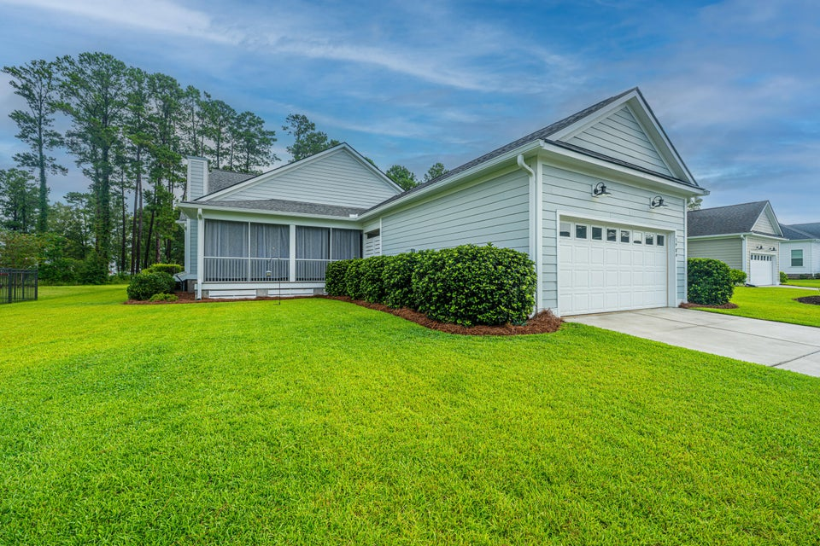

Open House! March 7th from 12 -2p
This stunning 5br, 4.5ba low country custom built home by Simonini Home Builders has been meticulously cared for situated on a .60 acre heavily treed lot on large pond in private gated community of Popular Grove. This spacious , two story, 4721 square foot home features master bedroom suite on the first level, full front porch, beautiful heart pine wood flooring, large entry foyer which separates the private study from formal dining room, open gourmet kitchen with Wolf 6 burner gas stove, built in SubZero refrigerator/freezer, dishwasher, microwave oven and large pantry. Half bath/Powder room under stairway and large utility room for washer and dryer and deep sink and built in cabinets off hallway. The smaller den with gas log fireplace opens to kitchen and breakfast room. The larger fireplace opens to kitchen and breakfast room and offers expansive views of the water year-round. The living room with its second gas log fireplace is great for entertaining away from dining areas. The large master bedroom suite is located on the first level and has travertine tile flooring in the master bath, his and hers walk in closets, separate vanities, soaking tub, and a large separate shower. There is a game room with separate stairs over the two-car garage large enough for a pool table. The second level boasts 4 spacious bedrooms and three bathrooms. On the rear of home is a large screened in porch and open deck overlooking firepit and pond. To reduce maintenance the exposed wood decking has been replaced with Trex decking and exposed rail caps with PVC. Yard has irrigation system and 120-gallon buried propane tank. Sellers just replaced roof with 50 year architectural shingles with transferable warranty. The two electric water heaters have been converted to a single LP gas fired tankless water heater. New epoxy coating on floors and newly finished walls now in two car garage. Neighborhood amenities include Privacy gate, Boat Ramp, Dock facilities, Exercise area, Pool, RV/boat storage and walking/jogging trails. Don't forget the fantastic equestrian center for your horses!
3984 Berberis Lane
Poplar Grove | Ravenel, SC 29470 | MLS# 25021028 | $764,000
NEW LOOK & NEW PRICE!! Welcome to charming Lowcountry living in the highly desirable Poplar Grove community. LOCATED just 5 minutes from local shops, grocery stores, and restaurants, and approximately 25-30 minutes from historic Downtown Charleston! A SPACIOUS & well maintained Single-Level home is perfectly positioned on a Premium lot, offering both comfort and convenience. This home provides an ideal balance of serenity and accessibility. Inside, you'll find a bright, open layout designed for effortless everyday living. Plantation Shutters throughout add timeless Southern elegance, while abundant natural light enhances the home's inviting feel. The Primary Suite provides comfort and privacy with walk-in closets,& spacious ensuite bathroom complete with garden tub & Large walk-in shower. Two additional bedrooms offer flexibility for guests, a home office, or hobbies. Additional highlights include a dedicated laundry room with washer and dryer, and an attached two-car garage.
2/26/2026 RECENT Enhancements to Exterior of Home
Freshly Painted Front Door and Front Porch and Railings and columns freshly painted. Screened Back Porch and Breezeway to Garage Freshly Painted and Stained. New landscaping/ New pinestraw around the Entire Exterior of the Home!
Enjoy the outdoors from the private screened back porch, ideal for relaxing in the tranquil setting Poplar Grove is known for. Residents of Poplar Grove enjoy exceptional amenities including a community dock, boathouse, boat landing, kayaking, fishing, crabbing, an equestrian center with boarding, and miles of walking, biking, and horseback riding trails. The community also features a marsh-front observation deck, fitness facility, and a saltwater pool. Just minutes from parks, shopping, dining, and major thoroughfares, this move-in-ready gem offers both tranquility and convenience. Don't miss your opportunity to call this beautiful home your own!
4
3
1,844
Robyn Lane 843-222-5599
robynlane01@icloud.com
Jenny Siggelkow 843-901-3494
jcsiggelkow@gmail.com
ERA Wilder Realty | 802 Johnnie Dodds Blvd | Mt. Pleasant, SC 29464

