Slide 1
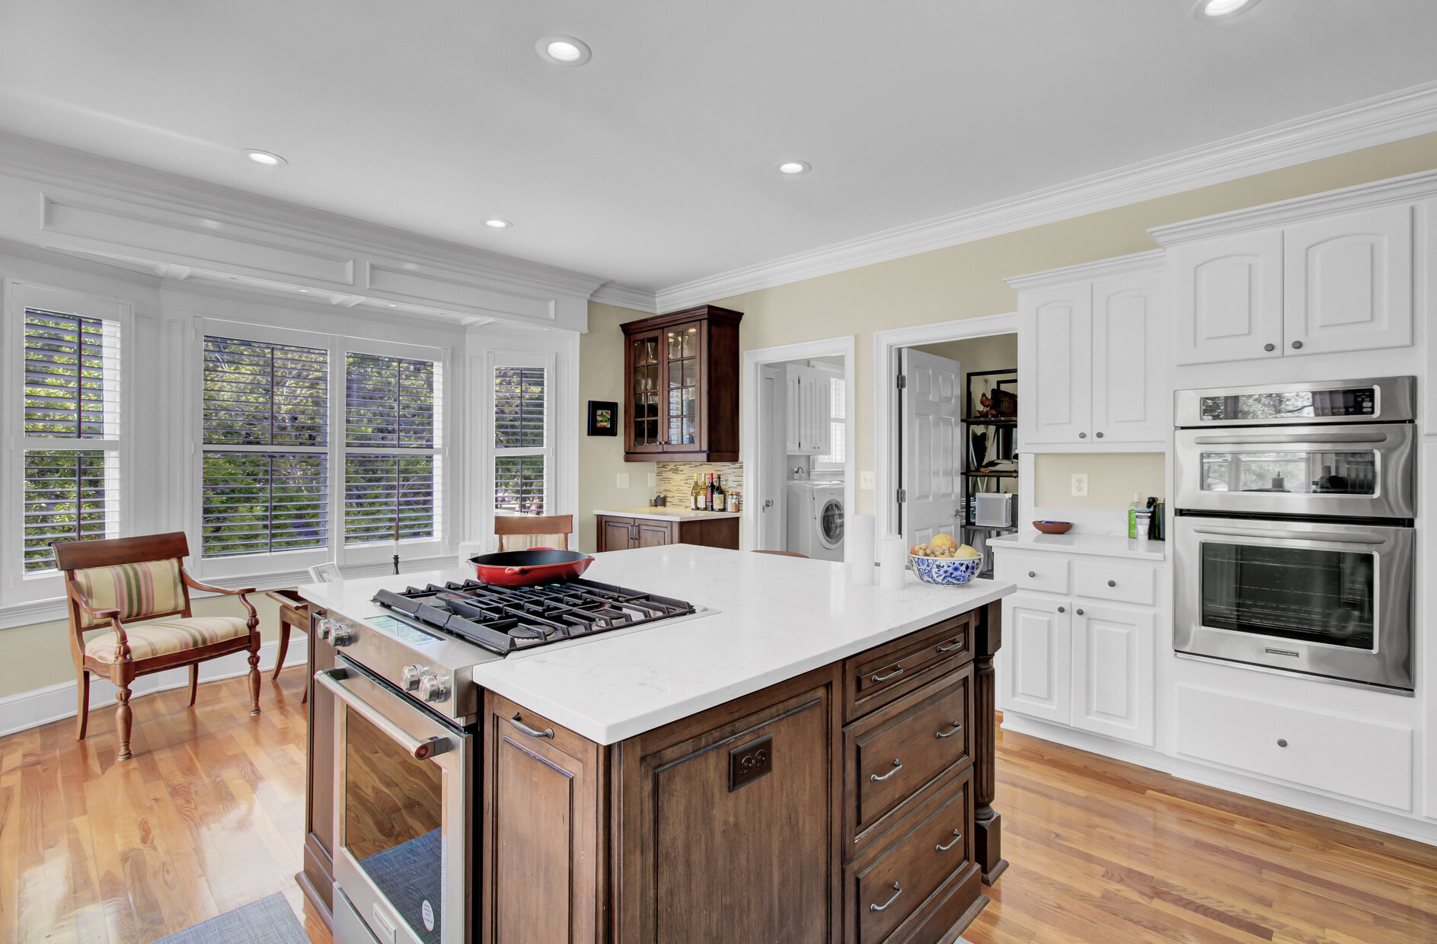
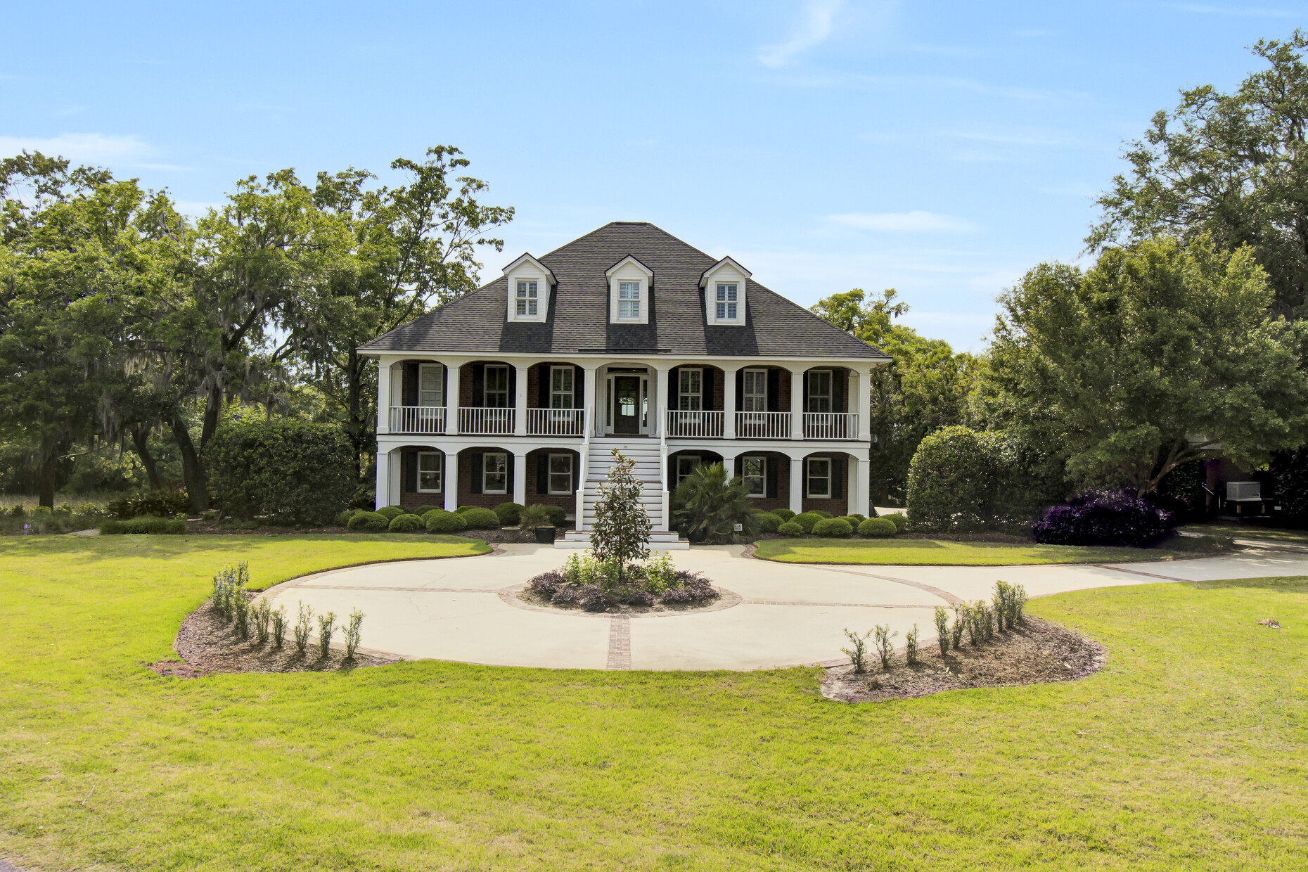
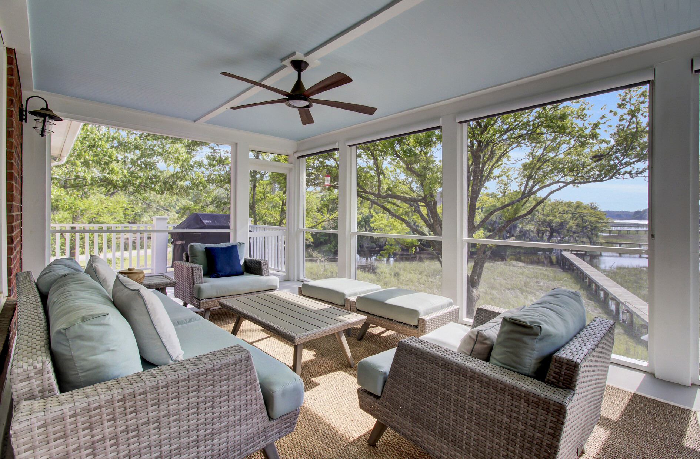
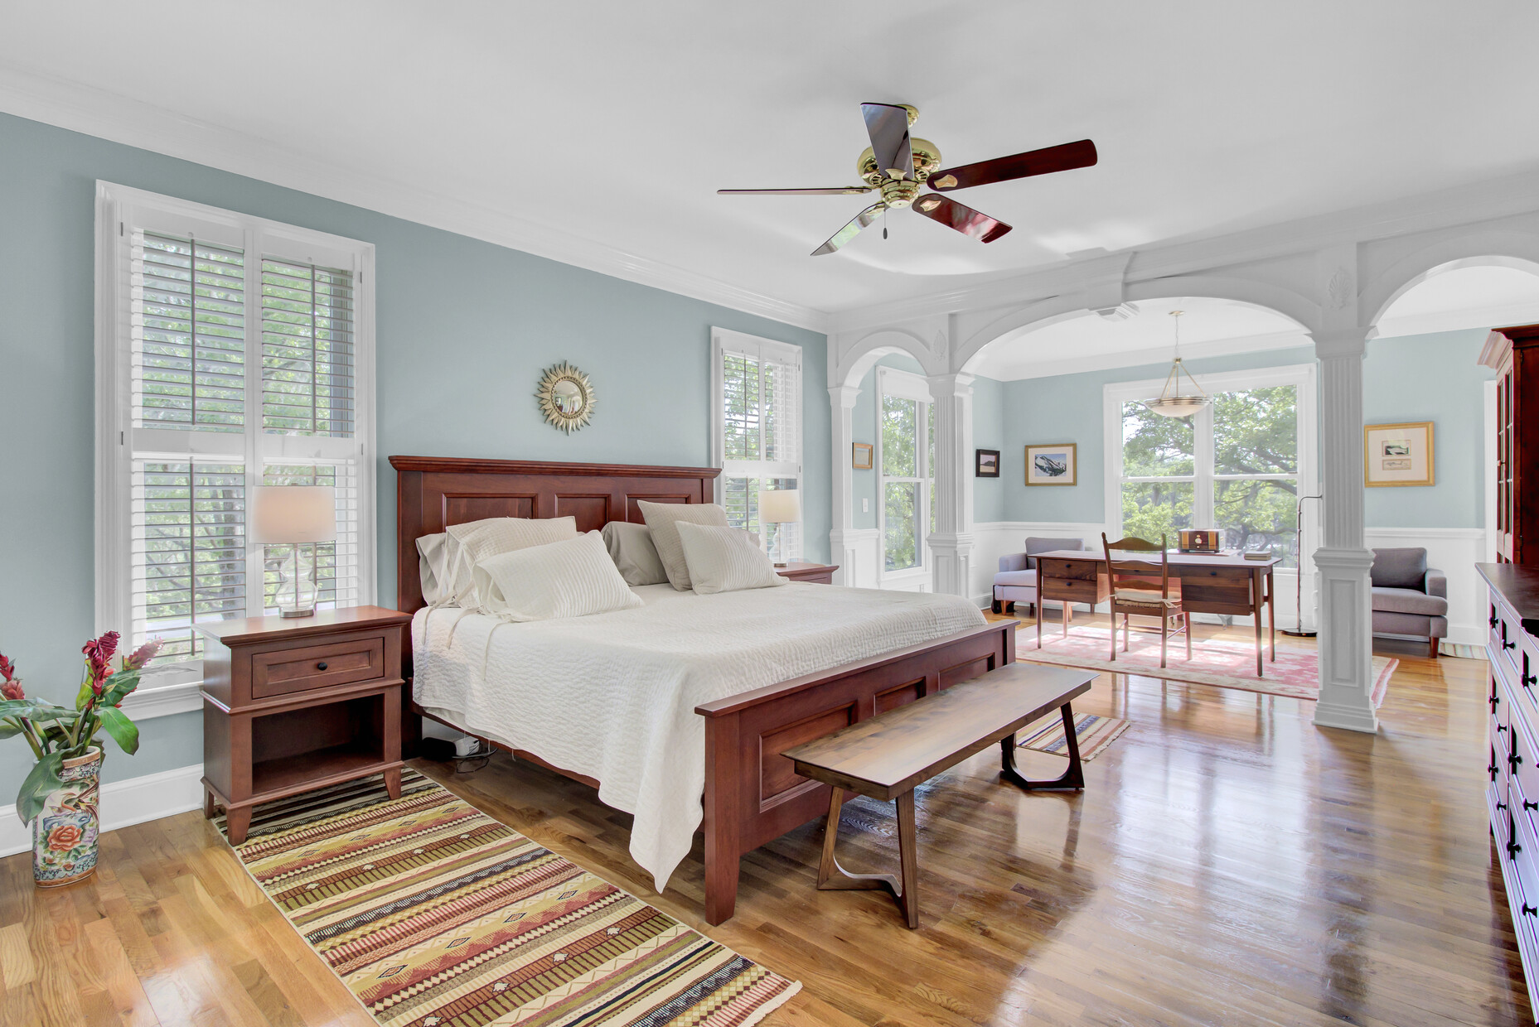
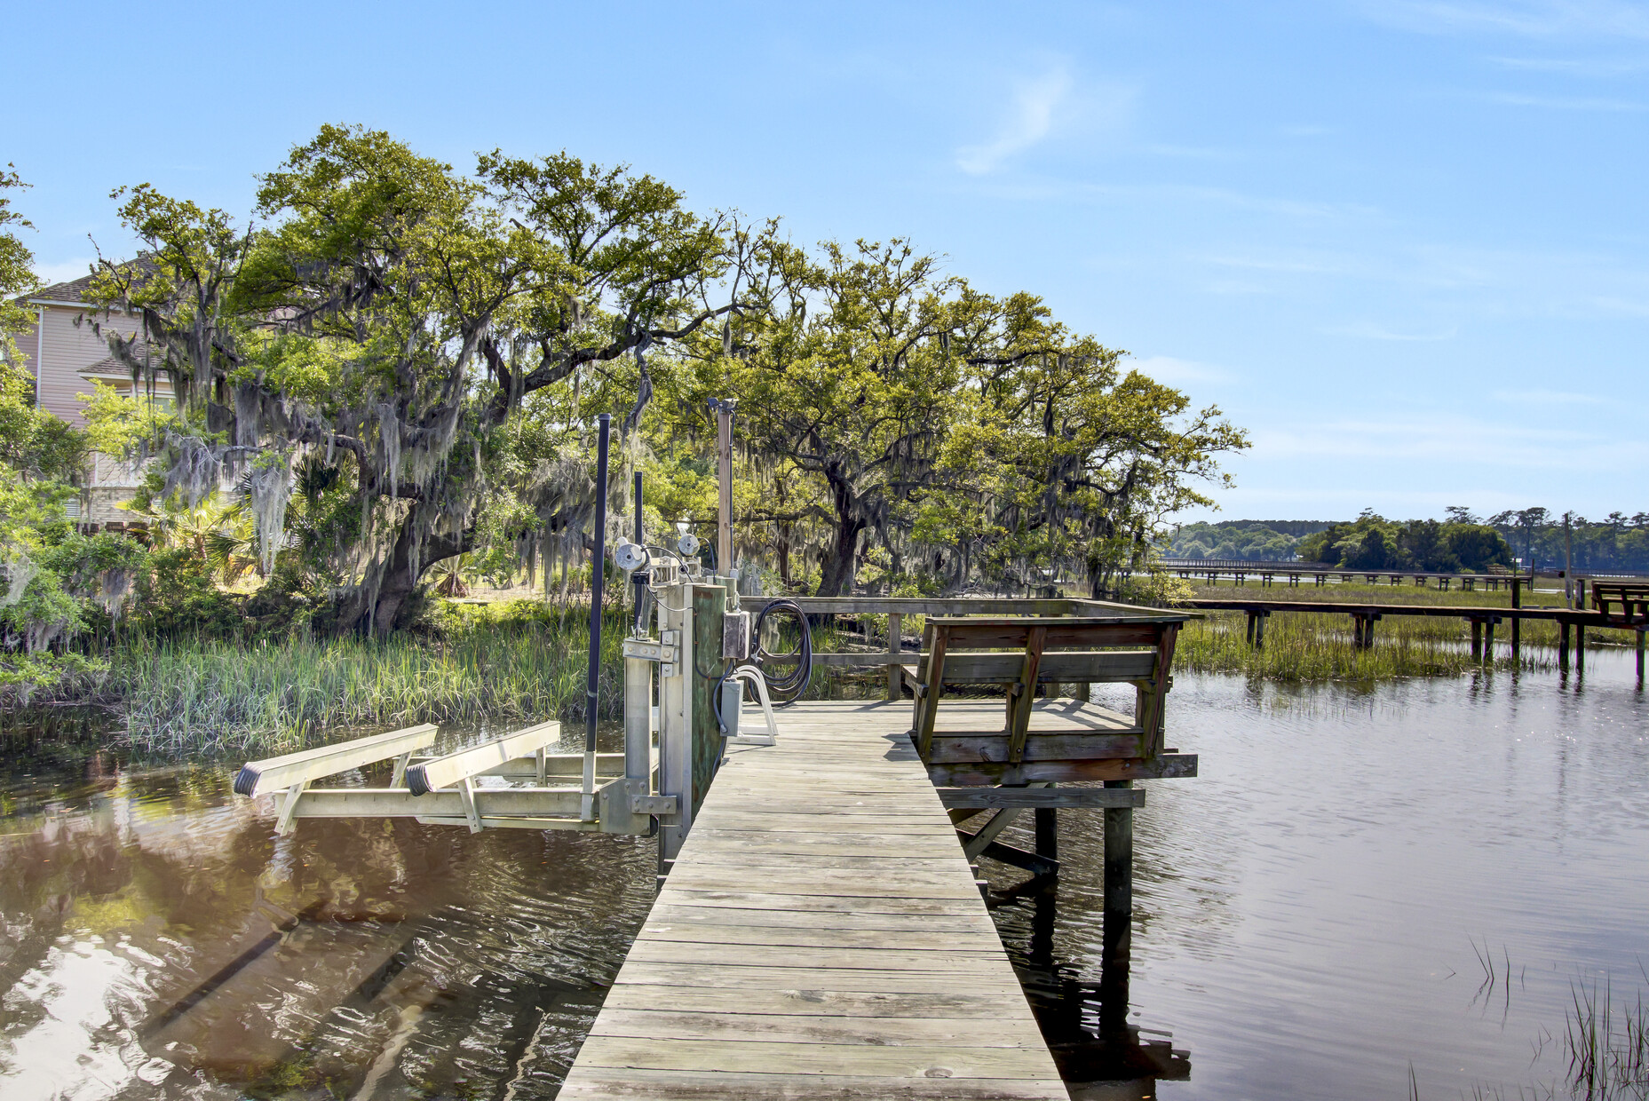
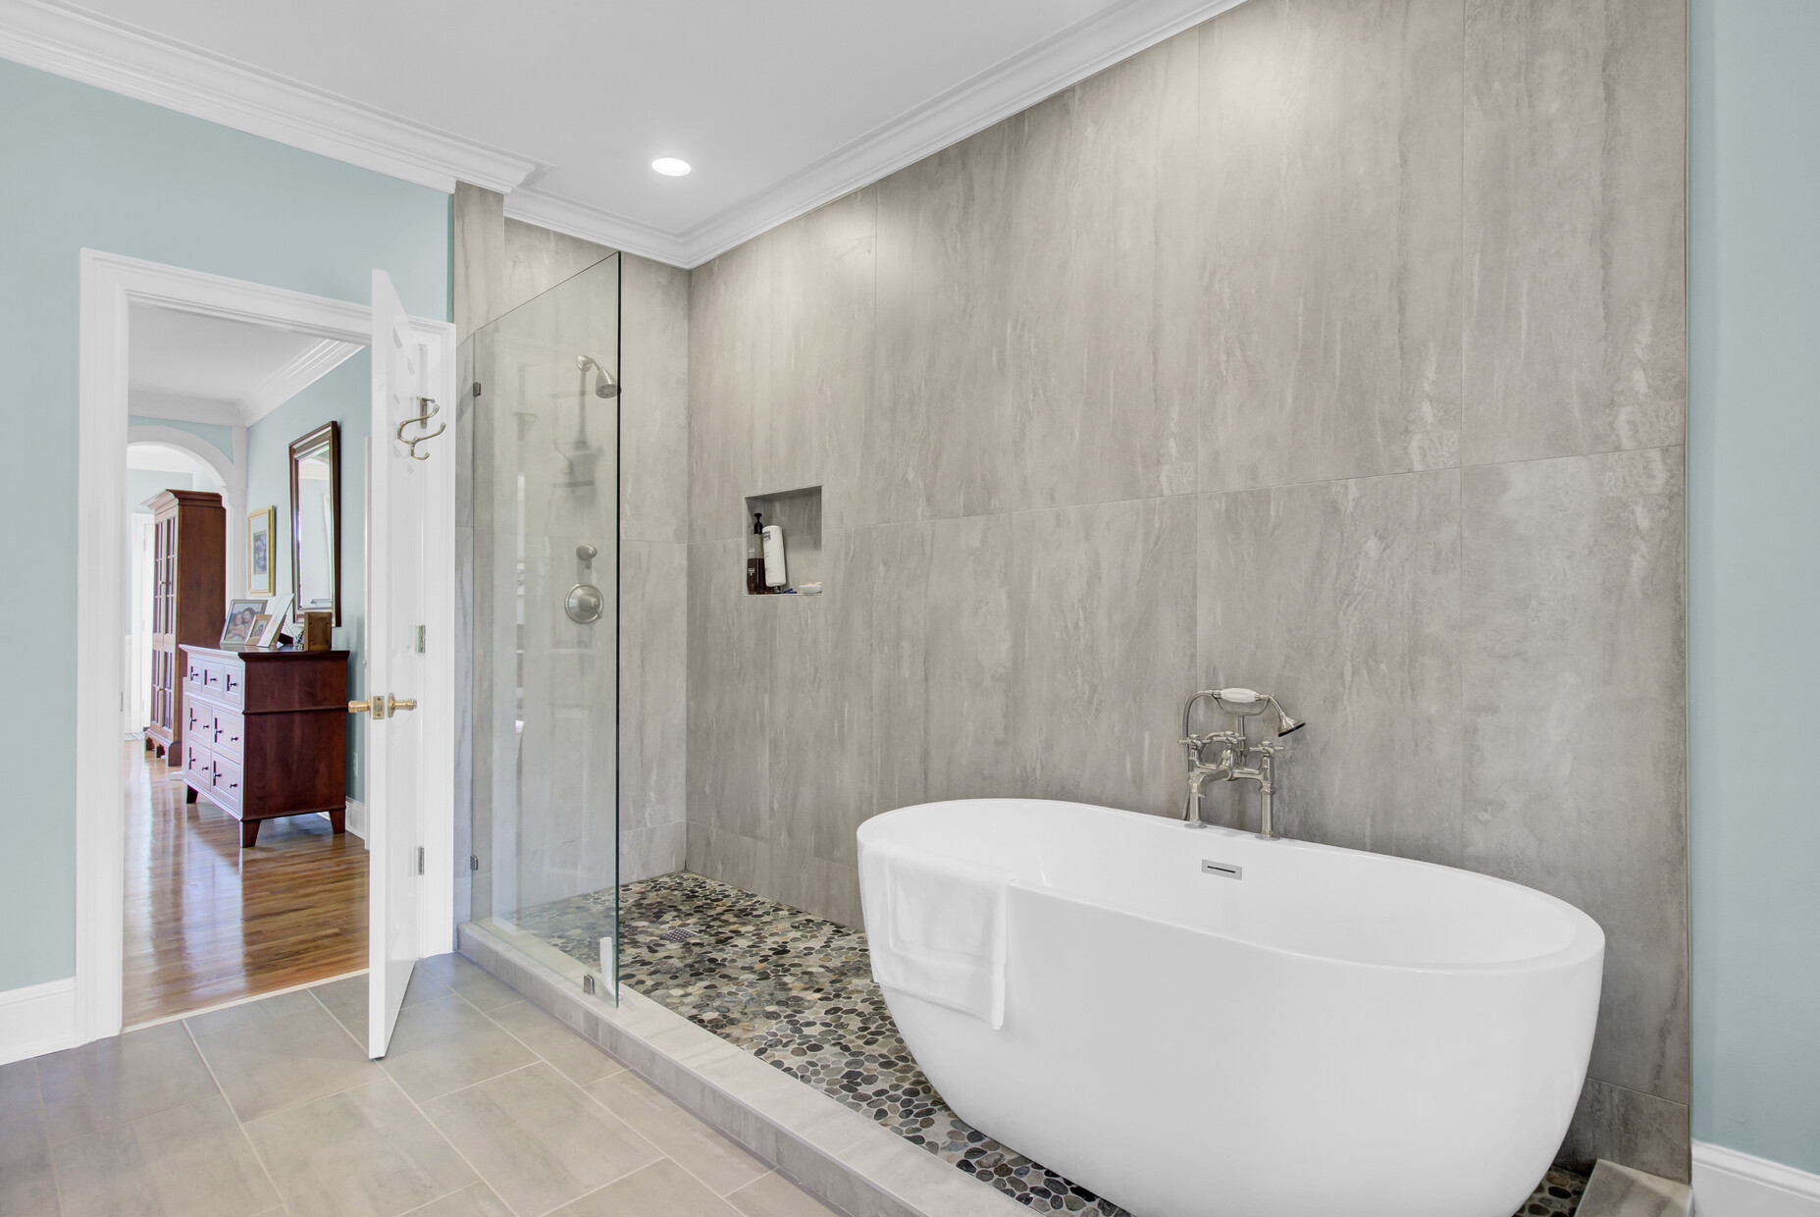
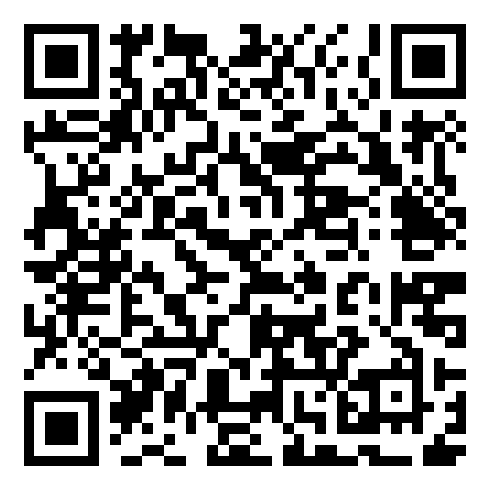
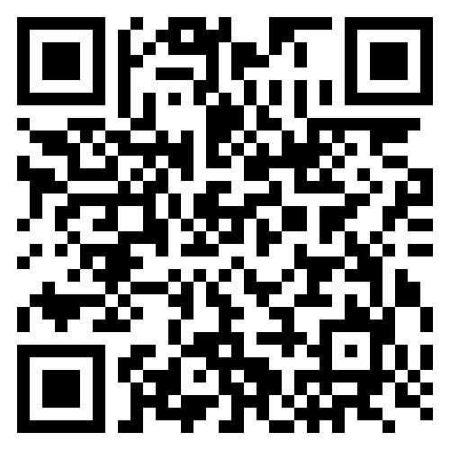


Stunning Custom Home With Private Dock And Boat Lift!
3984 Gift Boulevard
Gift Plantation
Johns Island, SC 29455
MLS# 24009938 | $1,795,000
Property Website
Video Tour
This home is perfect for anyone who loves the CONVENIENCE of hopping on the boat in their own back yard!
Elevated custom home with over 4600 sf including 4 bedrooms and 4.5 baths in gorgeous Gift Plantation. Priced at $1,795,000 this offers an UNBELIEVABLE Value!
Spend this summer on the Stono or just relax on one of the many porches taking in the marsh and river views. Bring your clients to see this home and take advantage of this amazing opportunity.
Property Website | Video Tour
Ellen O'Neil
Broker/Owner, ABR, e-PRO, CNE
Charleston Realtor of Distinction
843-300-8530
www.EllenONeilProperties.com

