Slide 1
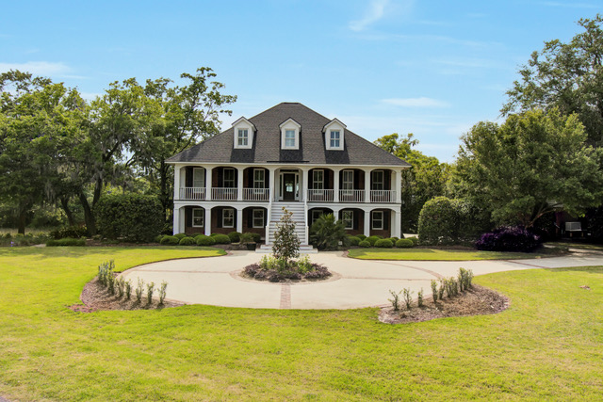
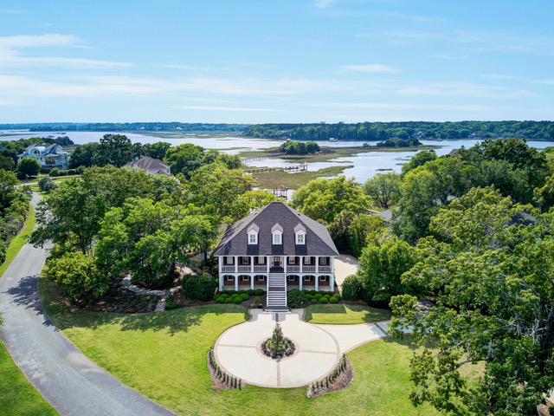
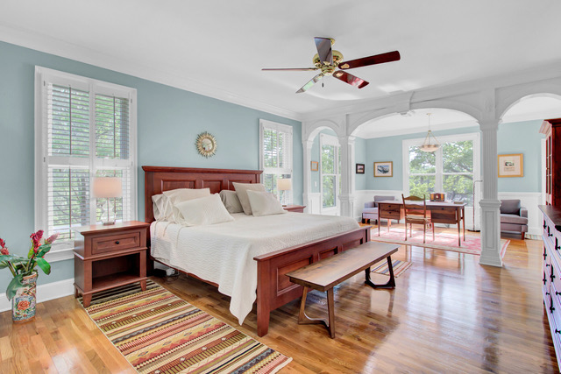
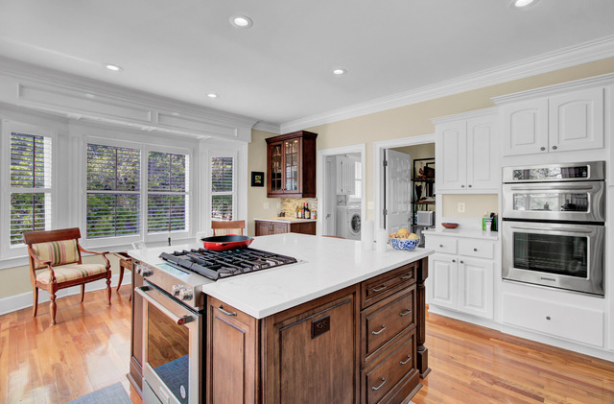
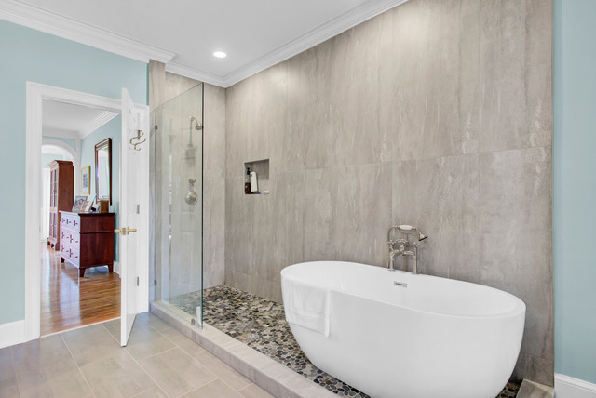
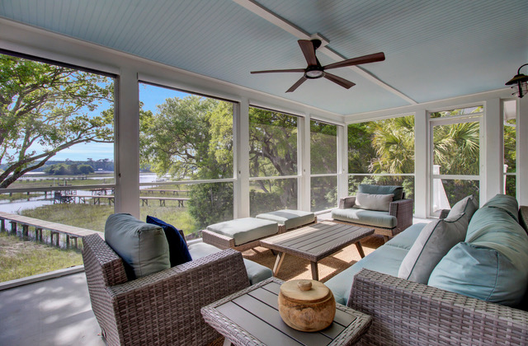
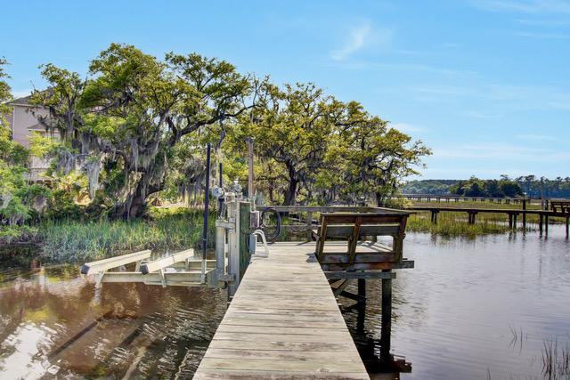
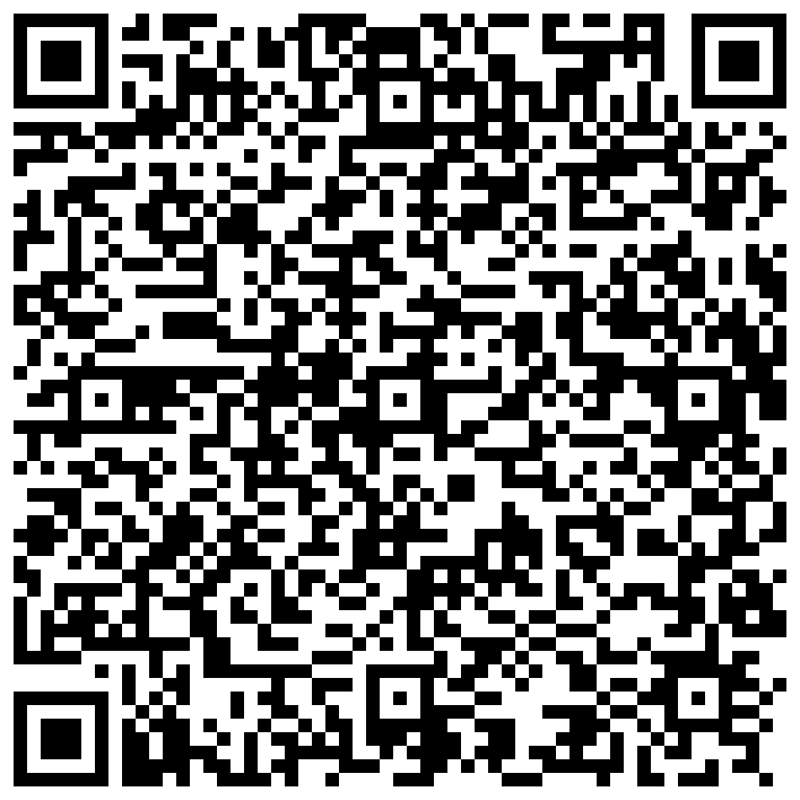


Waterfront Dream Home in Gift Plantation
3984 Gift Boulevard
Gift Plantation
Johns Island, SC 29455
MLS# 24009938 | $1,990,000
Video Tour
Elegance, Charm, Quality Construction - You can have it all in this magnificent waterfront home in the highly sought after community of Gift Plantation. Over 4600 square feet offering 4 bedrooms and 4.5 baths- this custom elevated brick home is sure to impress the most distinguishing of buyers.
Boaters will love the easy access to the Stono River from their own private dock with boat lift. Set upon a large private lot, the professionally landscaped grounds provide an outdoor oasis. Views of the water and marsh soothe the soul and can be enjoyed throughout the home which has a fantastic floor plan including a primary suite on the main level.
The kitchen is a chef’s delight with gas cooking and new stylish quartz counters. There are multiple porches, screened and open air, from which to enjoy the views and beautiful weather. The home has been upgraded and enhanced in numerous meaningful ways- a wonderful opportunity for someone who appreciates quality craftsmanship and natural beauty.
Schedule your tour of this fine home to see for yourself that this is a rare find.
Video Walkthrough
Ellen O'Neil
Broker/Owner, ABR, e-PRO, CNE
Charleston Realtor of Distinction
(843) 300-8530
www.EllenONeilProperties.com

