Slide 1
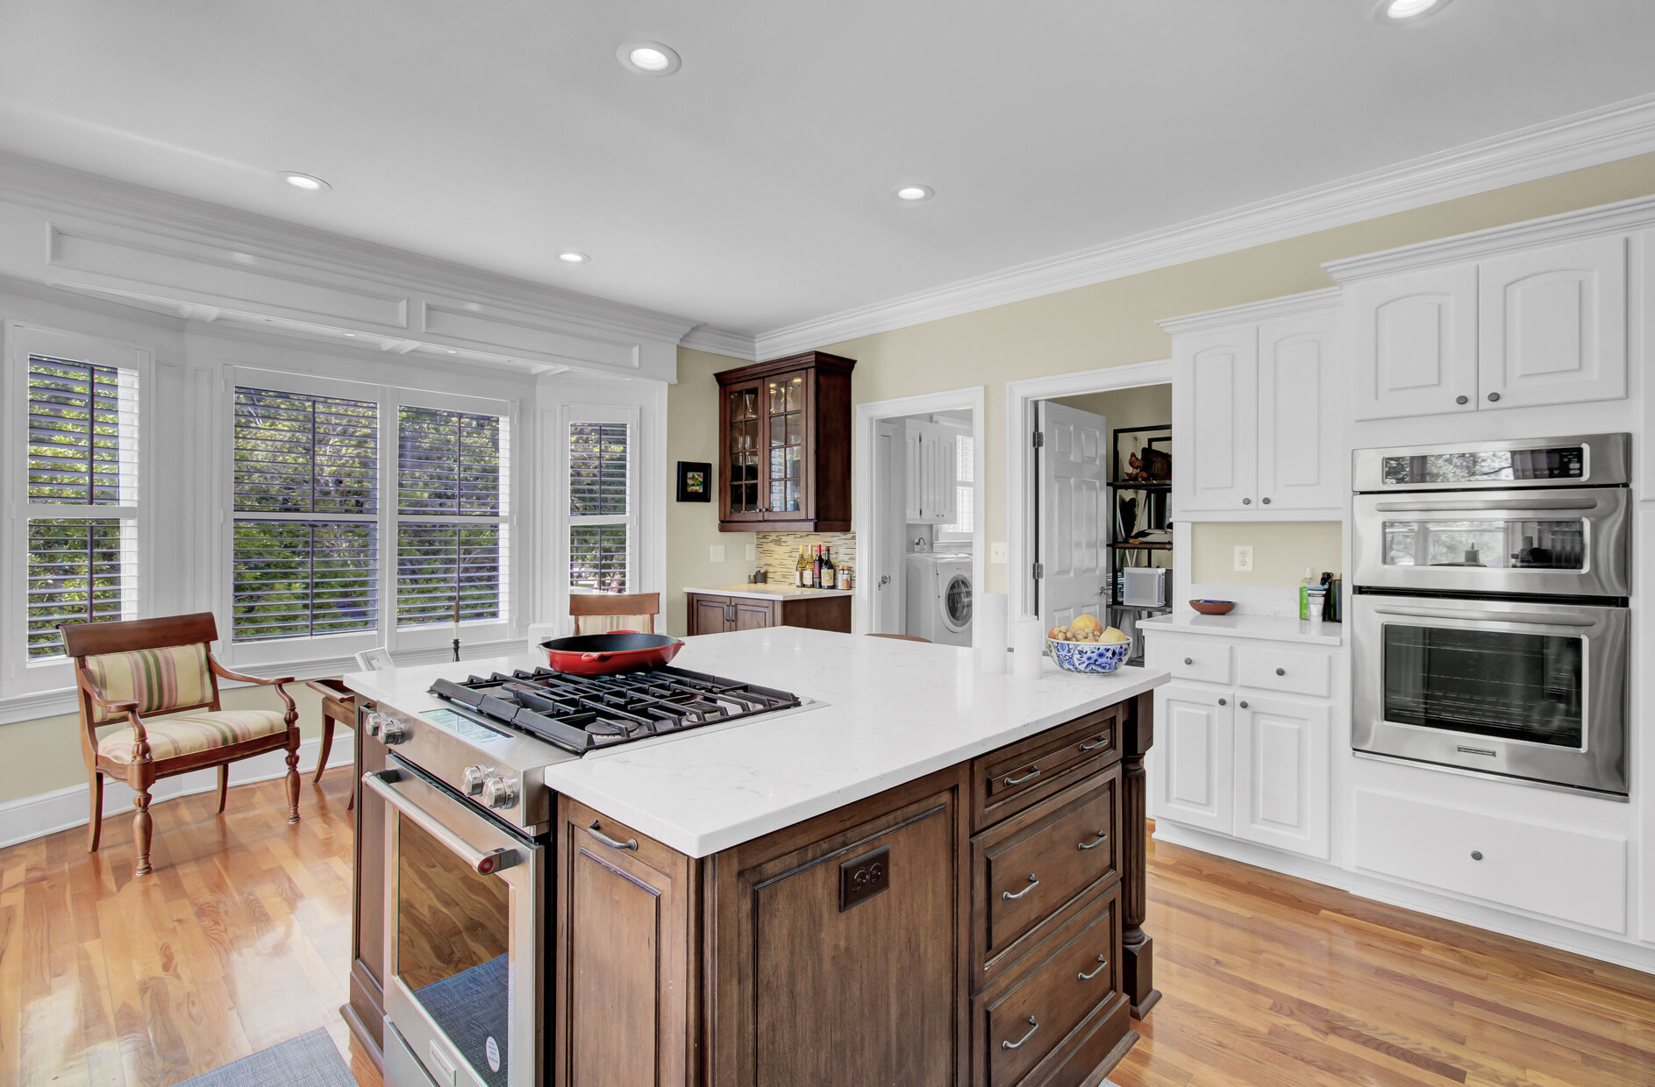
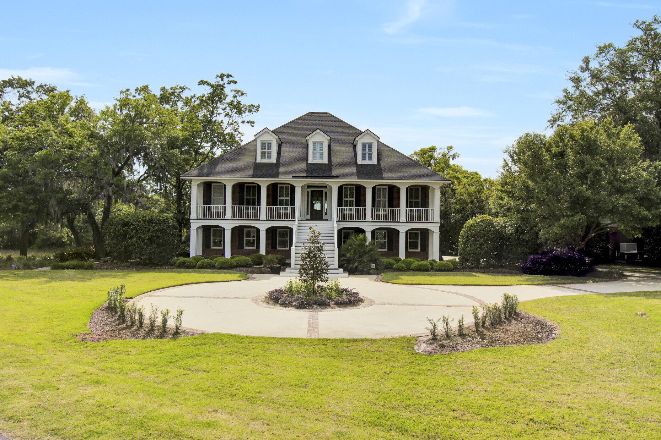
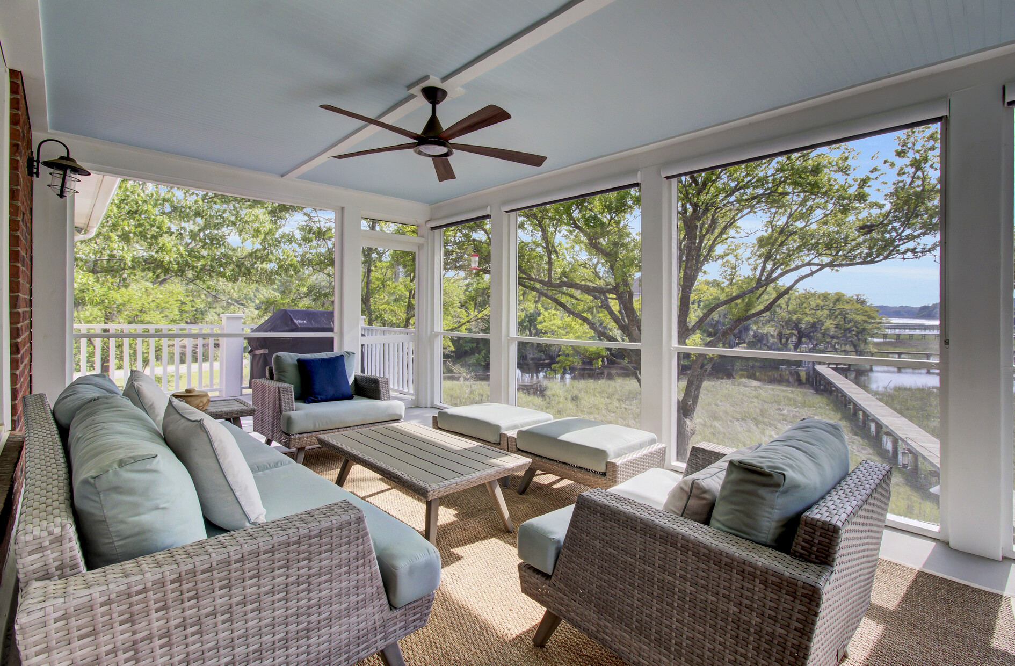
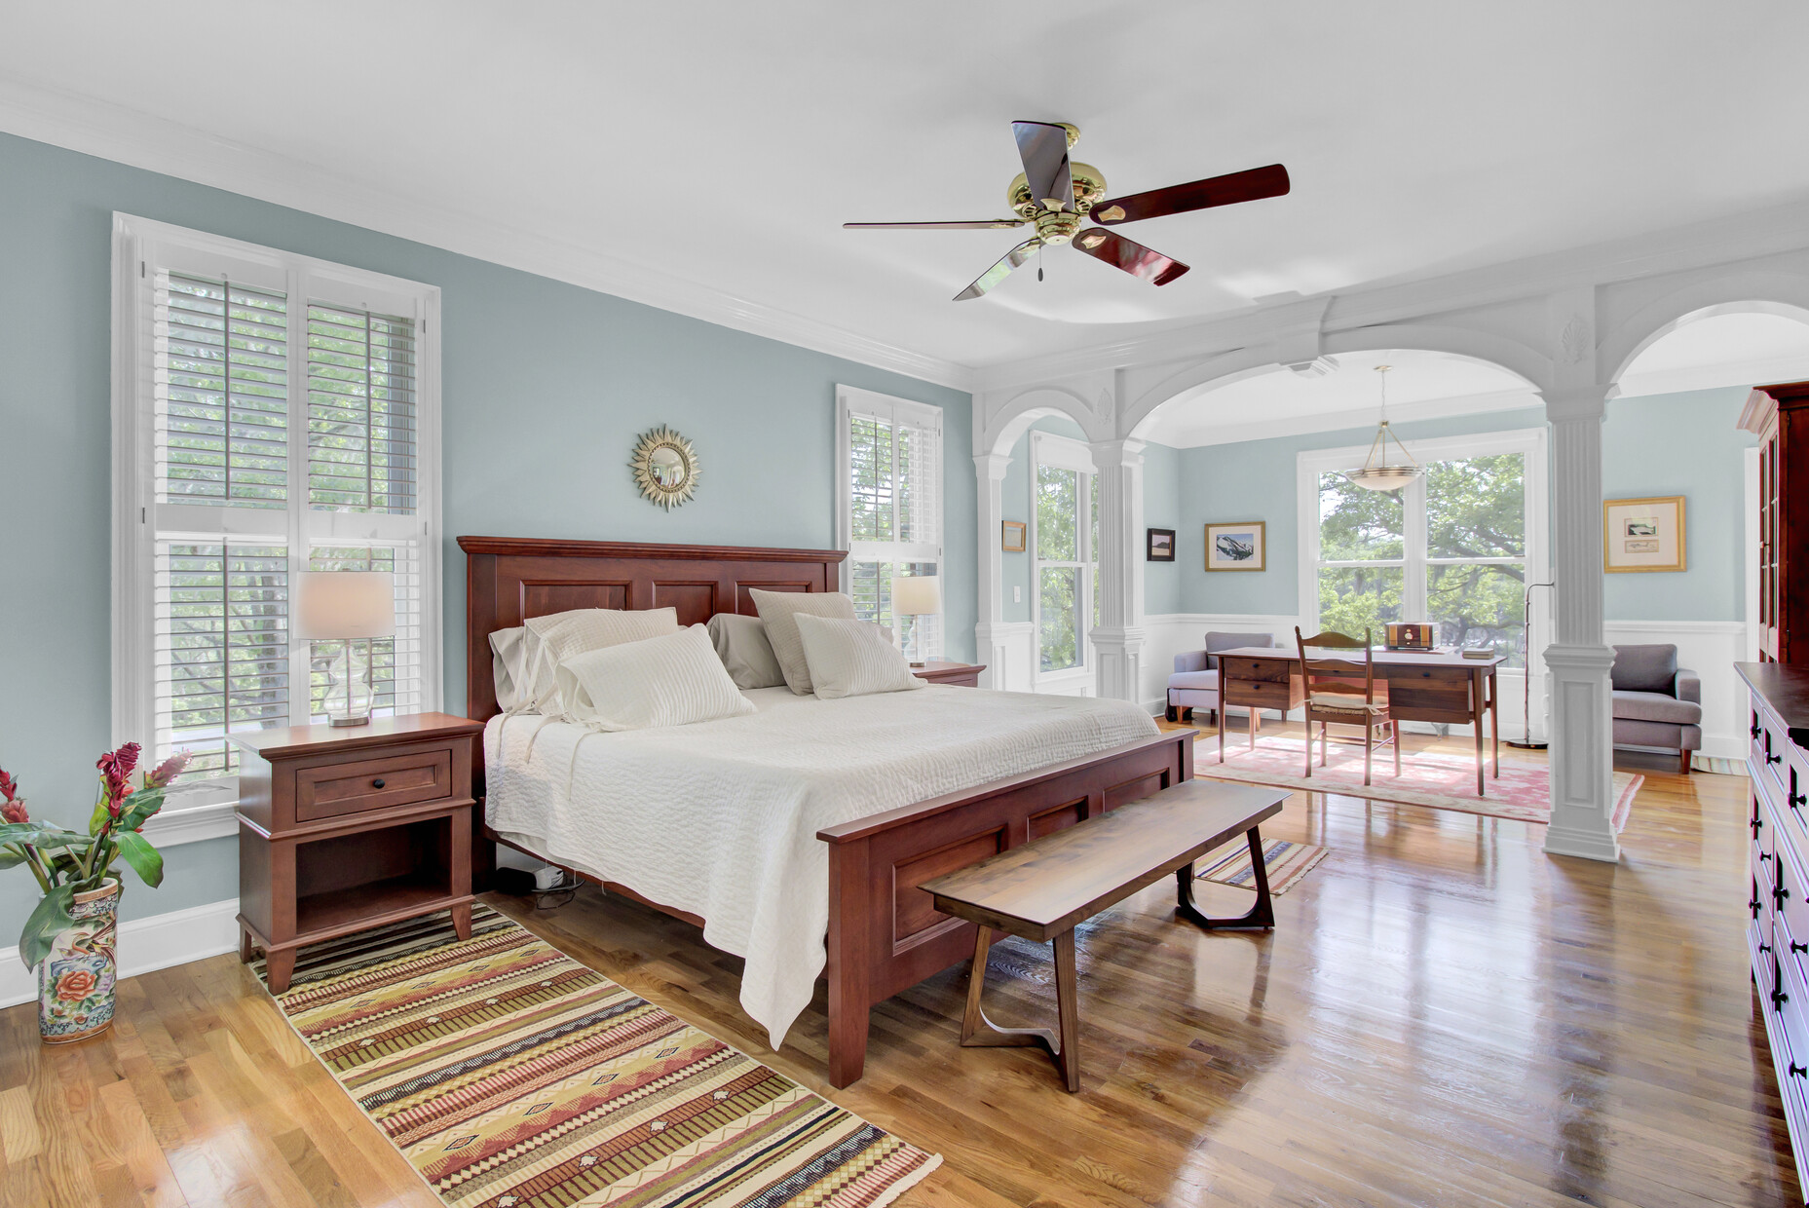
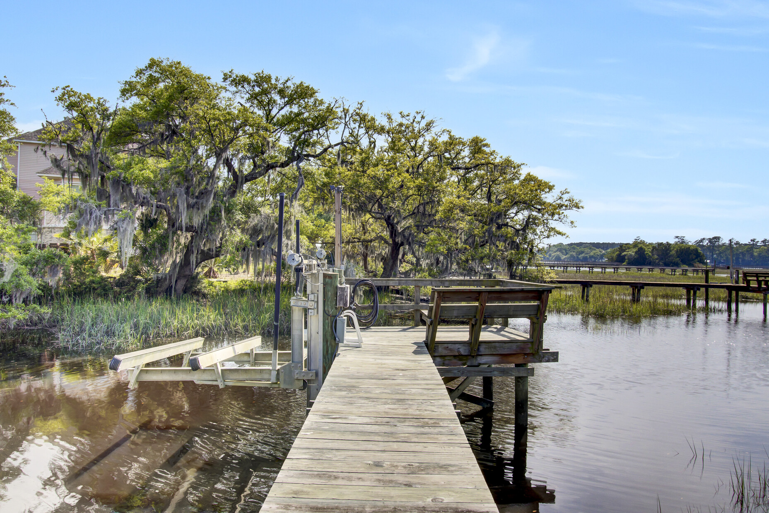
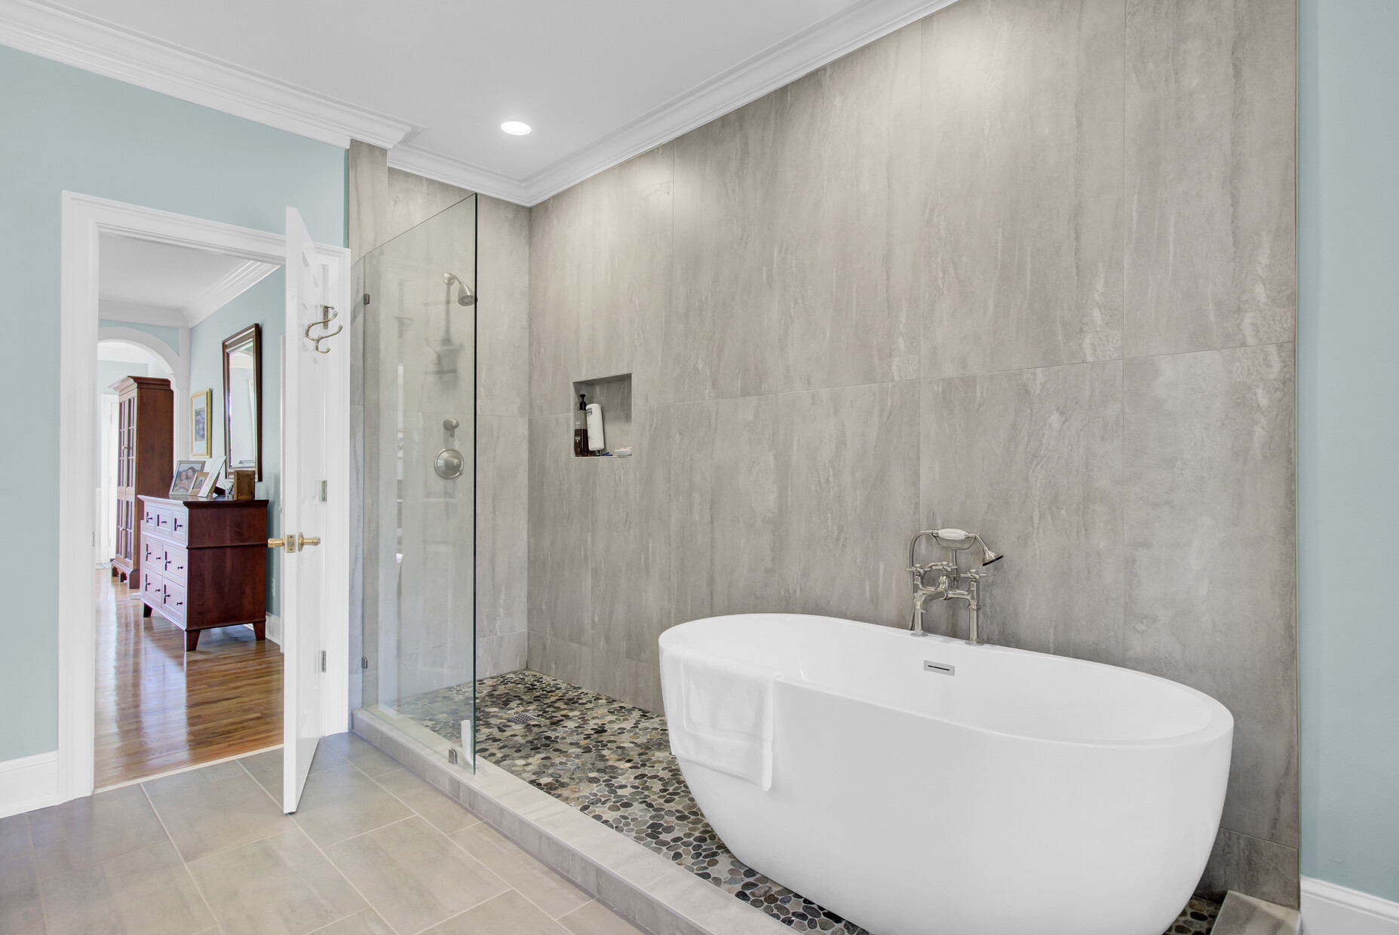
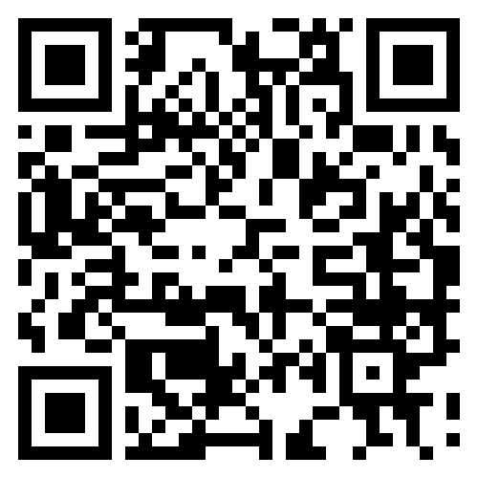
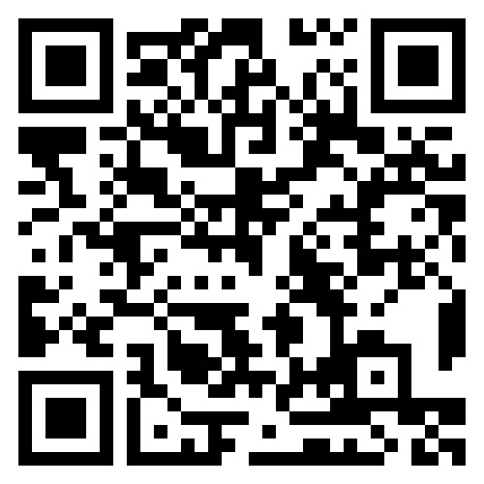


Waterfront Lowcountry Gem!
3984 Gift Boulevard
Gift Plantation
Johns Island, SC 29455
MLS# 25023953 | $1,795,000
Storybook
Video Tour
JUST LISTED!
Discover timeless Lowcountry charm at 3984 Gift Blvd. This all-brick custom home offers marsh & Stono River views, private dock w/ boat lift, and thoughtful updates including a new roof, generator, and chef’s kitchen.
Rarely does a waterfront retreat like this come available—schedule your tour today before it’s gone!
Video Tour | Storybook
Ellen O'Neil
Broker/Owner, ABR, e-PRO, CNE
Charleston Realtor of Distinction
843-300-8530
www.EllenONeilProperties.com

