Slide 1
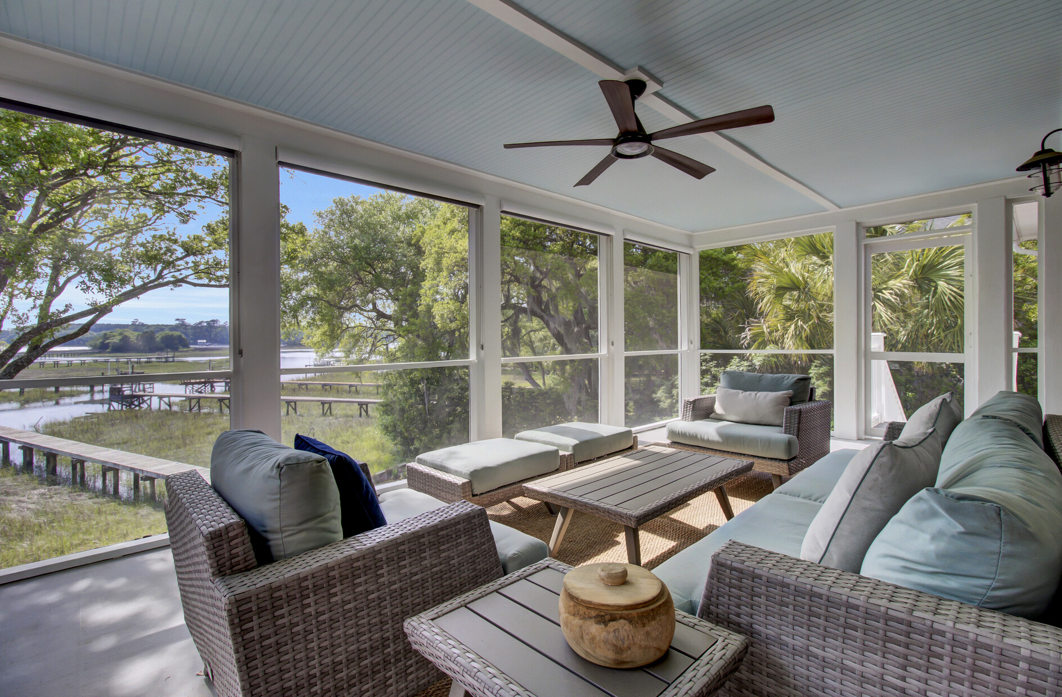
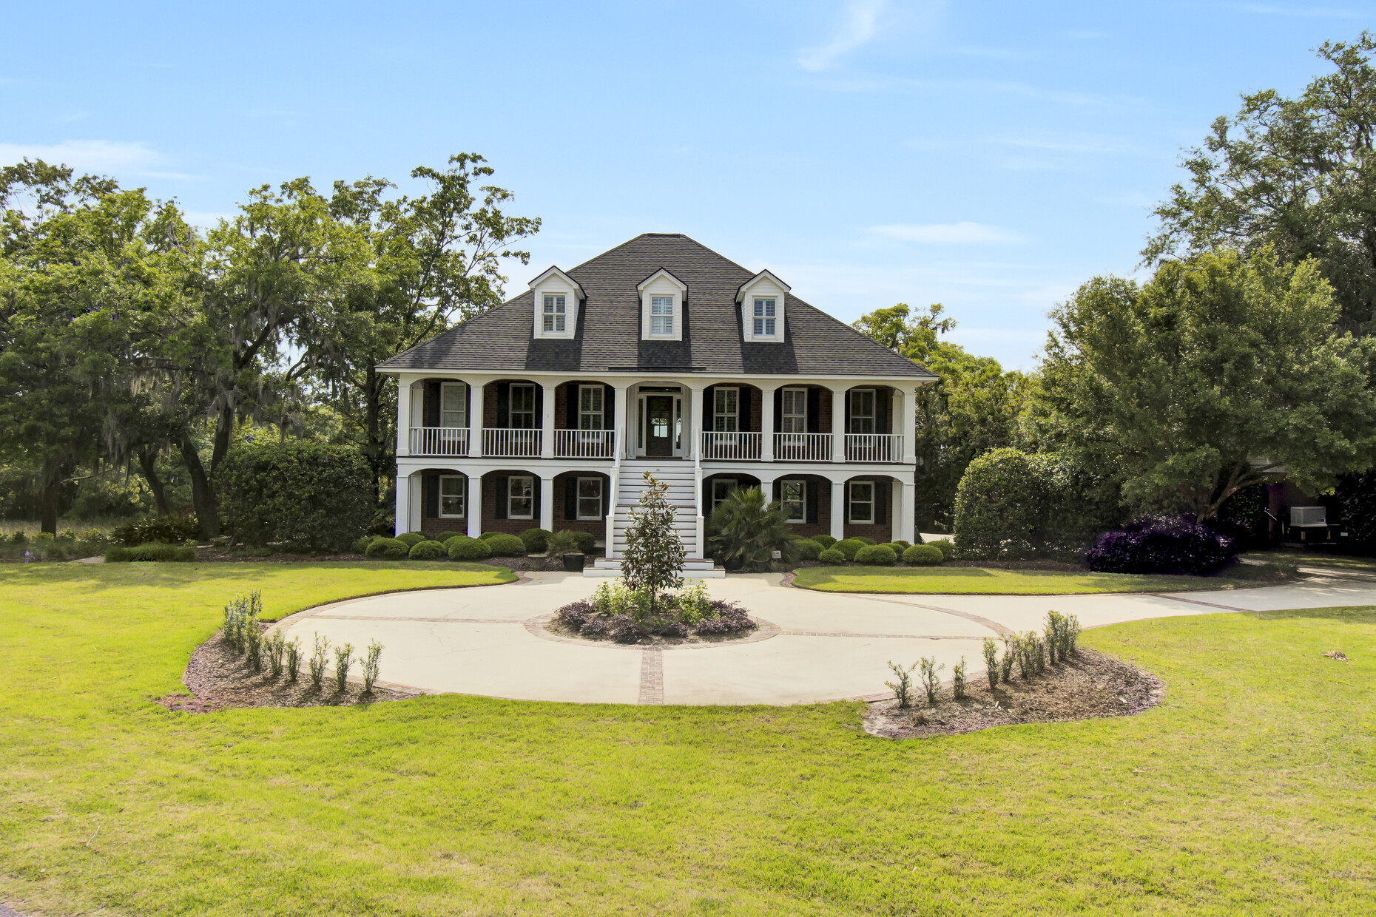
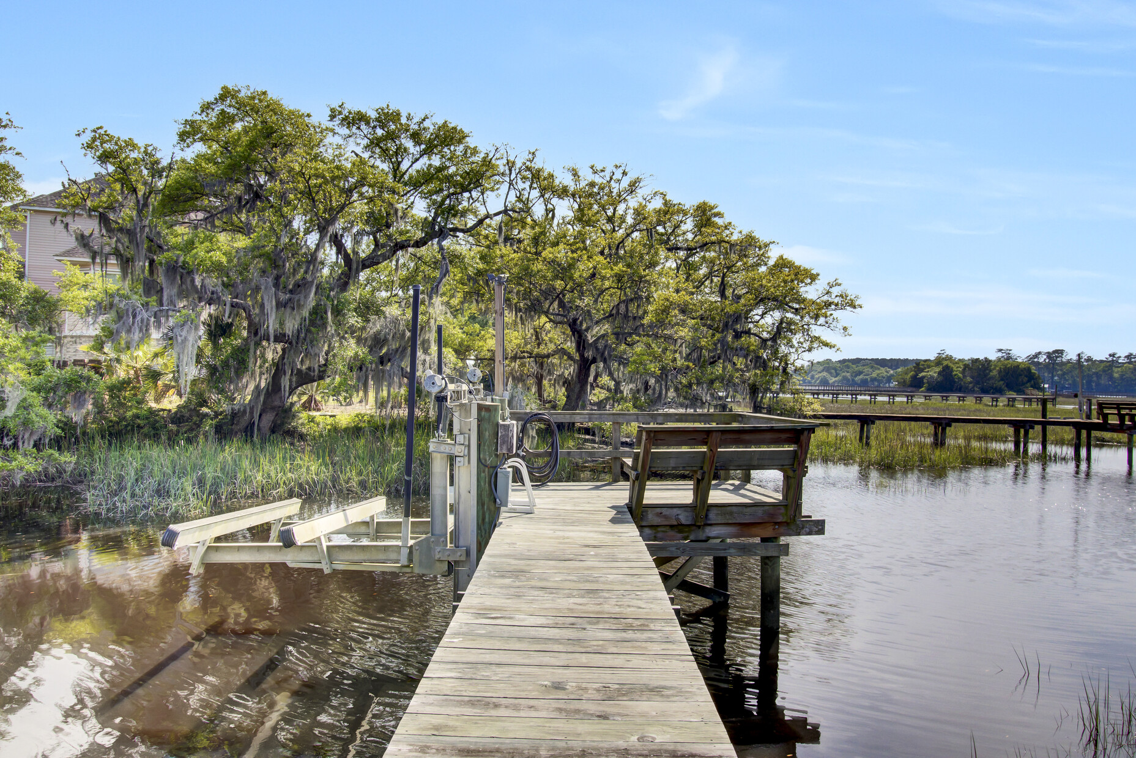
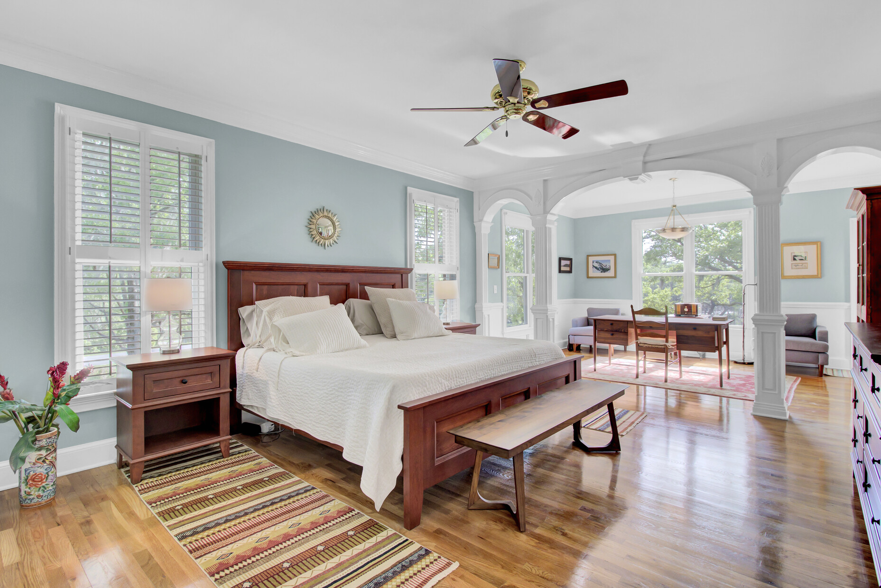
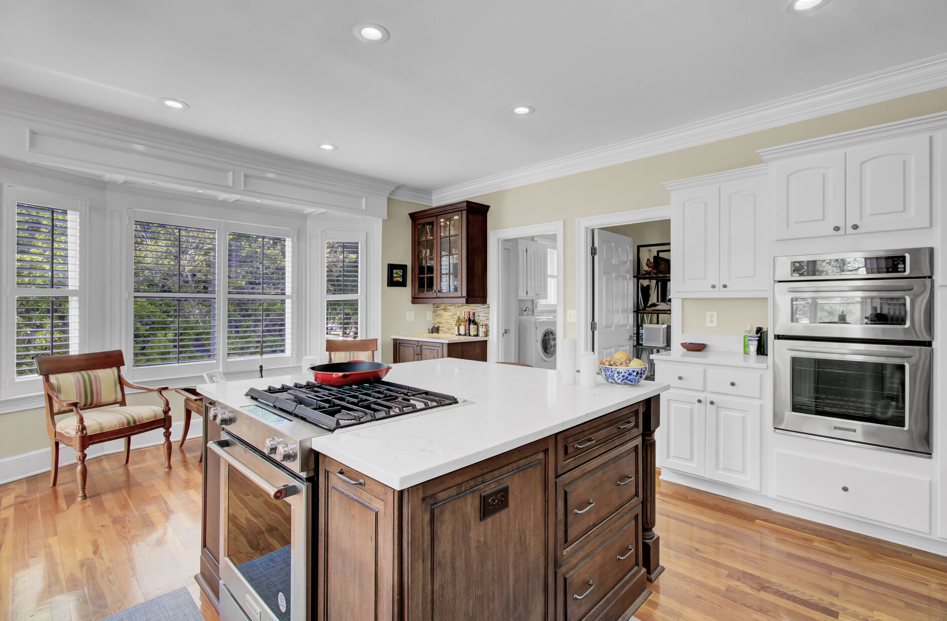
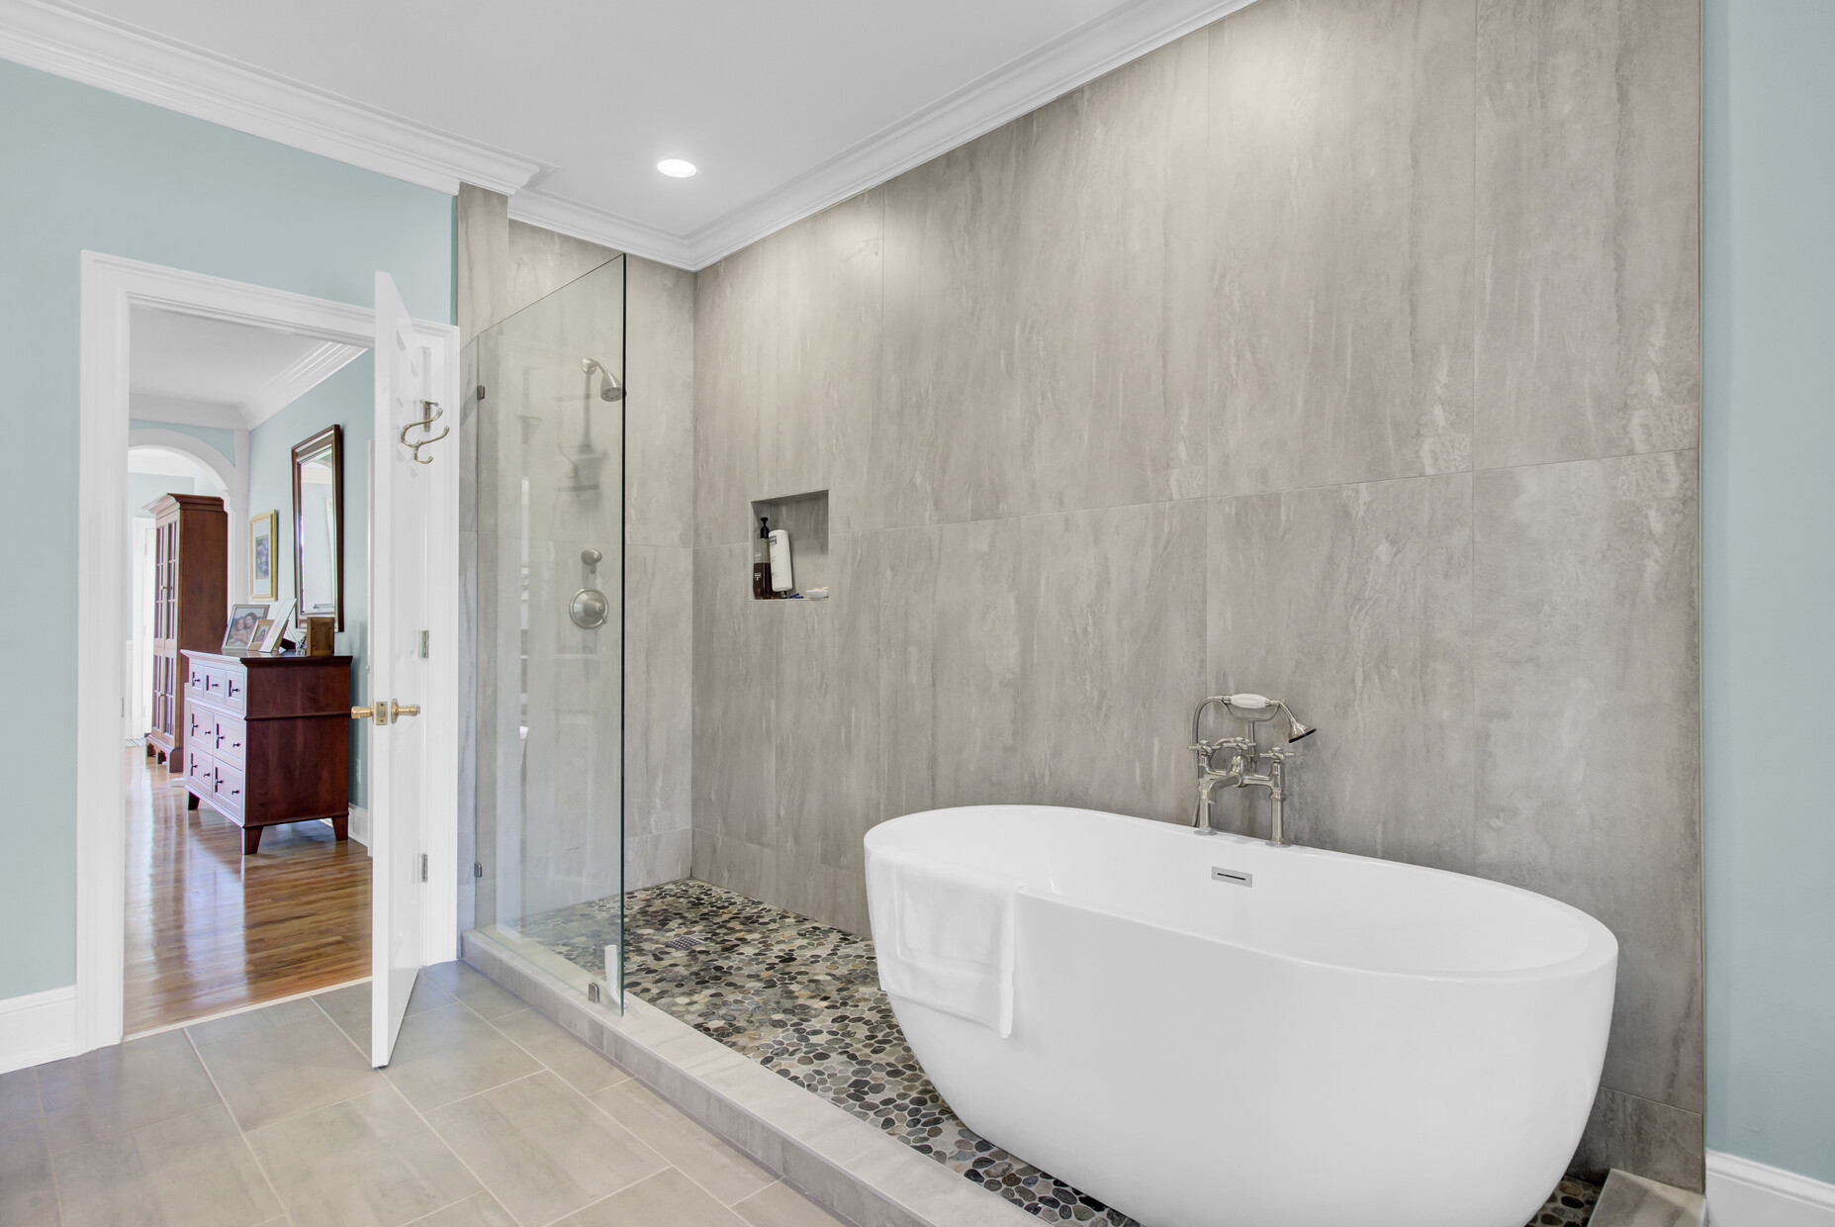
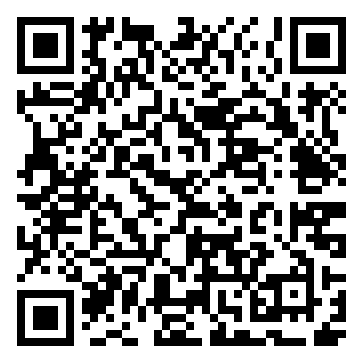
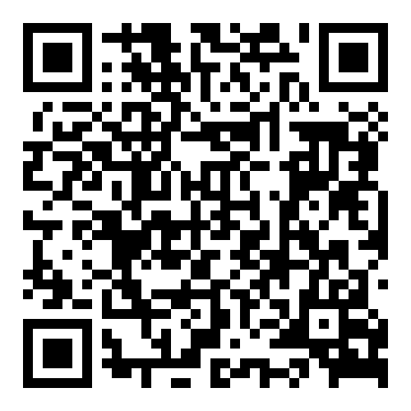


Explore 3984 Gift Blvd with Private Dock & Stunning Views!
3984 Gift Boulevard
Gift Plantation
Johns Island, SC 29455
MLS# 24009938 | $1,890,000
Property Website
Video Tour
Experience the ultimate Lowcountry lifestyle in this stunning waterfront home at 3984 Gift Boulevard, Johns Island. Revel in breathtaking marsh and Stono River views from almost every room. This elevated brick home features a private dock with a boat lift—perfect for boating enthusiasts.
Recent upgrades include a new roof, a whole-house generator, and two high-efficiency heat pumps with HEPA filters and UV light sanitizers. The chef's kitchen boasts new KitchenAid appliances, quartz countertops, and a gas stove, making meal prep a delight. Relax on the newly screened porch or step down to the dock to enjoy the natural beauty.
Thoughtful enhancements like new gas lines, stylish landscaping, and rebuilt seawalls make this home truly one-of-a-kind. Don't miss your chance to tour this exceptional waterfront property!
Property Website | Video Tour
Ellen O'Neil
Broker/Owner, ABR, e-PRO, CNE
Charleston Realtor of Distinction
843-300-8530
www.EllenONeilProperties.com

