Slide 1

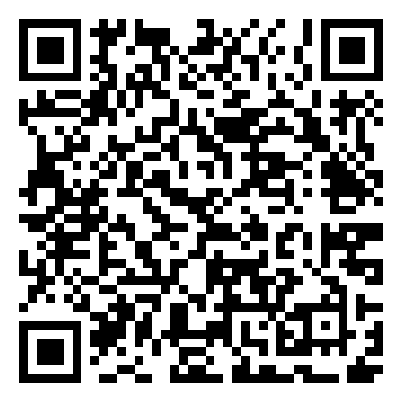
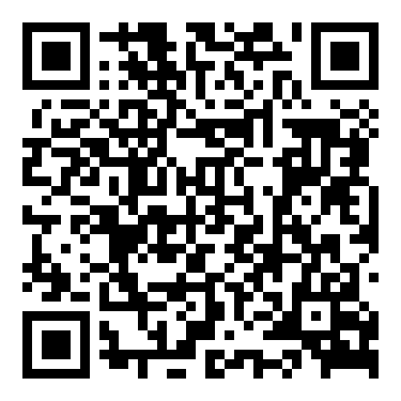


A Waterfront Dream for the Holidays!
Property Website
Video Tour
3984 Gift Boulevard
Gift Plantation | Johns Island, SC 29455 | MLS# 24009938 | $1,890,000
Imagine waking up to the breathtaking views of the Stono River and marshes from this elegant lowcountry home. Nestled on a large private lot, this elevated brick masterpiece with a private dock and boat lift is more than a home—it's a lifestyle.
From the new roof to the whole house generator, this home is designed to bring peace of mind and luxury living. The chef’s kitchen boasts new quartz countertops, a KitchenAid gas stove, double ovens, and a built-in microwave. Entertain effortlessly with gas lines now servicing your fireplace and outdoor grill.
Step into your newly screened porch or stroll down to your private dock with new pilings and sea wall, perfect for the boating enthusiast. Lush landscaping, gravel walkways, and elegant lighting complete this waterfront retreat.
This thoughtfully enhanced home is the gift you’ve been waiting for this season.
Property Website | Video Tour
Ellen O'Neil
Broker/Owner, ABR, e-PRO, CNE
Charleston Realtor of Distinction
843-300-8530
www.EllenONeilProperties.com

