Slide 1
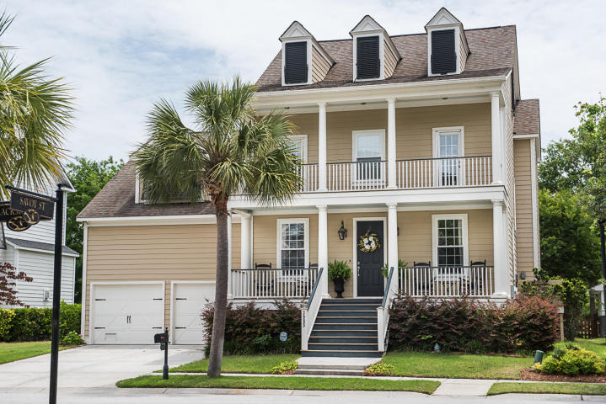
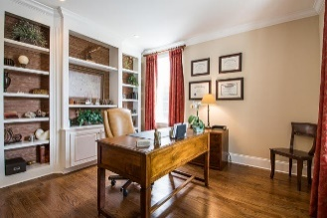
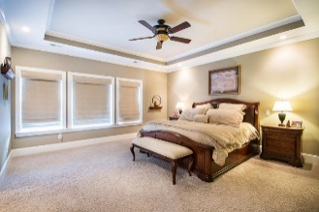
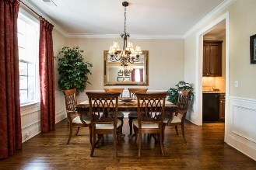
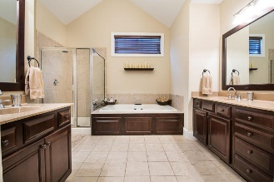
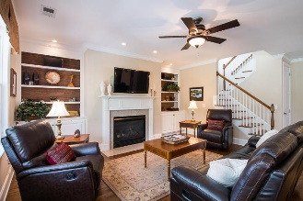
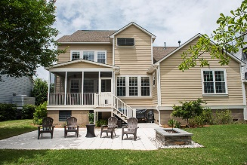
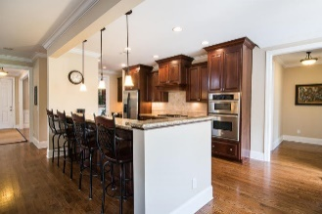
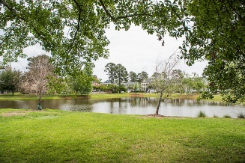


3985 Blackmoor Street
Hamlin Plantation ~ Mount Pleasant ~ MLS# 18015201 ~ $750,000
Price Reduced To $1,075,000!
Plus Sellers Offering A $25,000
Allowance To Buyer
W/ Acceptable Offer!
Open House
Sunday, July 8th 2-5 PM
This home exudes lifestyle in the Low country with it's double porches and gas lanterns on the front. On the back, a beautiful pond view, spacious screened porch and patio with an area for grilling and a fire pit. The first floor with site finished floors, has a study with custom designed, built-in shelving, a separate dining room, large kitchen with raised panel cabinets that is open to the great room, upgraded appliances and granite counters, a bar with stools, pantry and breakfast nook. Also, on the first floor is a bedroom with carpet, double closets, a full bath and a mud room. The second floor has a huge master bedroom with a tray-ceiling, walk-in closet, bath with double vanities, separate shower and garden tub. The two guest rooms have doors for access to the second floor porch.
The FROG, currently used as the media/game room, has a full bath and wet bar. The third floor has a flex space currently used for exercise equipment and a workshop. It has a closet and full bath so could be used as a 5th bedroom while providing many options for a new owner. This impeccably kept home has flexible use of space and is one you will enjoy showing!
Don't forget to check out the wonderful amenities Hamlin Plantation offers! Clubhouse, play park, boat storage, exercise area, tennis court and pool!
Mac Jenkinson
M (843) 224-0210
mac@carolinaone.com
Beth Moore
M (843) 532-4892
bmoore@carolinaone.com
www.jenkinsonandmoore.com
Jenkinson & Moore, LLC | Carolina One Real Estate | 1503 Palm Blvd | Isle of Palms, SC 29451-2280

