Slide 1
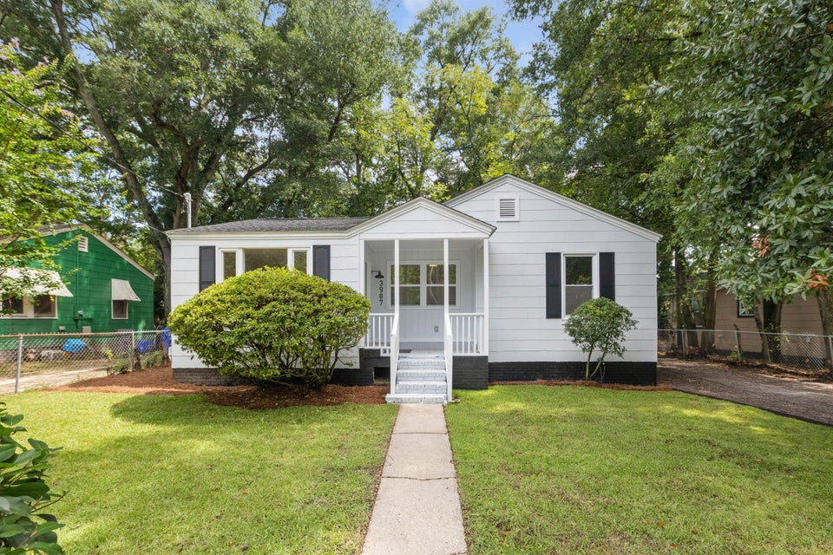
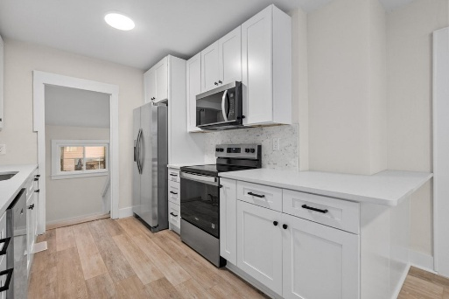
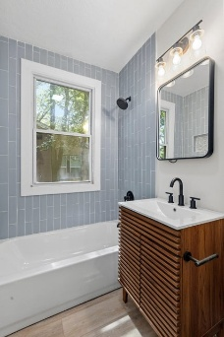
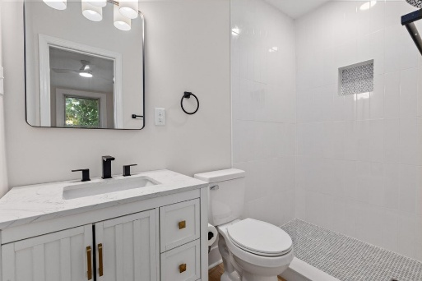


Great Value And Fully Renovated Home, Close To Everything!
3987 Niagara Street
Waylyn | North Charleston, SC 29405 | MLS# 25019070 | $340,000
Lots of updates in this well laid out home that is convenient to everything. New roof, new HVAC and ductwork, new flooring, new kitchen and bathrooms, etc. New sod in the front yard. Primary bedroom has en suite bathroom. Very close to Park Circle and peninsula Charleston, close to both 26 and 526, and close to the beaches. All at a budget friendly price. Transferrable termite bond in place. No flood insurance required
Justin Natale
843-437-9739 | jnatale1982@gmail.com
www.theblvdcompany.com
The Boulevard Company, LLC | 806 Johnnie Dodds Blvd Ste 100 | Mt Pleasant, SC 29464

