Slide 1
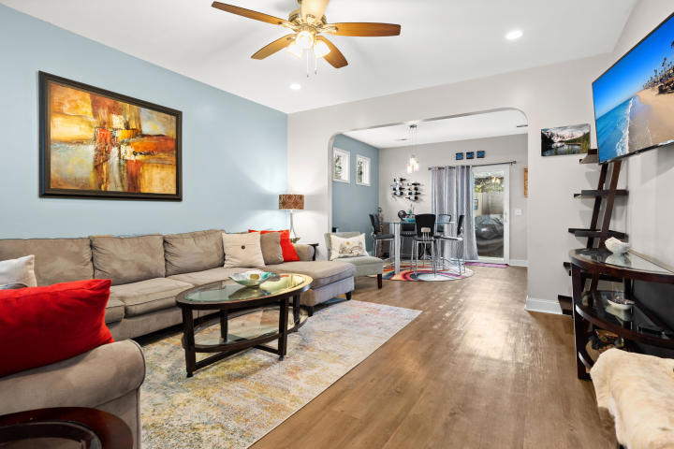
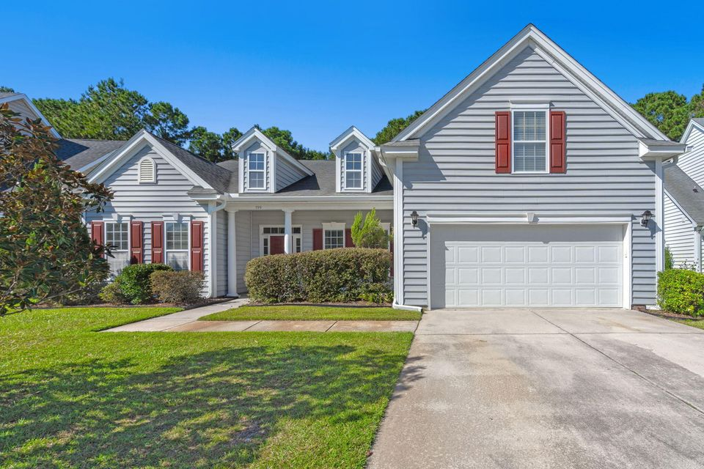
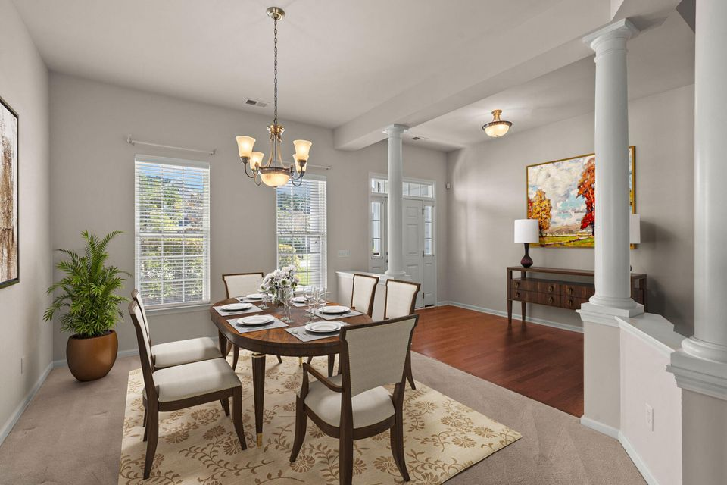
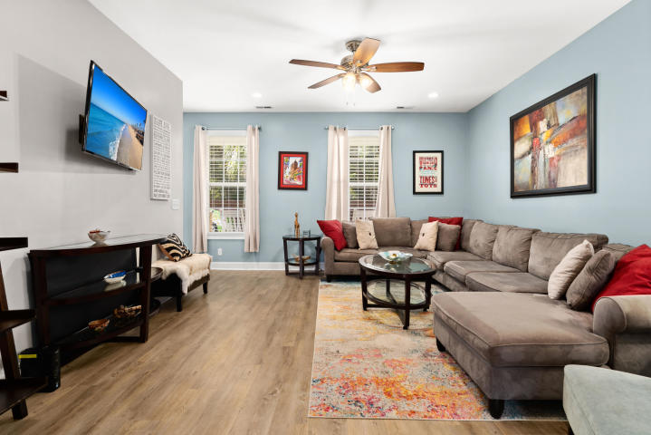
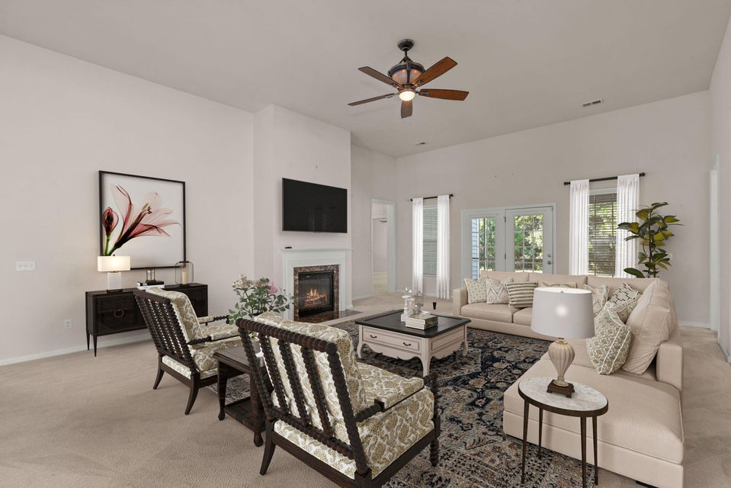
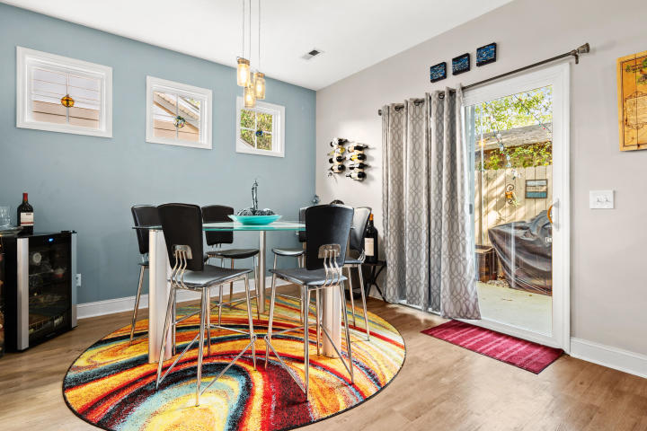
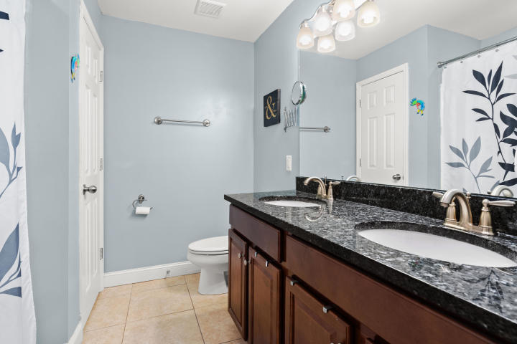
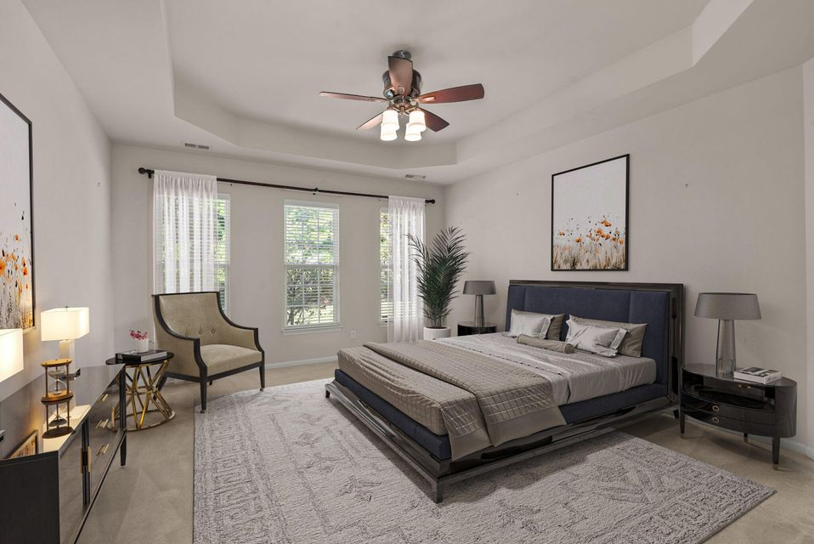
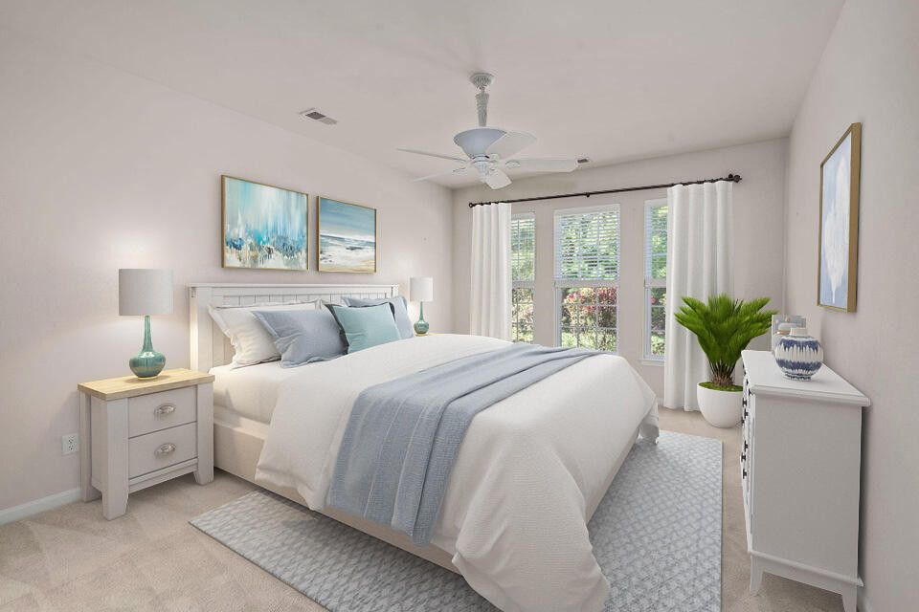
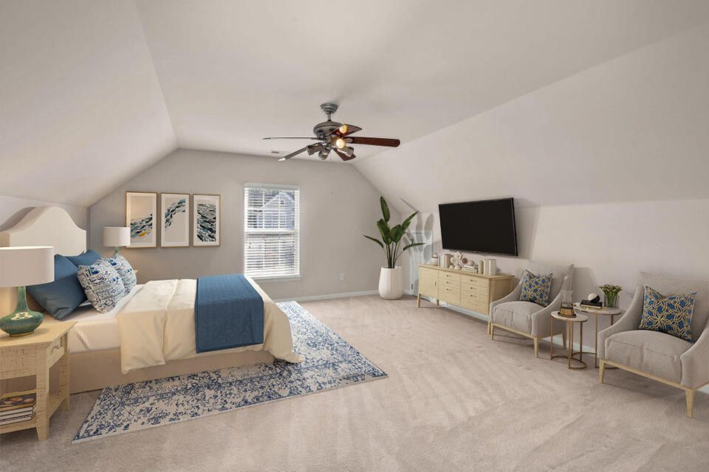
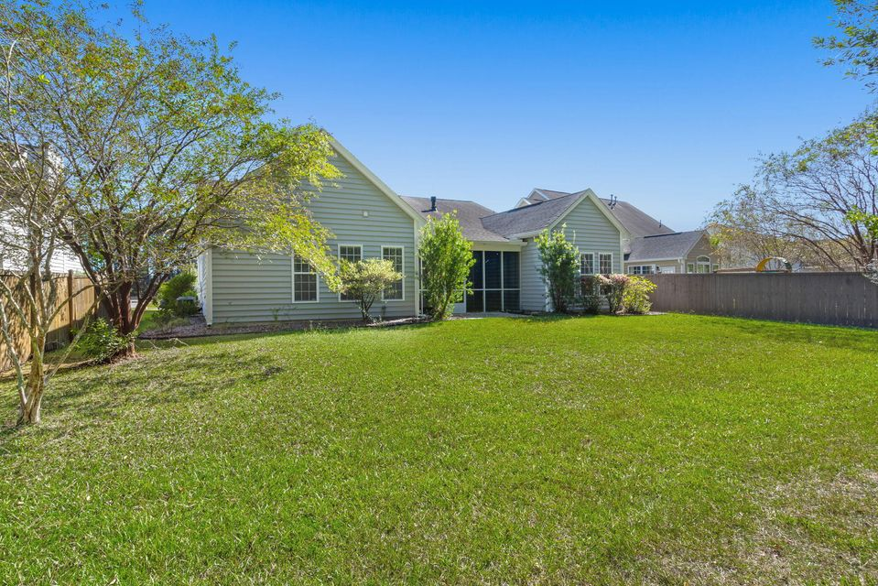

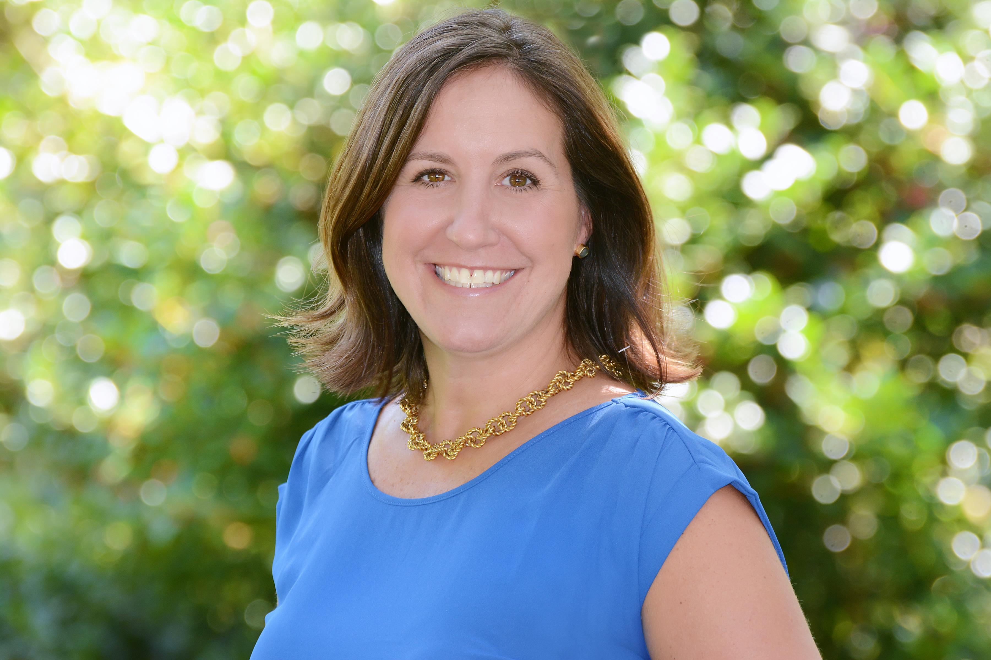
PRICE REDUCTION & BUYER CREDIT!!!
399 Decatur Drive
Cane Bay Plantation · Summerville, SC 29486 · MLS# 24026292 · $464,900
Seller offering buyer credit of $5k for the buyer to use as they wish!! A stunning family haven that combines comfort and convenience in one swoop! Nestled in the friendly confines of Cane Bay, this spacious 3,196 square feet of one story living simultaneously offers the privacy and the space needed by multiple family members living under one roof. This home features not one, but two primary suites on the main level - ideal for those who appreciate a touch of privacy and luxury without needing to traverse stairs. Each offers a private entrance and they are on the left and right back corners of the home. The ground floor is further enhanced by an additional two spacious bedrooms which flank a hall bathroom, making a total of four bedrooms and a breeze to host guests or provide a separate space for the kids.
But wait, there's more! Venture above the garage and you'll find a fifth bedroom with it's own full bath, making a perfect retreat for teenagers, long-term guests, or possibly your own hideaway when the rest of the house buzzes with activity. This domicile isn't just spacious; it's also smartly laid out to cater to various family dynamics.
Waltzing into the large chef's kitchen, culinary enthusiasts will be over the moon with the ample cabinetry - a charming challenge to fill! Whether you're whipping up a batch of cookies or a gourmet meal, this kitchen responds with flair and function. Open to the living and dining areas, entertaining is easy and there are plenty of areas to gather, including the oversized screened porch overlooking the private backyard.
Keller Williams Realty Charleston West Ashley
1180 Sam Rittenberg Ste 300
Charleston, SC 29407
Amy Z. Powers
(843) 534-3523
amy@amyzonarich.com
liveandlovecharleston.kw.com

