Slide 1
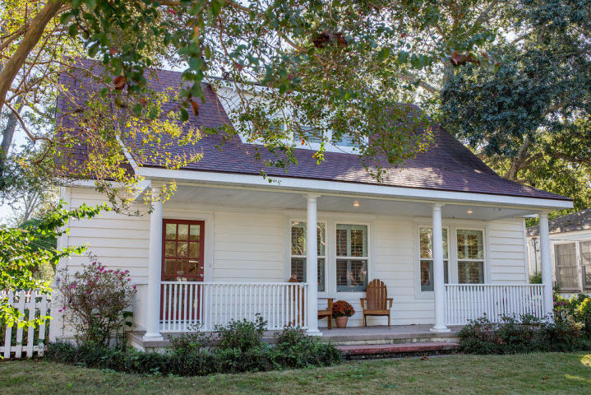
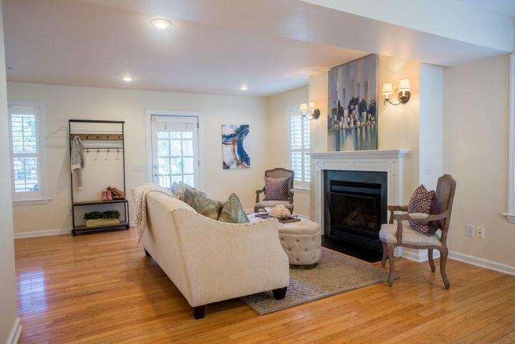
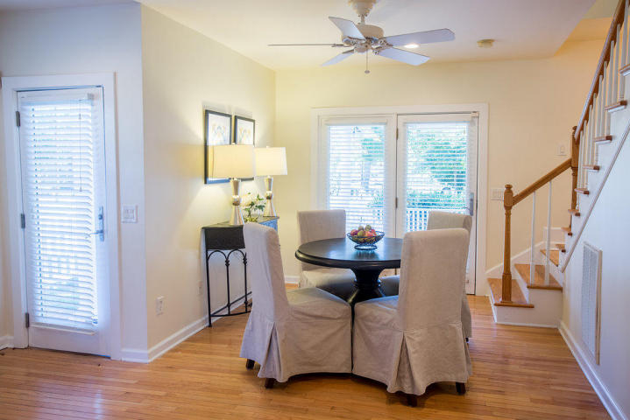
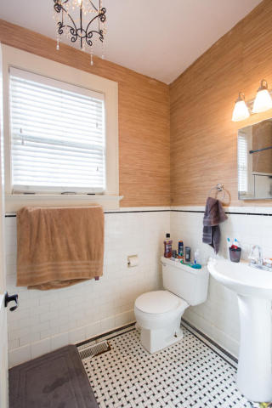
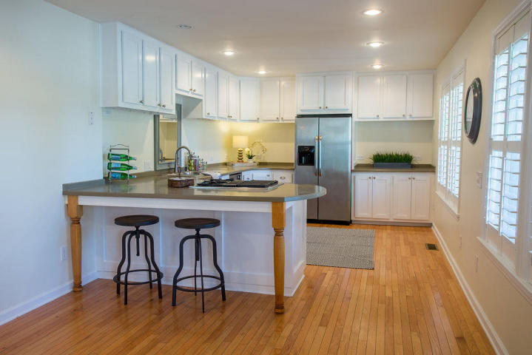
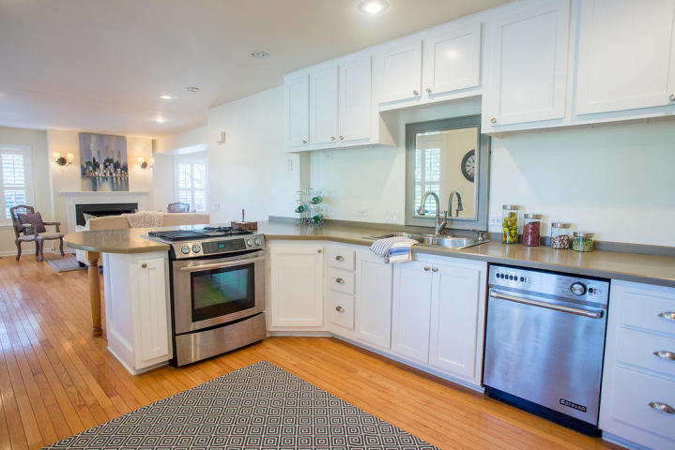
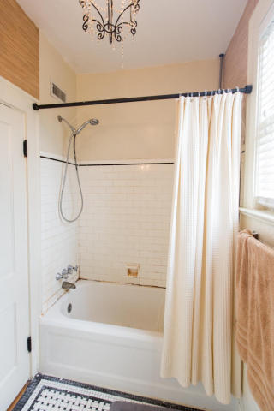
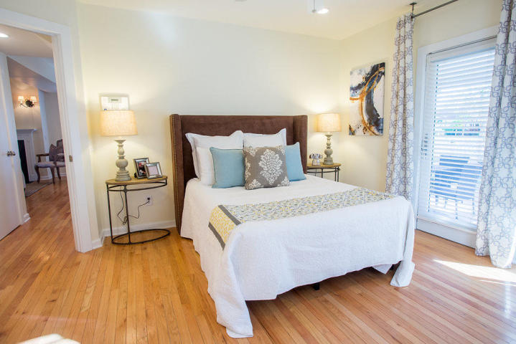
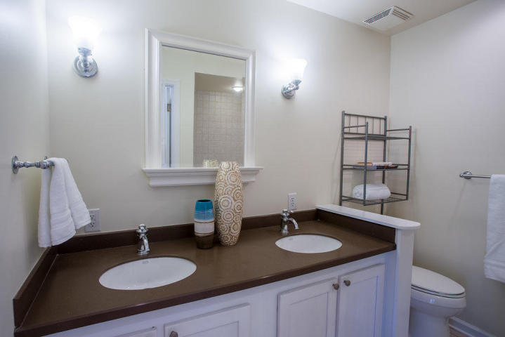
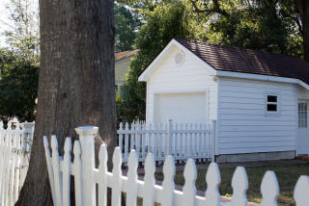
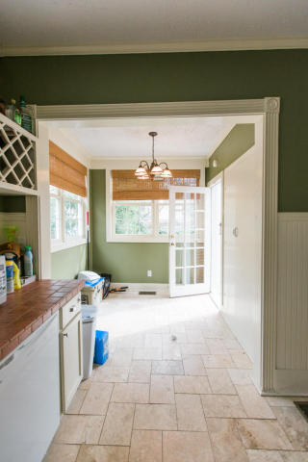

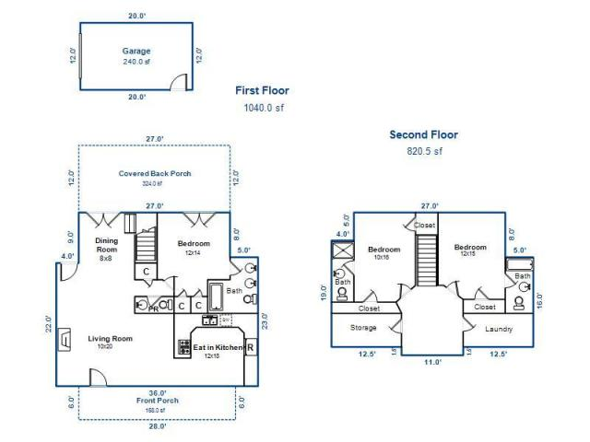
39 Alberta Avenue
Hampton Park ~ Charleston, SC 29403
MLS# 17021292 ~ $639,000
Comfortable home in a great neighborhood!
Enjoy lots of natural light, outdoor living space, ground-floor master bedroom and tons of storage.
Upstairs are two more bedrooms with en suite baths, separate laundry room & a bonus room.
See attached floorplan and come see this house!
Marion Jackson
Mobile - (843) 442-4404
marionjacksonrealtor@gmail.com
Charleston Property Brokers | 151 St. Philip St. Apt A | Charleston, SC 29403

