Slide 1
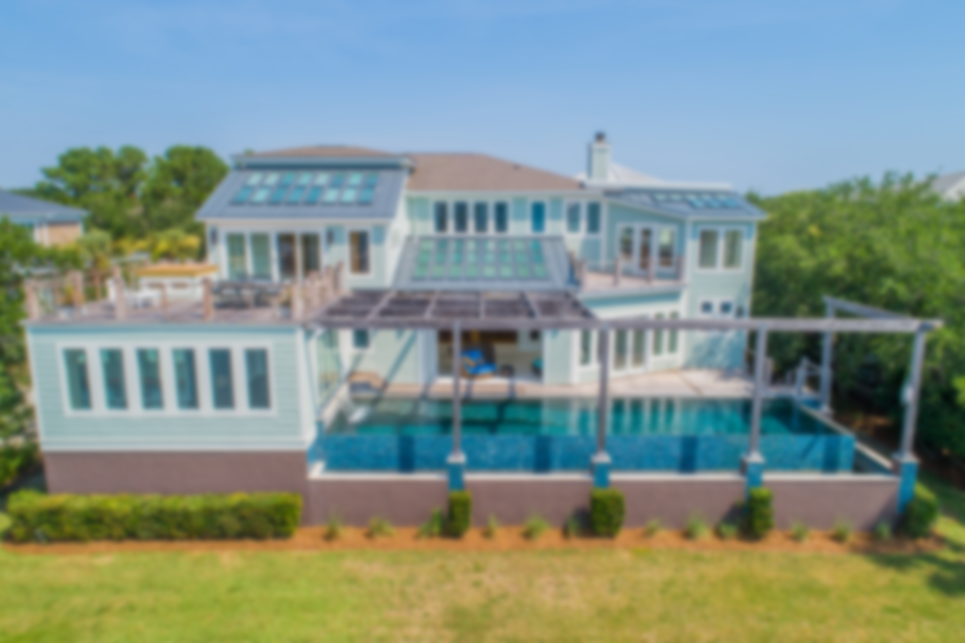
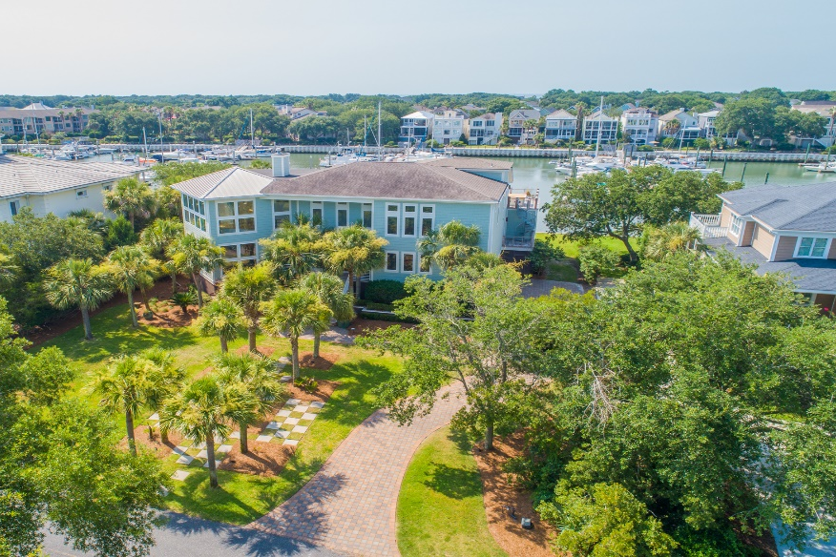
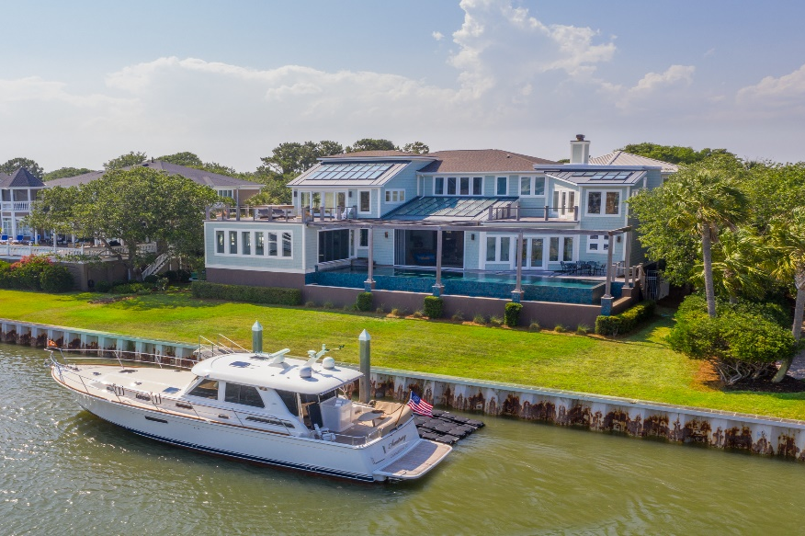
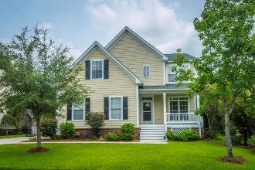
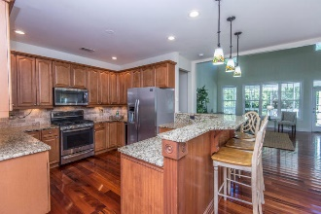
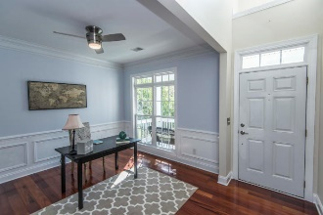
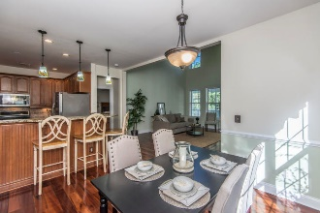
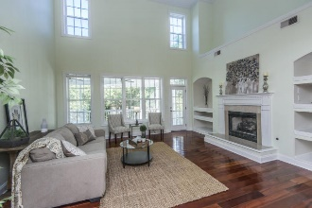
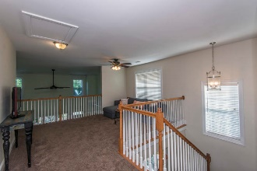
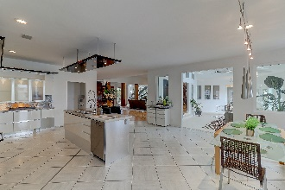
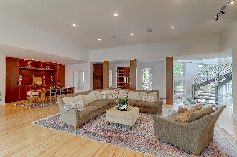
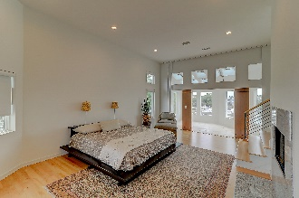
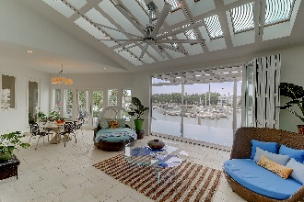
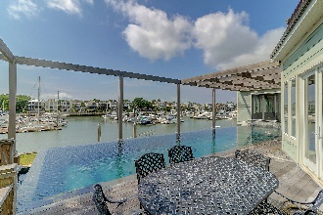


39 Waterway Island Drive
Wild Dunes | Isle of Palms, SC 29451 | MLS# 18021164 | $2,575,000
Luxurious Home Overlooking the Wild Dunes Marina
Stately home with a private dock overlooking the Wild Dunes Marina. This is the perfect home for entertaining and for large gatherings, with room enough for 50 people to enjoy a sit-down dinner! The open floor plan includes a huge great room and dining area, as well as an adjoining sunroom. The spectacular sunroom has 24 skylights, a commercial ''Big Ass Fan'' as well as a 6 panel NanaWall which opens out onto a deck with a 50' long horizonless salt water pool. With the NanaWall open and the screens down, the sunroom converts into an amazing indoor/outdoor living space.
A professional grade kitchen has German cabinetry and is equipped with only the best appliances. An exercise room with a second NanaWall also overlooks the pool and comes equipped with its own spa room. The spa is accessed through an exotic double door handmade in Morocco, while inside the spa are a Japanese massage/pedicure chair as well as a combined Jacuzzi/steam shower.
The master bedroom suite is located on the second floor and has a gas fireplace, sunroom and a private deck. Upstairs are two more large bedrooms including one with its own sunroom, and a large deck overlooking the marina which is ideal for outdoor entertaining and has an exterior spiral staircase down to the kitchen. There is also an in-home movie theater with a 110" screen and built-in surround sound along with two rows of luxurious reclining leather seating. Secondary master suite on the first floor.
A dock permit for a 10'x48' floating dock plus an additional 9'x13' jet ski dock has been approved by OCRM, permit is transferrable.
Check out the virtual tour and floorplan here: www.floorplanonline.com/story/278835
Asking $1,200,000
MLS# 17023051
3,692 SqFt
4 Bed/3½ Baths
Short Drive to Historic Downtown Charleston & Beaches
Charlie Aikman
(843) 696-3990
caikman@carolinaone.com
Carolina One Real Estate • 1503 Palm Blvd • Isle of Palms, SC 29451
www.CharlieAikman.com

