Slide 1

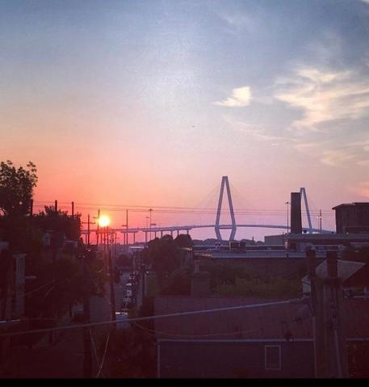
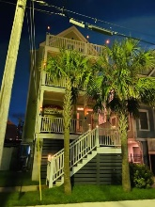
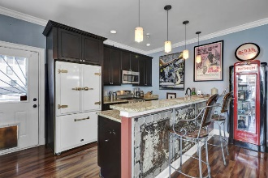
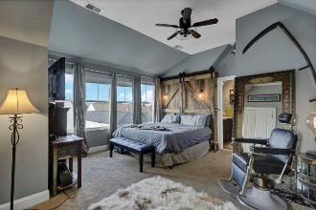
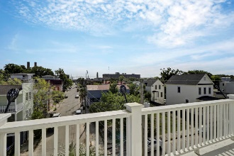
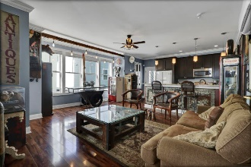
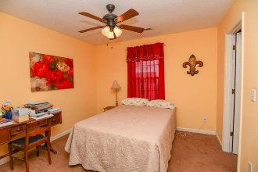



Open House Saturday & Sunday From 2-5
39 Aiken Street
Eastside | Charleston, SC 29403
MLS# 20017719 | $650,000
This is a place that will be talked about by anyone that wants a modern home with a twist of eclectic! 3 Story & a view of the iconic Charleston bridge. Built in 2014, so very energy efficient & even more so now with foam insulation added to interior of roof, two higher caliber A/C units changed out for efficiency. Close to everything downtown. Use your golf cart to go to dinner. History everywhere & new construction adding on every street to make this area even more exciting. This is a one of a kind newer home that has features you will not see elsewhere! Custom made stairs. The Hand hewn boards from a local saw mill are the risers and the finished stair treads are from the same wood, just polished off. Custom made pipes for stair handrails. Nostalgic phone booth was built in to be the entry to the master bedroom. Owner will remove it & replace with door frame if buyer doesn't want it. Custom built headboard that is attached in master bedroom to remain. Artifacts include a fountain lion head on front of house to remain. Built in dental cabinet in the kitchen houses spices, it is from the 1960's, it will remain. There is a very cool antique chevy hood attached to the car shed to cover bbq grill. Shed was built to house owners custom vehicle, has a great doggie feature underneath to keep your pup cool & out of the sun. One car garage with room for your golf cart for evening rides to have dinner around town.
BJ Rodgers
843-697-1409 | bjrodgerscharleston@gmail.com
www.bjrodgersrealtor.com
EXP Realty LLC | 170 Meeting Street Ste 304 | Charleston, SC 29401

