Slide 1
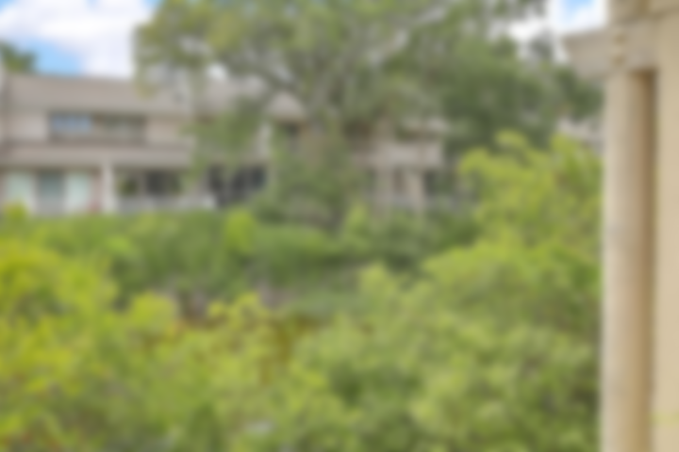
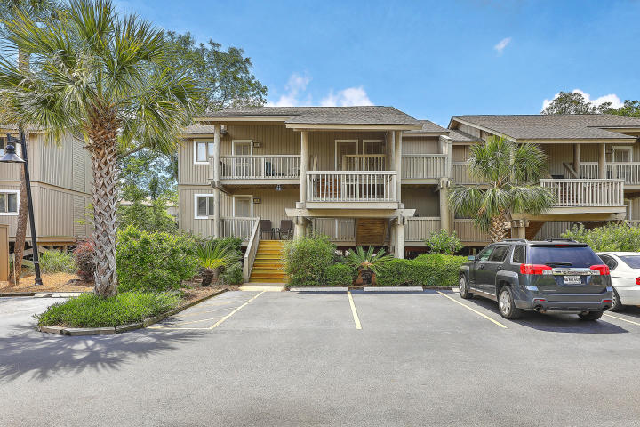
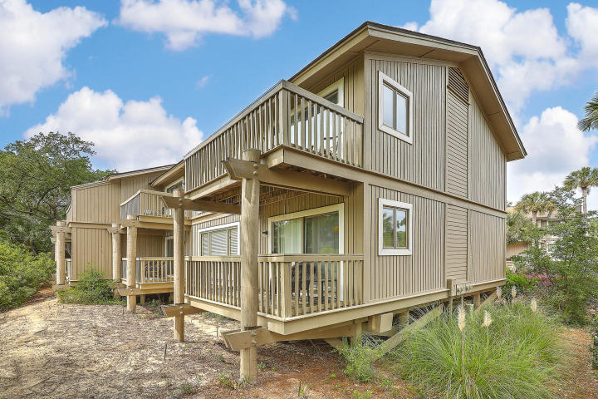
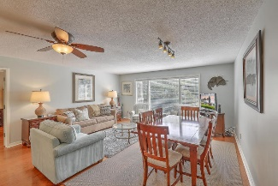
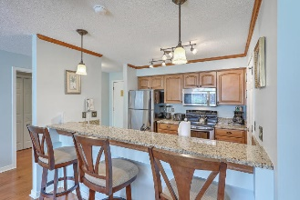
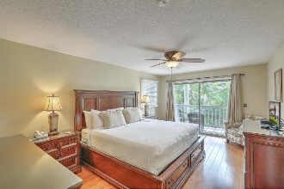
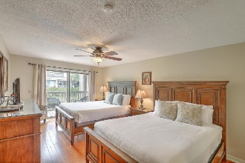
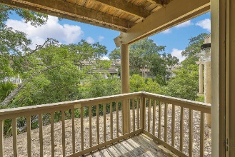
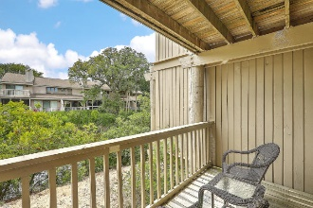
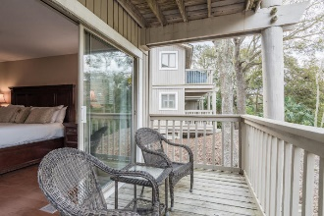
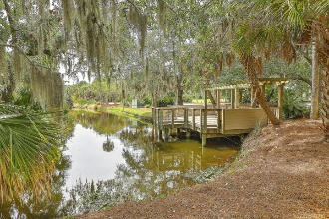
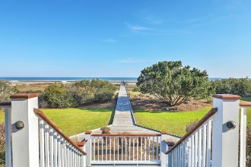
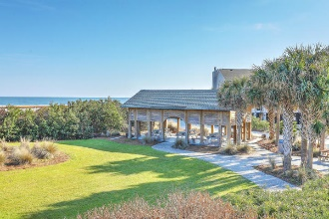


JUST LISTED!
Fully Furnished Turn-Key Condo in Wild Dunes
39 Lagoon Villas
Lagoon Villas Phase I | Isle of Palms, SC 29451 | MLS# 20013637 | $439,975
Privately situated, overlooking a serene lagoon, your tropical getaway is just steps to the beach and makes an excellent rental property! Turn-key ready, this tastefully renovated, fully furnished unit, has gleaming hardwood flooring throughout. The open airy floor plan features two spacious Master en-Suites situated on either side of a light filled family room, offering guests the maximum privacy. Both bedrooms offer separate entrances and private balconies overlooking lush greenery and calming water views. No need to eat out all the time with your well-appointed kitchen which has plenty of granite counter space to prep meals, stainless steel appliances, plenty of cabinet storage and a breakfast bar to hang out at and enjoy an icy cold beverage after a hot day at the beach. Wild Dunes is an amazing gated community with golf, tennis, biking trails, vast stretches of sandy beach & much, much more! Located in the heart of the resort, you and your guests are just a short walk to tennis, shopping, dining and the day spa. Love to golf? No better place than to take a swing on 36 holes of signature golf courses, designed by Tom Fazio. Come and take a look today, you won't want to leave!
Virtual Tour: https://my.matterport.com/show/?m=GG4FutfVDK1
Desiree Maurer
Office - (843) 416-2000
Mobile - (843) 327-9010
desiree.maurer1@gmail.com
www.yourcharlestonhousesearch.com
Keller Williams Realty
496 Bramson Ct Ste 200
Mt. Pleasant, SC 29464

