Slide 1
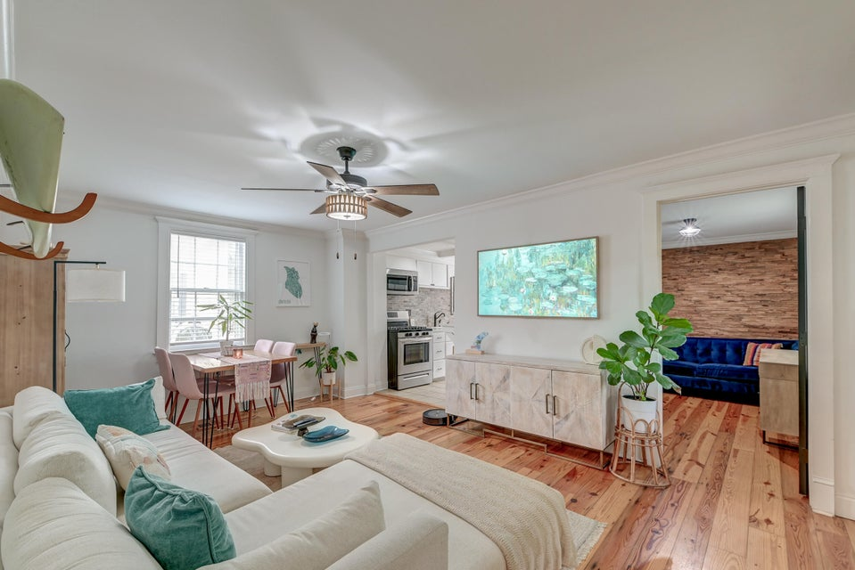



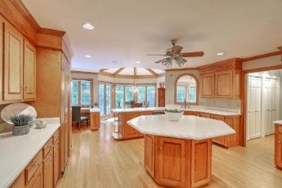
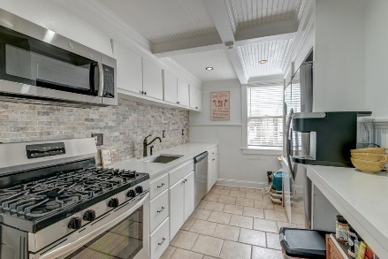



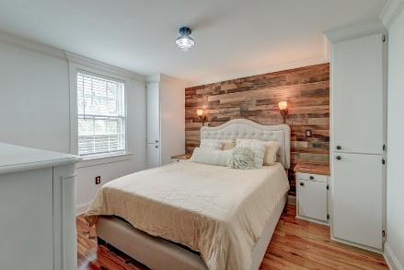


Parkshore Marshfront
Price Improvement
3½ Kracke Street C
Elliotborough | Charleston, SC 29403 | MLS# 25011493 | $599,000
***Ask about the possibility of receiving 1% reduction in interest rate and free refi.*** With an unbeatable downtown location and an impressive walk score of 90, this well-appointed and move-in ready condo offers comfortable living in the heart of Charleston. Just steps away from MUSC, Publix, Brittlebank Park, and the vibrant energy of King Street, you'll also be within walking distance of countless coffee shops, bars, and restaurants throughout the Cannonborough-Elliotborough community. The location is truly exceptional, with The Citadel and the College of Charleston located within a mile. Situated on the lower level, the home welcomes you into a bright and open living and dining area featuring crown molding and beautiful wide plank wood floors.
The kitchen is both stylish and functional, with white cabinetry, stainless steel appliances, attractive countertops, a sleek backsplash, and a designated space for a stackable washer and dryer. Just off the living room is the first of three bedrooms, complete with a charming accent wall. Further down the hall are two additional bedrooms, each featuring shiplap accent walls, and a beautiful bathroom with a tiled step-in shower.
One of the unique perks of this property is the shared courtyarda rare and valuable feature in this area. The condo also includes one on-site parking space, access to on-street parking, and two guest spaces available for community use. With so much right outside your door, you'll love calling this home. Don't miss this opportunity to enjoy everything Charleston has to offer.
Caroline Treece ctreece@mattoneillteam.com 843-754-0050

