Slide 1
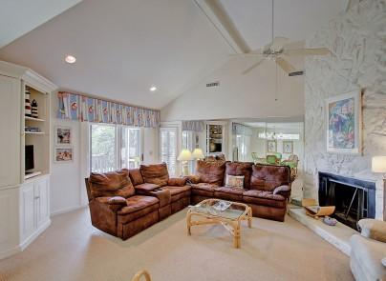
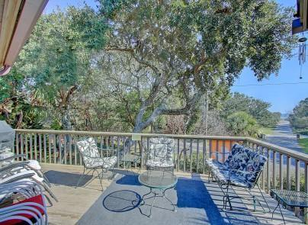
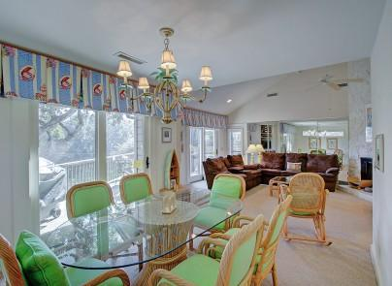
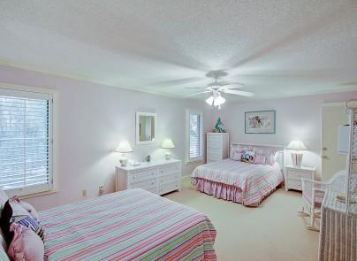
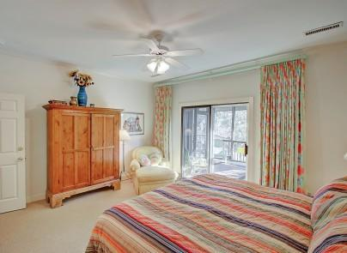
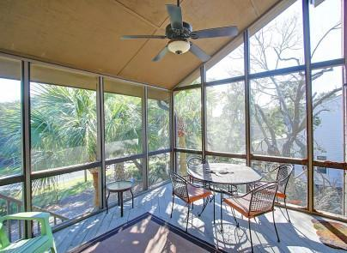


3 Conch Court
Wild Dunes
Isle of Palms
MLS# 16005318
$925,000
Check it out This Week!
Open For Showings June 13- 18th
Partial Ocean Views, Master on Main Level,
& Great Rental
This 3 bedroom, 2.5 bath home is just a block from the beach and offers partial ocean views from a 2nd floor deck and screened porch. You will enjoy being so close to the beach as well as Wild Dunes. Tons of light beams through this home with an open plan and choices of the screen porch or decks for entertaining. Master is located on the main level with the other 2 bedrooms on the lower level. The fireplace will be enjoyed by many on those chilly nights. 3 Conch Court is located on a quiet cul-de-sac street with beautiful trees. This well maintained home has proven to be a great Vacation Rental.
Darlene Smith
Office - (843) 886-8110
Mobile - (843) 696-7824
darlenesmith@carolinaone.com
DarleneSmithTeam.com
Carolina One Real Estate
1503 Palm Blvd Ste
Isle of Palms, SC 29451

