Slide 1
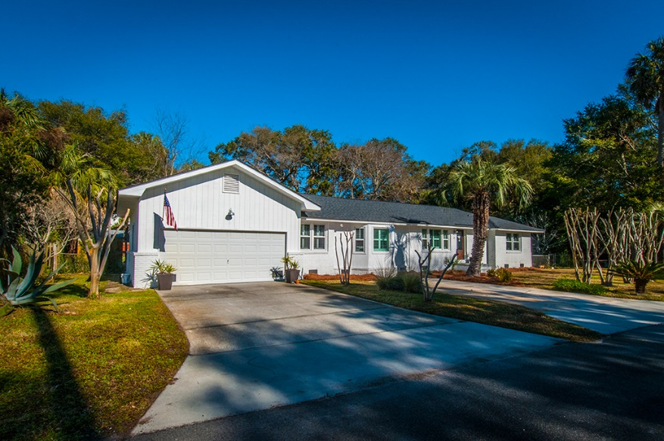
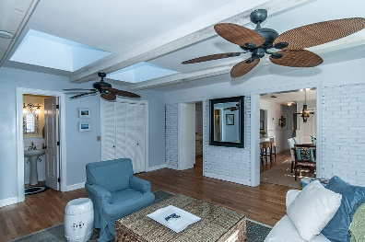
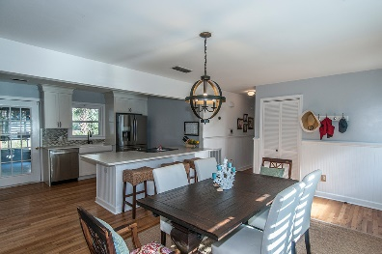
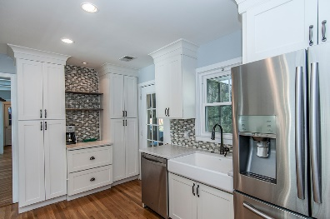
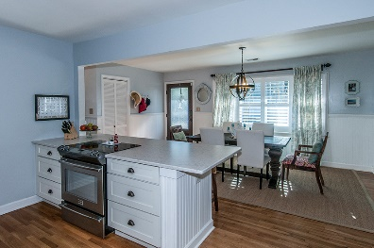
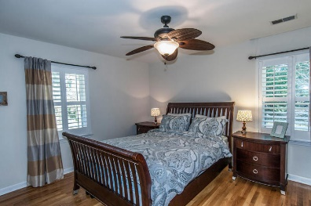
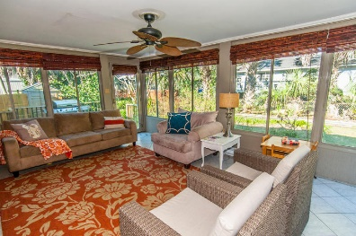
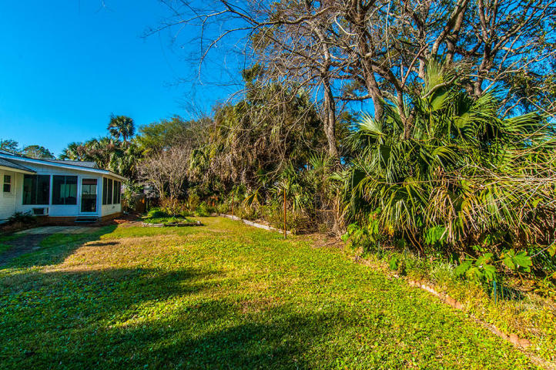

3 Lauden Blvd
Isle of Palms, SC 29451
MLS# 17004685 | $689,000
3 Bed | 3 Bath | 1,796 SF
This lovely home is located on a very private street near the Isle of Palms recreation center, minutes to the Isle of Palms marina and the beach! The kitchen of this home was completely renovated in 2014 with new Silestone countertops, glass tile backsplash, all new cabinets with soft close drawers, new appliances including a refrigerator with both sparkling water and water dispensers in the door and a flex zone temperature controlled drawer great for drinks and a new white ceramic farm sink with new kitchen faucet. In 2015 all new HVAC system including ductwork & Nest was installed as well as a new hot water heater. In 2016 a new architectural roof, all new windows, skylights in the living area and all new paint on the exterior of the home were all completed. This home has hardwoods throughout, bead board and chair rail in the dining area and down the hall and plantation shutters for the windows. The master bathroom was completely renovated in 2016 as well with new cabinets, new tile shower with pebble floor, flooring, mirror and light and plumbing fixtures. The 2nd bathroom has also been redone as well with new vanity, mirror and tile floor. Off the kitchen enjoy an all season room with both heat and cooling and a deck great for grilling. This home has a very large yard with plenty of possibilities of an addition, ADU, and/or pool. This yard also has many fruit trees and rose bushes. An outside shower with both hot & cold water and storage shed complete this lovely backyard. This home has plenty of off street parking including a 2 car garage, and 2 driveways.
Quiet Street on Isle of Palms
Kendra Boozer
843.834.5089
kendrafboozer@gmail.com

