Slide 1
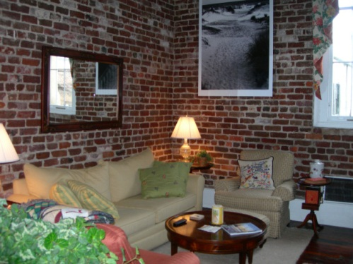
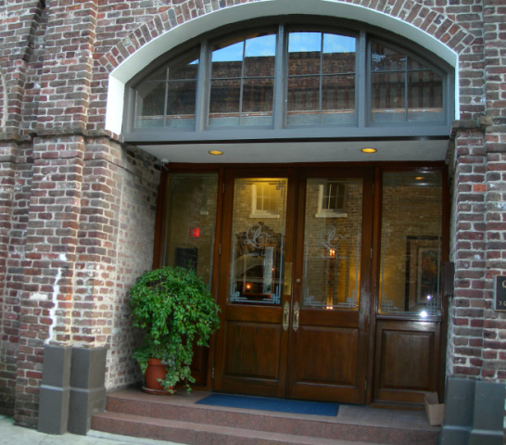
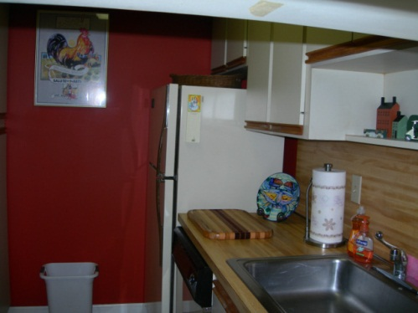
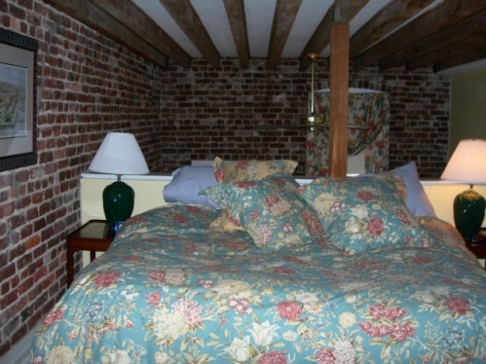

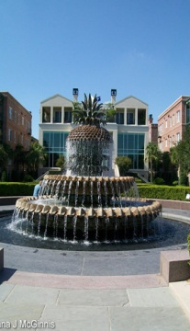
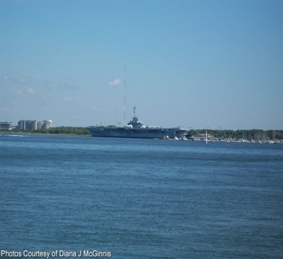


3 Queen St #203 ~ MLS# 1414172
$395,000
This condo located in the historic Charleston French Quarter is amazing. It is convenient to everything and has parking. The first level is a parking garage with entrance from State Street. The building has an exercise room, sauna,and a laundry room. There is a full time residential manager. This is the perfect pied-a-terre with great security so you can just lock your door and know your home or second home and is very safe. The building has WiFi and the regime covers the master insurance policy, water, and common area maintenance. This loft condo has the beautiful original brick on 2 walls and hardwood floors on the first level. The large window overlooks Queen Street and makes a very bright and inviting home. There is a trash chute on each floor, an office area with office equipment available for residents. The furniture and art work in the condo are negotiable if you would like to just move in immediately and just bring your toothbrush. This is one of the best locations in the city. Enjoy all Charleston has to offer.
Peggy Reese
E-PRO, GRI
phreese@bellsouth.net Mobile (843) 693-2050
Real Estate ● Mortgage ● Insurance ● Business Brokerage

