Slide 1
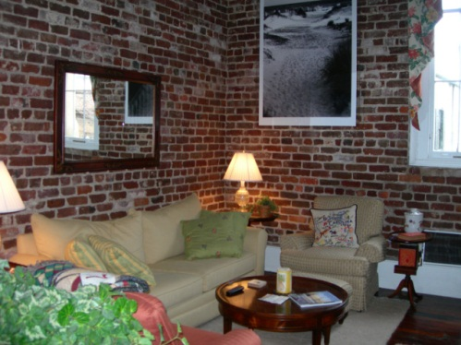
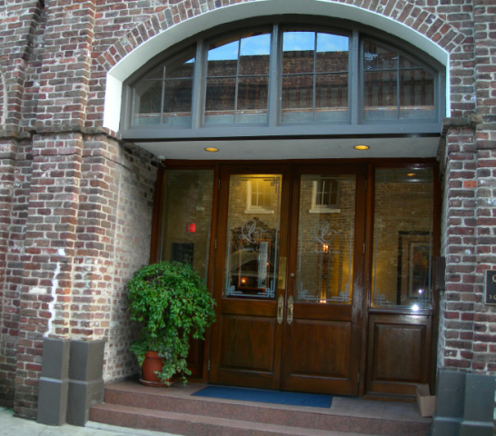
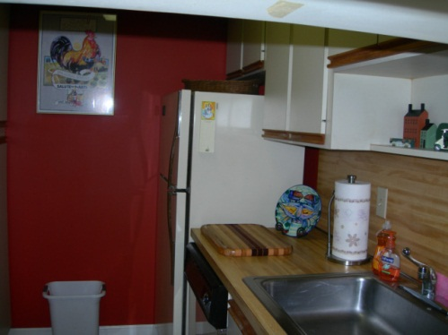
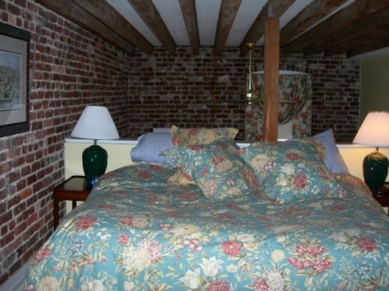
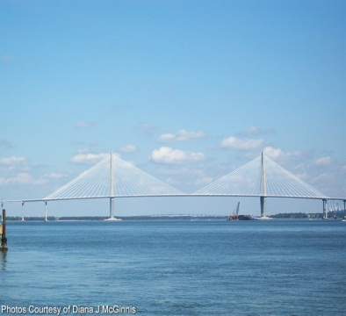
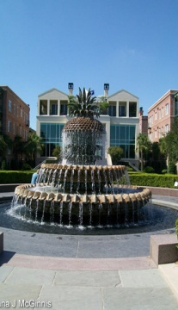
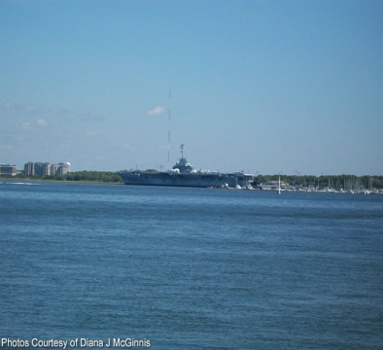


3 Queen St #203 ~ MLS# 2900607
$399,000
Fabulous location in French Quarter. Loft condo with soaring ceilings and a large window overlooking Queen Street. Beautiful exposed brick on 2 walls and old heart of pine floors. Live-in manager. Large gym exclusively available for owners. Office area for residents with office equipment available when needed. Trash chute on each hall. Laundry room on 2nd floor. Parking space under building and extensive security cameras. The perfect pied-a-terre close to everything--fine dining, waterfront park, shopping. Building is in wonderful shape and is taken care of by the building manager. Furniture and Art work is negotiable--just bring your toothbrush. A bike also conveys. Upstairs shower installed 2006, Blinds on large window for complete privacy conveys. New heat pump April 2005. New garbage disposal 2004. Sensor on water heater installed 2008. There isn't a better spot downtown. Board is investigating a roof-top patio for the perfect place to have that morning coffee overlooking Charleston.
Peggy Reese
E-PRO, GRI
phreese@bellsouth.net Mobile (843) 693-2050
Real Estate ● Mortgage ● Insurance ● Business Brokerage

