Slide 1
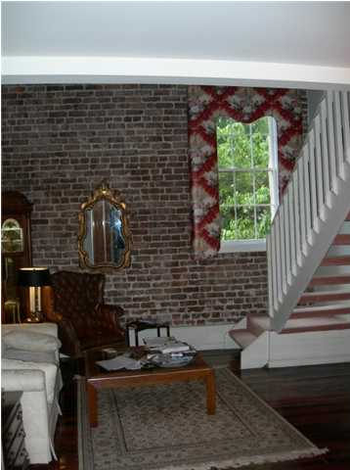
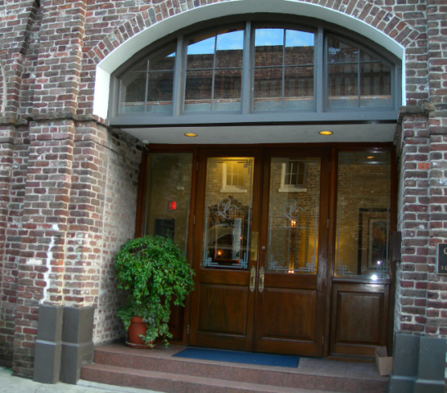
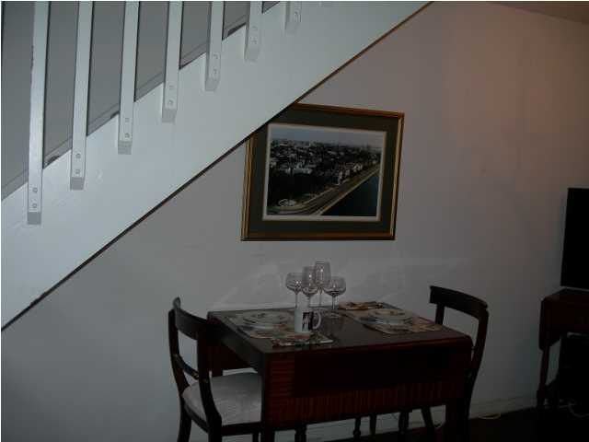
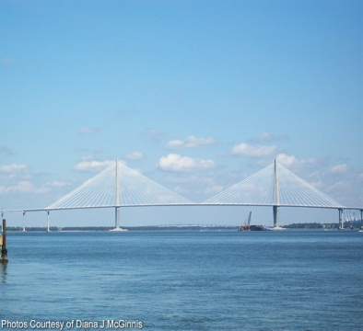
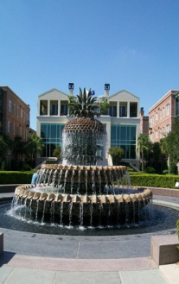
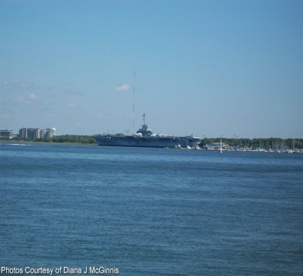


3 Queen St #206 ~ South of Broad ~ MLS# 1417014
$395,000
This condo is located in the French Quarter of Historic Charleston. It is the perfect location to enjoy all that Charleston has to offer and is carefree living. The first level is parking with an entrance from State Street-safe and protected. This loft condo is on the second floor and offers a unique place to call home or use as a second home. There is a residential manager to care for your home while you are gone making it a place just to visit and feel safe leaving. There is an exercise room, sauna, laundry facility and the building is WiFi. New carpeting will be installed through-out the common areas and walls and trim will be painted. There will be a special assessment to cover this. This is a unique building in one of the best locations in Charleston. Step out the door to wonderful dining, shops and walking throughout this area. Lender paid closings costs of 0.50% of the loan amount, redeemable only at the time of closing when financing is completed by the seller's preferred lender. Closing costs credit must be mentioned at application and may only be applied to offset actual costs. *for a Jumbo loan amount (over $417,000) the credit is 0.375%
Peggy Reese
E-PRO, GRI
phreese@bellsouth.net Mobile (843) 693-2050
Real Estate ● Mortgage ● Insurance ● Business Brokerage

