Slide 1
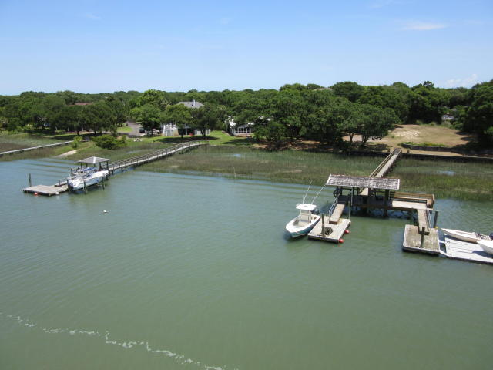
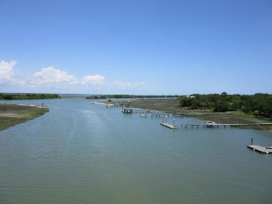
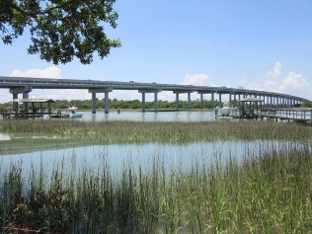
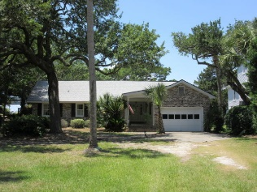
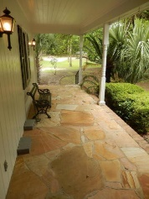
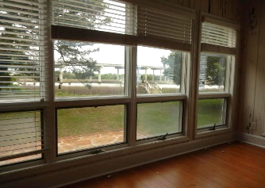
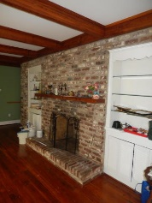
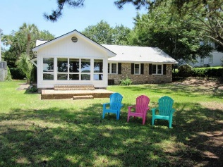


3 17th Ave
Isle of Palms, SC 29451 | MLS# 15010229 | $1,000,000
Move Right In or Build Your Dream Home
New offering price is $1,000,000. This rare opportunity where island lifestyle meets boater's delight does not come around very often! Build your dream home with dock on Hamlin Creek. Dock permit approved!! No question the real value is in the land. This is a one of a kind 1/2 acre dockable deep water homesite on Hamlin Creek. The charming 3br, 2ba brick ranch is adorable and functional, but property may be better suited for new construction. Property has mature trees and amazing views of pristine marshes, tidal creeks, intracoastal waterway and sunsets. Home is vacant and on lockbox. Easy to show.
Tommy & Lynne Lovett
Tommy - (843) 442-1276
Lynne - (843) 697-0491
tlovett@carolinaone.com
lynne.lovett@carolinaone.com
www.tommylovettrealestate.com
Carolina One Real Estate
628 Long Point Rd.
Mt Pleasant, SC 29464-3032

