Slide 1
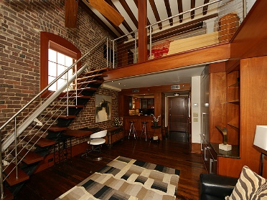
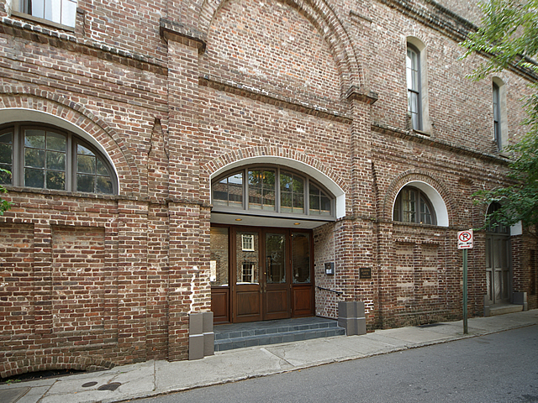
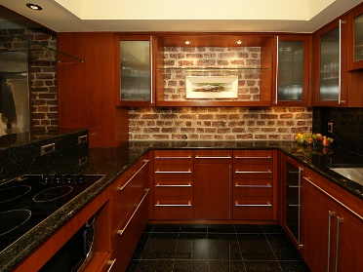
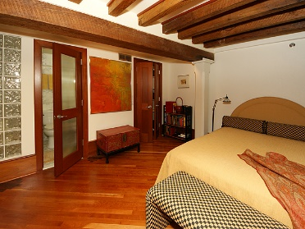
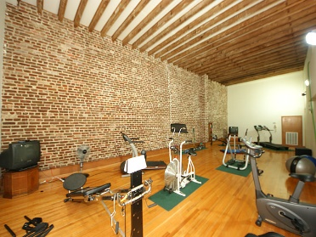
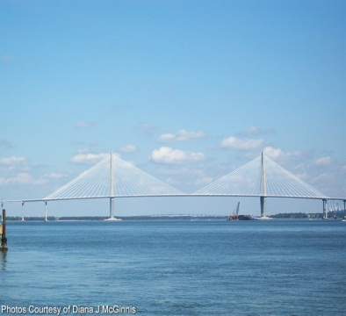
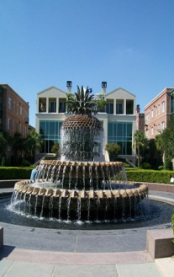
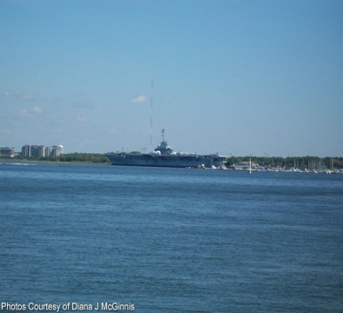


~ Historic Downtown Charleston Condo ~
3 Queen St #204
MLS# 16023888 ~ $460,000
$450,000
Beautiful totally renovated condo in the heart of historic Charleston. End unit with 2 original brick wall and amazing views out of the second window. This is the perfect home or second home as it has excellent security and is easy to lock and go. The first level is the parking garage with one space per unit. There is a full time residential manager who handles all needs of the building and owners. There is an exercise room and a laundry facility. This was a former warehouse that was built in the 1800's so has all the charm of Charleston. The regime covers water, master insurance policy with flood insurance, and maintenance. The only utilities needed are electricity and cable. Just park the car and walk to all the wonderful places to see in Charleston. A must see.
Peggy Reese
E-PRO, GRI
phreese@bellsouth.net Mobile (843) 693-2050
Real Estate ● Mortgage ● Insurance ● Business Brokerage

