Slide 1
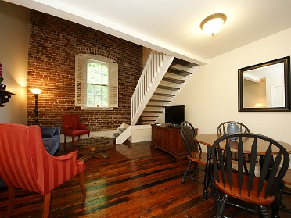
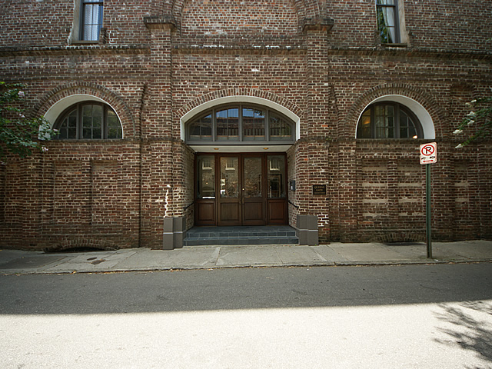
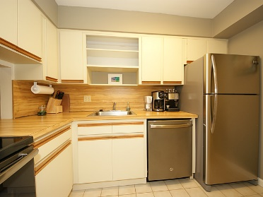
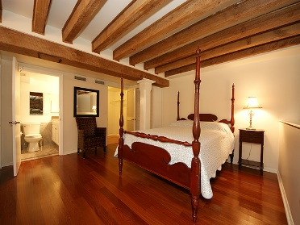
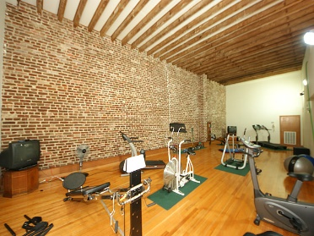
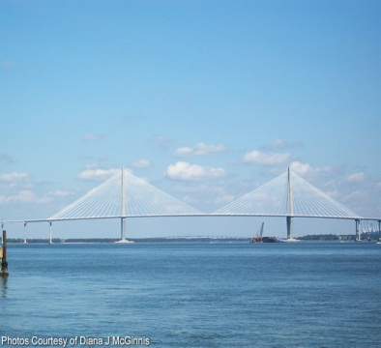
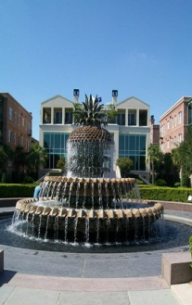
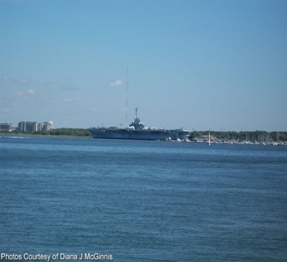


~ French Quarter Luxury Rental ~
3 Queen St #205
MLS# 16018926 ~ $2,800/Mo
$450,000
Furnished luxury condo for rent in the heart of Charleston's French Quarter! Just footsteps away from Charleston's best restaurants, art galleries, theaters, waterfront park, battery, and more! This charming loft boasts new stainless appliances, a newly remodeled master bathroom, beautiful hardwood floors, exposed brick walls and plenty of closet space. Parking space is in covered garage also included with rental, along with cable, wireless internet, and all utilities. Building has an exercise room and laundry and is WiFi ready. Do not miss the opportunity to live in this exquisite, centrally located, luxury condo! View the virtual tour for details.
Peggy Reese
E-PRO, GRI
phreese@bellsouth.net
Mobile (843) 693-2050
Real Estate ● Mortgage ● Insurance ● Business Brokerage

