Slide 1
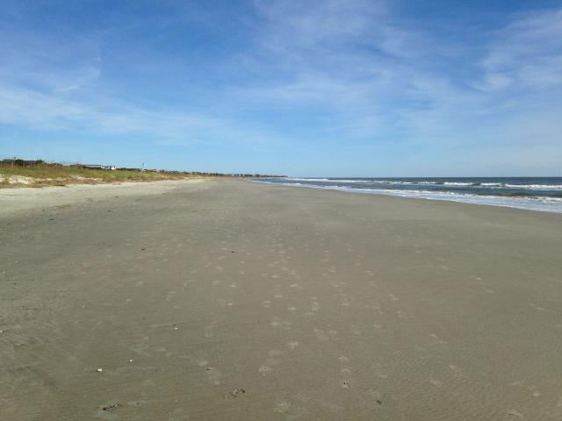
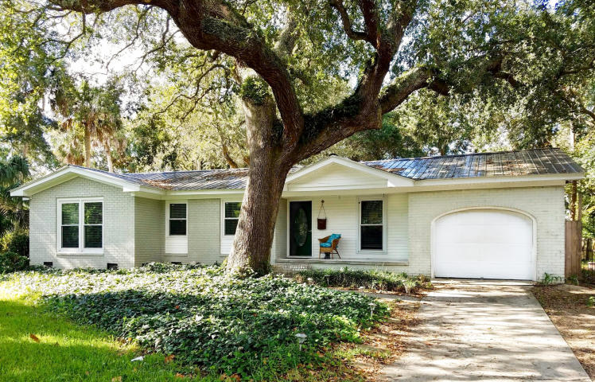
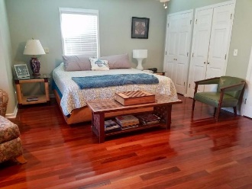
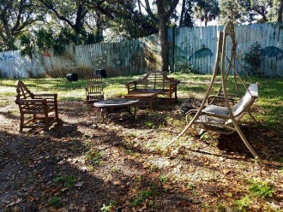
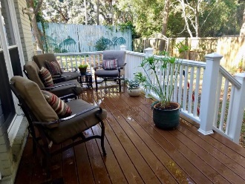
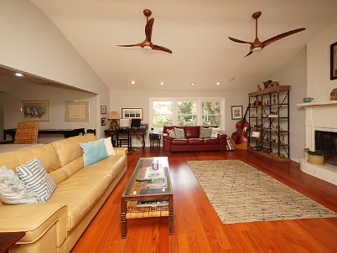
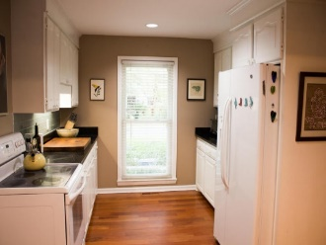
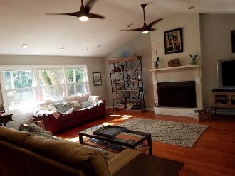
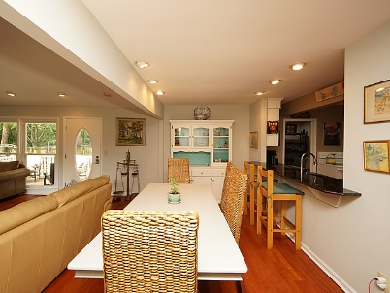
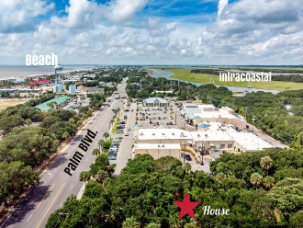

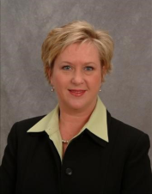

3 20th Avenue
Isle of Palms
MLS# 18025100
$849,000
2,187 Sq. Ft.
3 Bed | 2 Bath
New Listing
Open House, Sat. 11-2
Steps to the Beach!
Fully renovated
Open, light-filled floorplan
Hardwood flooring
2 Newly remodeled baths
Large family/dining room w/ cathedral ceiling
Kitchen w/granite & tiled backsplash
Spacious master suite
Deck
Large fenced backyard
Storage building
Jennifer Nipper, Realtor®
(843) 478-1800 | jen@AgentOwned.com
www.AgentOwned.com
The AgentOwned Realty Co | 824 Johnnie Dodds Blvd | Mt. Pleasant, SC 29464
Real Estate • Mortgage • Insurance

