Slide 1
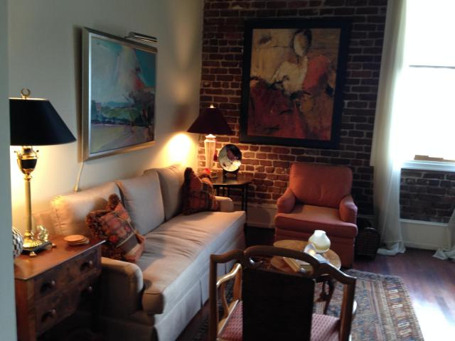
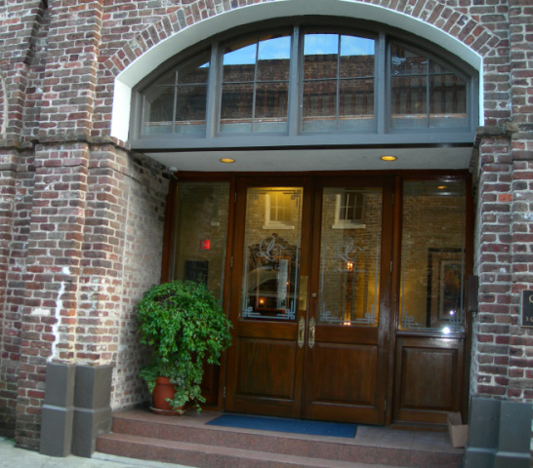
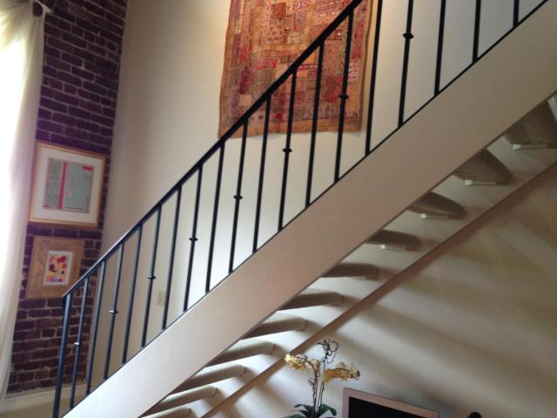
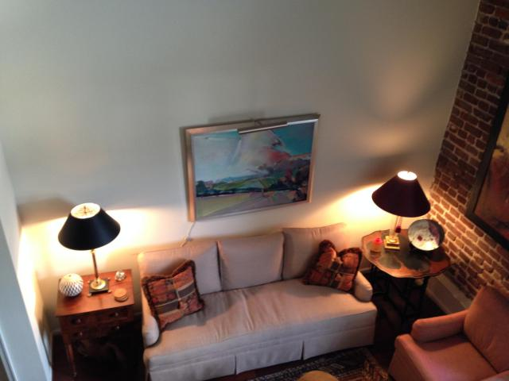
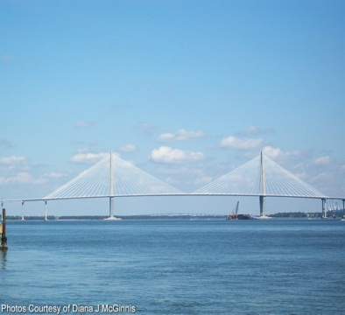
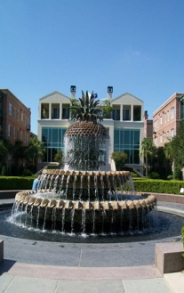
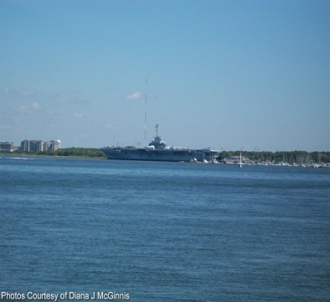


3 Queen St #302 ~ French Quarter ~ MLS# 15009450
$450,000
$450,000
Completed renovated loft condo in one of the best locations in the historic Charleston district. First level is parking with one space per unit. The condo was completely renovated and was a second home. There is a residential manager and excellent security in the building. There is an exercise room and Sauna and laundry facility. The building is WIFI and the regime covers common maintenance, water, master insurance policies. The unit has beautiful hardwood floors, the original brick on one wall. It is the perfect place to park the car and enjoy all the wonderful areas of Charleston. It is a perfect place for a second home or city living. An elegant place to call home.
Peggy Reese
E-PRO, GRI
phreese@bellsouth.net
Mobile (843) 693-2050
Real Estate ● Mortgage ● Insurance ● Business Brokerage

