Slide 1
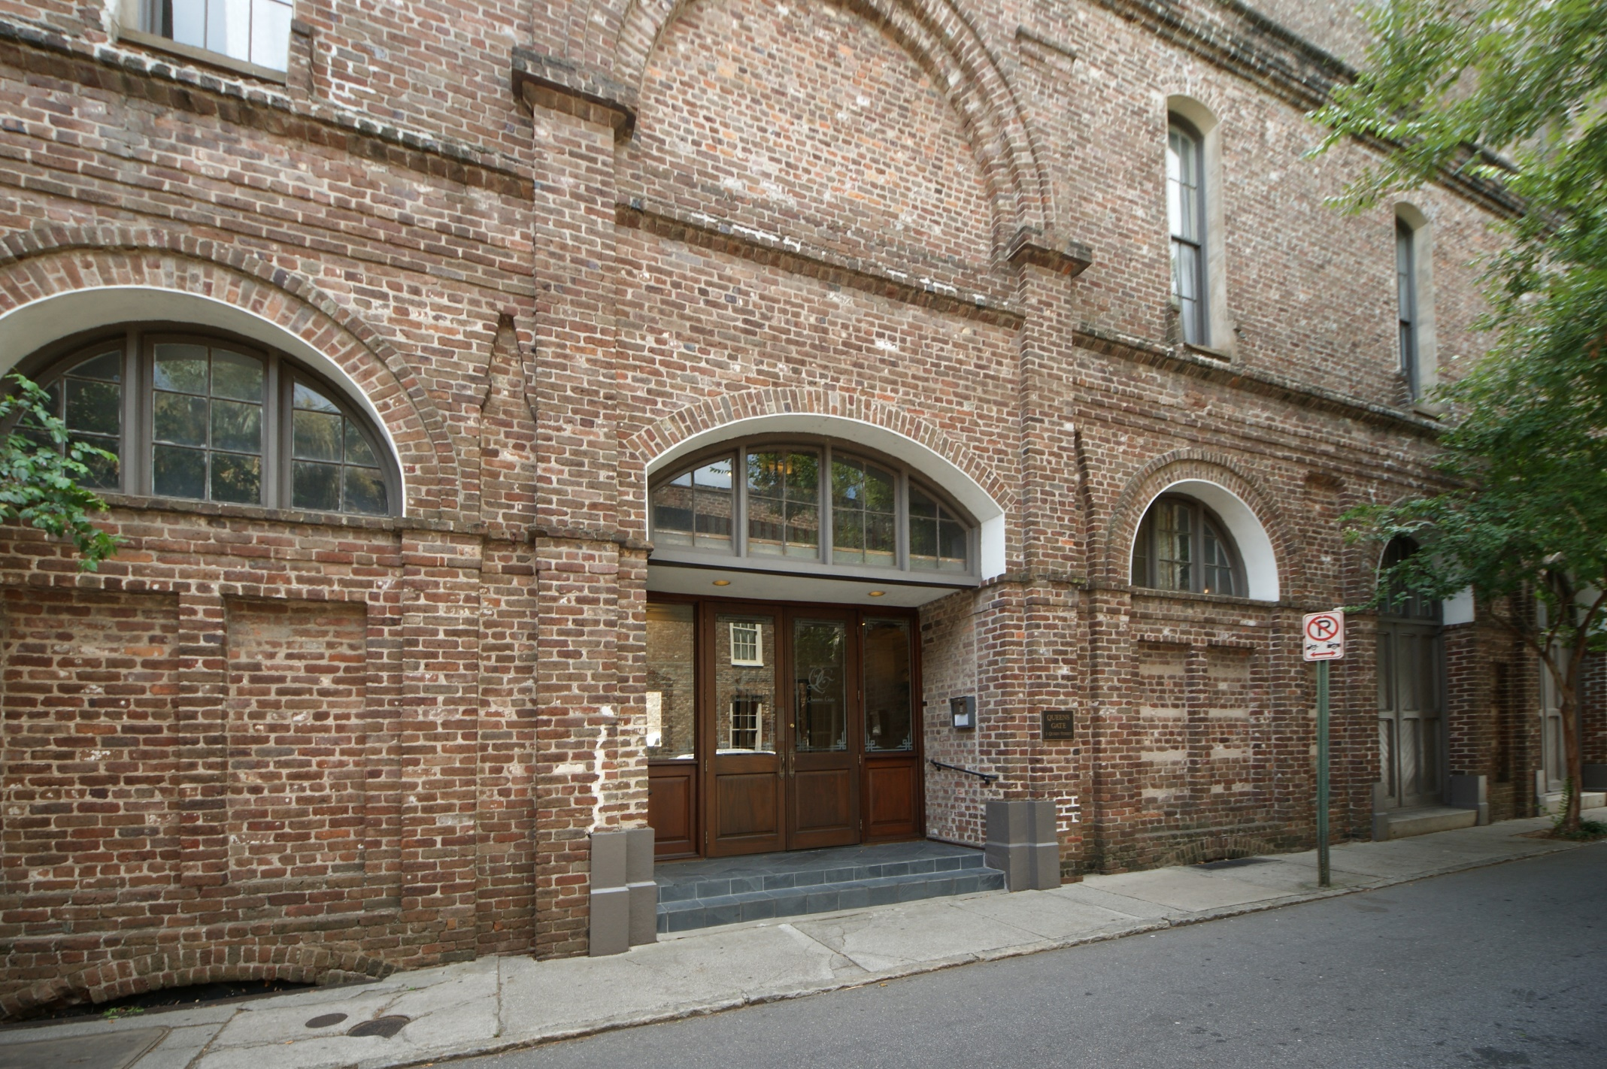
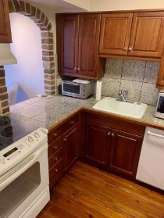
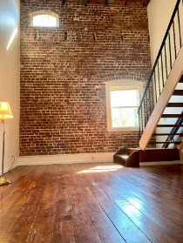
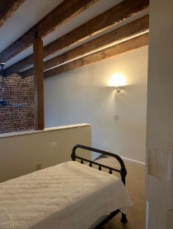
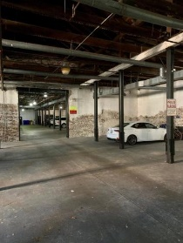
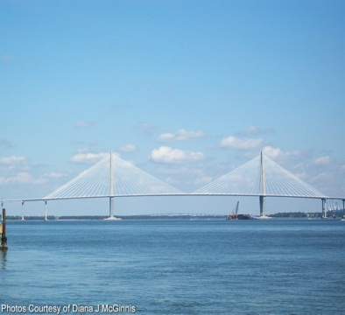
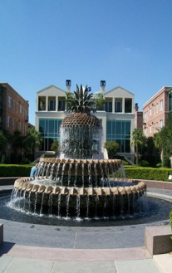
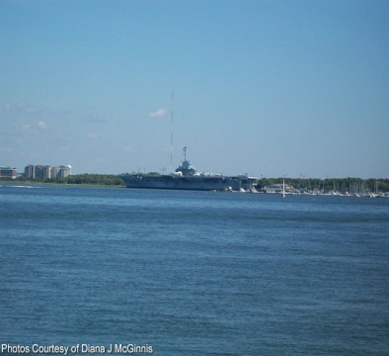


Beautiful Condo In The Perfect Location
3 Queen St #306
MLS# 19028905 ~ $450,000
$450,000
This original warehouse is home to 22 condos. The exposed brick and flooring give the perfect feeling of Charleston. The first floor is a parking garage, so this is the perfect second home to visit and lockup when leaving. There is a residential manager who lives in the building and takes care of the property. Workout room is down the hall and a laundry facility. There is a chair ramp that can be removed and floors repaired if desired. A very unique and special place to call home. Enjoy all Charleston has to offer in this perfect location. Regime covers water, flood insurance, earthquake insur., manager.
Peggy Reese
E-PRO, GRI
phreese@bellsouth.net Mobile (843) 693-2050
Real Estate ● Mortgage ● Insurance ● Business Brokerage

