Slide 1
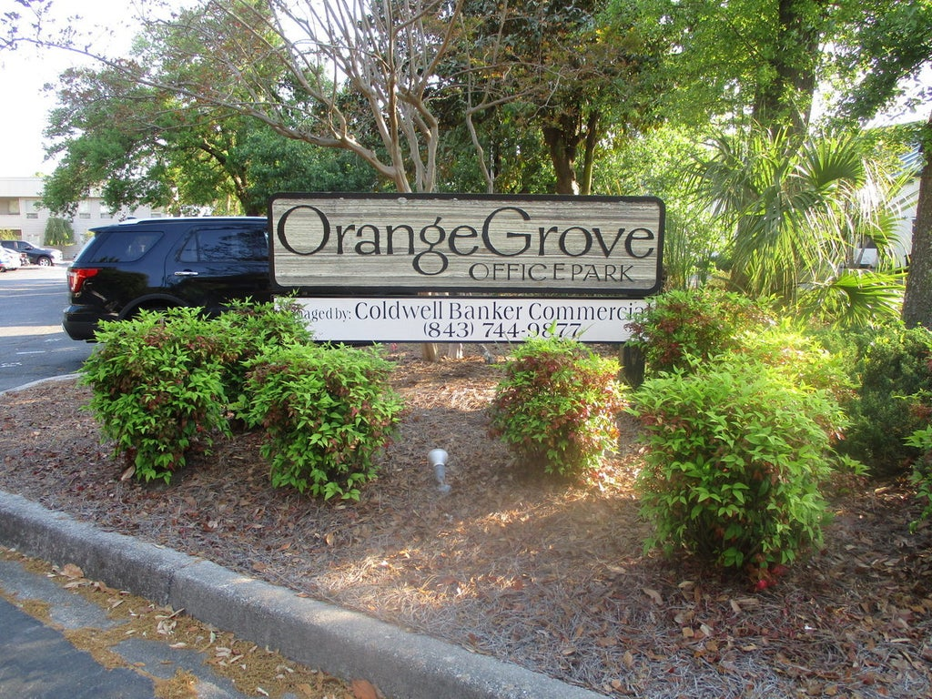
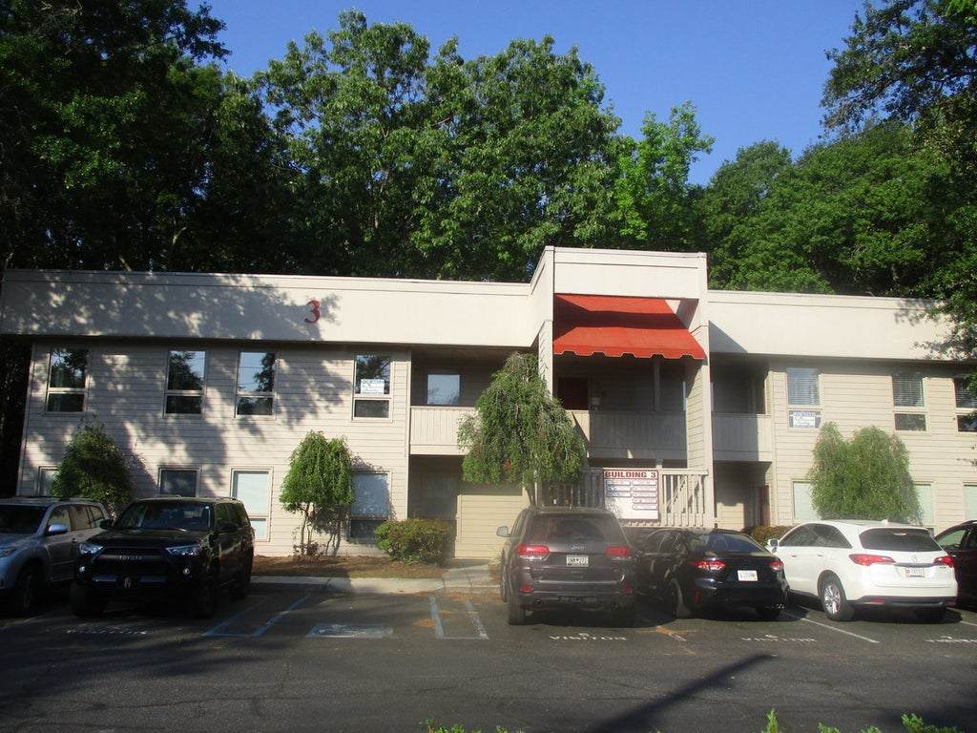
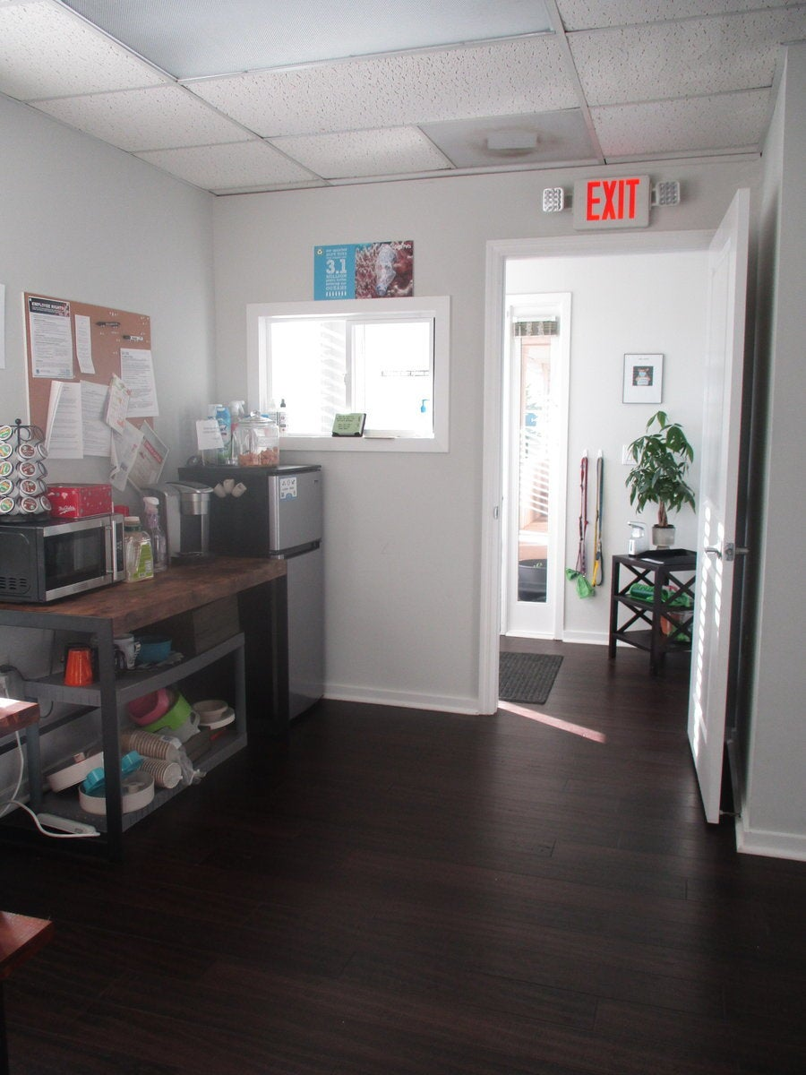
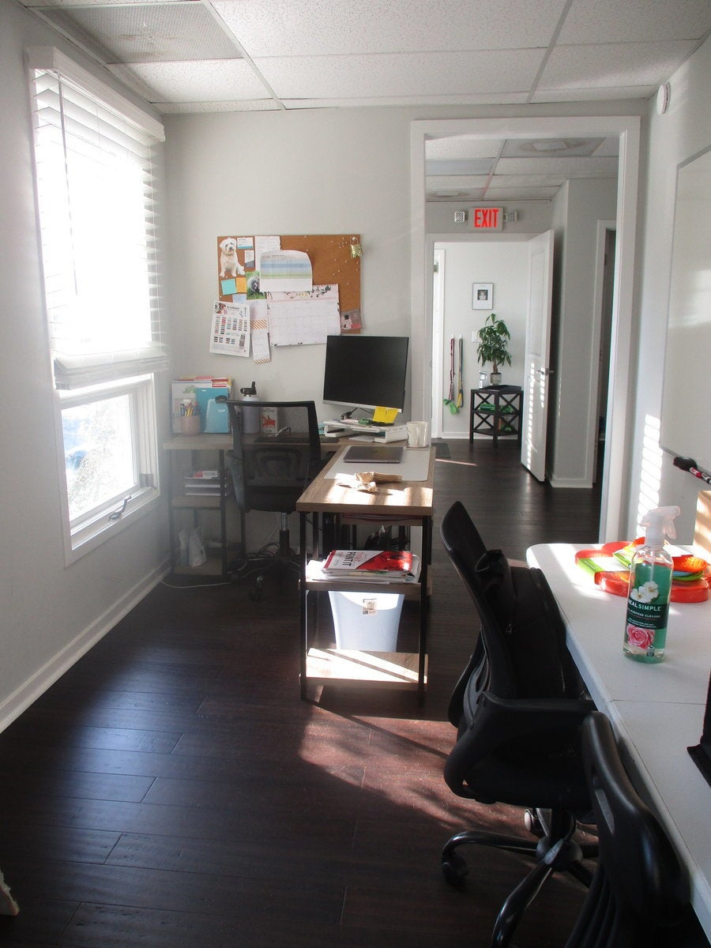
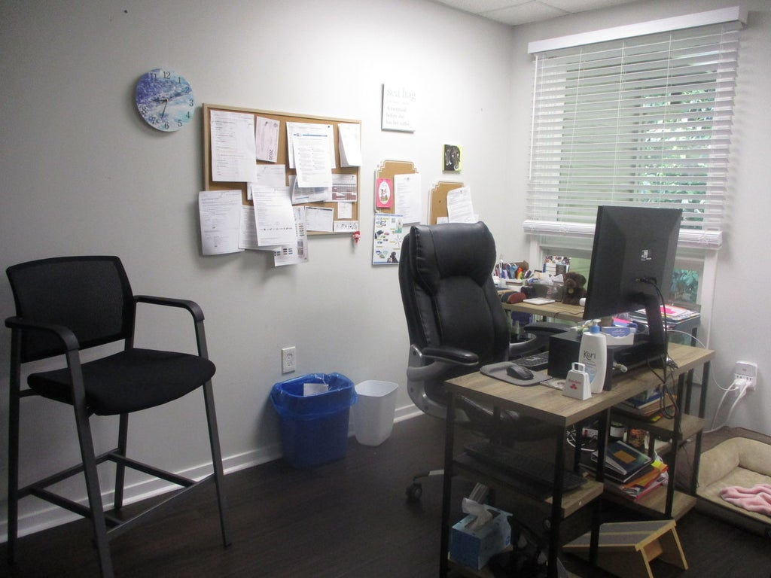
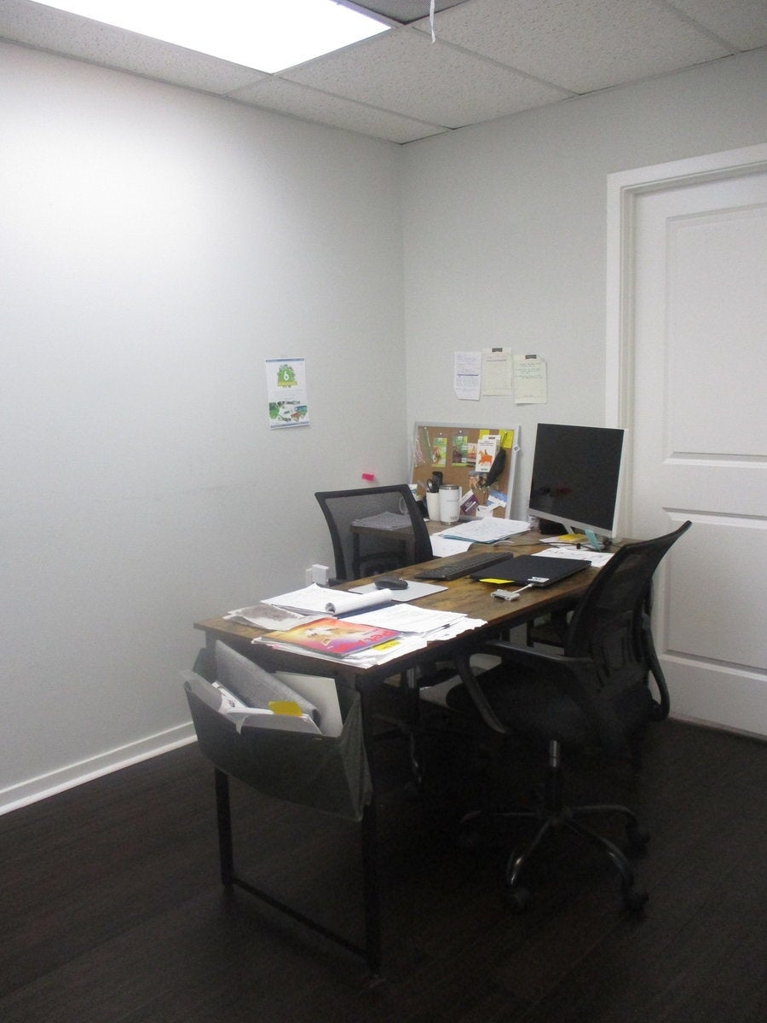
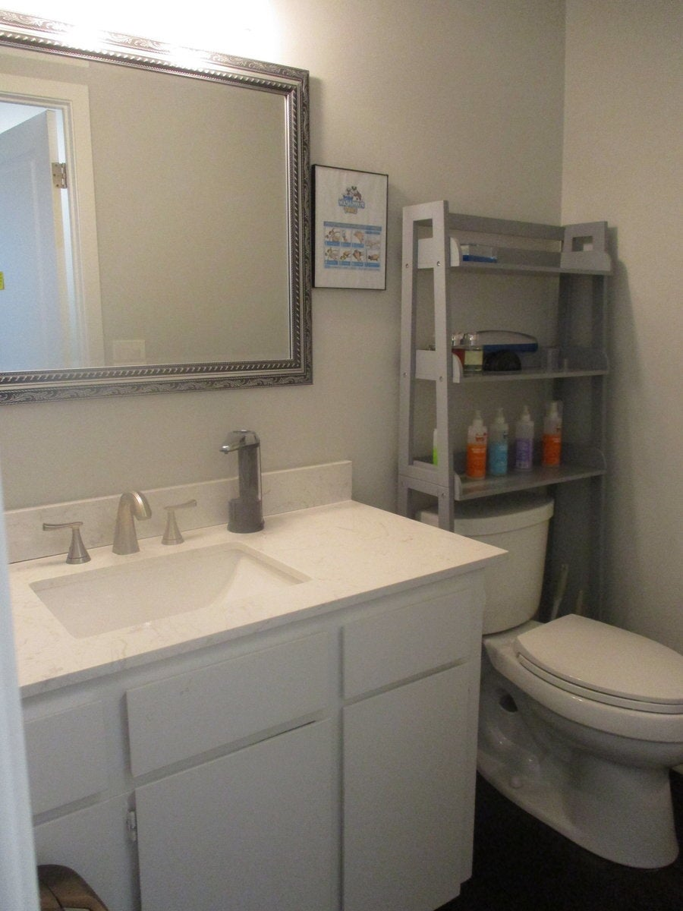
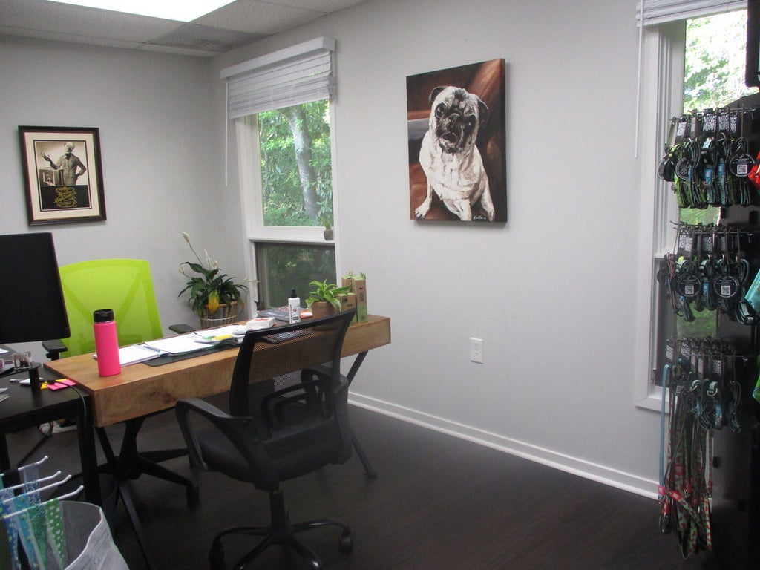
Back on the Market
3 Gamecock Ave #308
Charleston, SC, 29407
MLS# 30724581 | $169,900
Great opportunity to own a commercial condo unit in Orange Grove Office Park. This upstairs unit has 3 offices, 2 access/exit doors, foyer, reception area, bathroom, & plenty of parking. The Owner has renovated this unit approximately 3 years ago with high end bamboo flooring, crown moulding, new doors, new blinds, all new electrical outlets, updated bathroom with granite countertop, new bathroom sink, & a top of the line AC unit was installed 5 years ago. Great location near shopping, restaurants, local businesses, & I-26.
Charles Salmonsen
M (843) 224-0300 | O (843) 388-6613 | charles@salmonsen.com
Salmonsen Realty | 864 Lowcountry Blvd Ste B | Mt Pleasant, SC 29464

